Slide 1

MARINE CARGO SURVEYORS TRAINING
Notes:
Damos Inicio al curso de “Induccion al Inspector

Slide 2


DAY
ONE
¡¡BIENVENIDOS !!
Notes:
Se da la bienvenida al Curso a los asistentes se Presenta el capacitador (Nombre y Lugar ) Se presentan los asistentes. (Nombre y Lugar)

Slide 3

DAY
ONE
I N D E X
OVER AND MATERIAL REFERENCES
WELCOME
WHO WE ARE?
ABOUT TRANSGLOBAL SOS
MISSION
VISION
OBJECTIVES
OUR GLOBAL SERVICES
WHAT WE EXPECT FROM YOU?
PROYECTED GROWING
I INTRODUCTION
INTRODUCTION
DEFINITIONS OF INSPECTIONS AND SURVEYS
DIFERENCE BETWEEN INSPECTORS AND SURVEYORS
WHATS IS A MARINE CARGO SURVEYOR?

Slide 4
DAY
ONE
I N D E X
MAIN FUNCTIONS OF AN MARINE CARGO SURVEYOR.
TERMS AND WIDE ROLE.
REGULAR AND OCASIONAL SURVEYORS.
PERSONAL PROTECTIVE EQUIPMENT.
EXAMPLE OF REQUISITES OF SECURITY MEASSURESON ABOARD.
II INTRODUCTION TO MARINE CARGO SURVEYING.
INTRODUCTION TO MARINE CARGO SURVEYING.
TYPES OF SURVEYS.
PREVENTION AND CERTIFICATION SURVEYS.
INVESTIGATION SURVEYS.
TYPES OF SURVEY EXAMPLES.
SURVEY EXAMPLES.
UPSTREAM / DOWNSTREAM.
TYPES OF SURVEYS.
EVALUATION

Slide 5
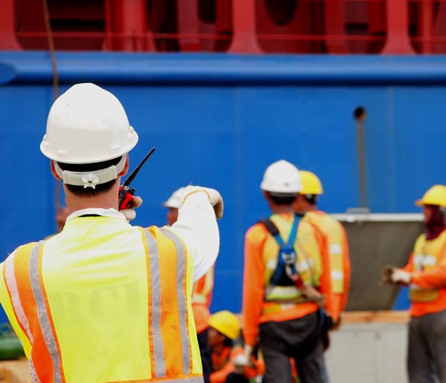
A.
WELCOME
In this section, we explain the mission and goals that every one of us have to achieve for our own committed to our clients.

Slide 6

WHO WE ARE?
We are a company that offer logistic services, surveys and operation support to vessels in all of the Mexican Territory, with headquarters in Tampa, Fl. USA.
Our founders and management team have more than 100 years of combined experiences in the Maritime Industry; we effectively direct key business functions through the use of strong leadership, superior level of quality, customer satisfaction, solving problems and making sound decisions, good business planning and excellent organizational skills.

Slide 7
ABOUT TRANSGLOBAL SOS
WE are a group of sea professionals trained in different Sailing Schools’ of Mexico and professional staff from a wide array of engineering disciplines and careers.
OUR customers are shippers, consignees, shipping companies, shipping agencies, port terminals and the shipping industry in general.
WHAT we offer to our customers is the technical and professional capacity of years of experience of those involved in the company's.

Slide 8

MISSION
TransGlobal SOS is to provide world class services, through the commitment and collaboration of our staff and shareholders, satisfying our customers requirements by offering a service that will ensure effectiveness in all processes creating added value.

Slide 9

VISION
Integrity:
Honesty, transparency, and ethical behavior
Respect:
Respectful, courteous, and considerate of others
Help Each Other Succeed:
Collaborate, support, and inspire accomplishment
Dedication to Excellence:
High standards, high expectations, and great results
Efficiency:
Minimize waste of time, effort and resources

Slide 10
VISION
Continuous Improvement:
Always learn, always innovate, and always improve
Member Focused:
Understanding needs, deliver quality service, and exceed expectations
Effective Communication:
Share information, active listening, and ensure understanding
Commitment:
Dedication, responsibility, obligation, devotion, allegiance, and loyalty

Slide 11

OBJECTIVES
Be an attractive business partner who can be trusted and relied upon
Ensure highly competent staff focused on results
Training and Development of staff
Quality and Continue Improvement
Professionalism, Commitment, Dependability and Customer Oriented
Safety and Security

Slide 12

OUR GLOBAL SERVICES
Los servicios a ofrecer son variados y destinados a áreas claves que inciden en resultados óptimos tanto operativos como de costos, resultado de un equipo con gran experiencia en el medio marítimo a nivel internacional.
A continuación enumeramos un desglose de nuestros servicios:

Slide 13
OUR GLOBAL SERVICES
Sistemas de comunicación abordó de los buques en puerto ( servicio de Internet).
Alquiler de equipo profesional que ayuden al fácil acceso a los sistemas públicos de comunicación, precios accesibles y con apoyo profesional, retroalimentación sobre el servicio y/o corrección de problemas de darse estos, mejora continua para asegurar la óptima calidad en el servicio.

Slide 14
OUR GLOBAL SERVICES
Inspecciones de todo tipo a las cargas:
Inspección de cargas (calados), On- Hire, off-Hire, inspecciones de consolidaciones y desconsolidaciones, inspecciones de trincado en contenedores normales y especializados, cargas de proyecto, cargas sobredimensionadas y especiales, lo anterior tanto abordó como en tierra, inspecciones de cargas en contenedores, inspecciones de averías, inspecciones generales de cargas en patios internos y externos, inspecciones de casco y maquinaria, inspectores certificados y de formación Marítima en escuelas Náuticas, calidad en todos los procesos y atención y seguimientos con valores agregados de calidad y servicio.

Slide 15
OUR GLOBAL SERVICES
Seguimiento logístico de cargas desde plantas o lugares de origen a destinos finales,
Situación de posición de las cargas en todo el trayecto en tiempos reales, análisis de áreas de oportunidad, corrección, aplicación de métodos permanentes de control y control de costos.

Slide 16
OUR GLOBAL SERVICES
Planeación y coordinación en todos los sectores relacionados con cargas de proyecto, sobredimensionadas y cargas especiales,
Seguimiento y aplicación logística en todos los procesos, análisis de cada operación, detección y corrección de áreas de oportunidad en los casos ajenos al control de la logística de TG, análisis de costos y medidas enfocadas a este tipo de ahorros.

Slide 17
OUR GLOBAL SERVICES
Seguimiento eficiente de reportes y estadísticas,
Enfocados en forma particular a cada cliente en base a sus necesidades actuales y establecimientos de nuevos sistemas en base a estudios personalizados sobre las necesidades reales de cada empresa, acceso directo a la obtención de los diferentes formatos requeridos y seguimientos en tiempo real de cada etapa de los procesos involucrados, establecimiento de estadísticas generales, análisis de resultados, diagnóstico, toma de medidas de corrección, establecimiento de medidas permaneces para control de áreas de oportunidad, enfoque en el análisis de control de costos.

Slide 18
OUR GLOBAL SERVICES
Manejo y administración de personal, tanto abordó como en tierra,
personal adecuadamente entrenados y con alto nivel profesional y atención de calidad a nuestros clientes.
Búsqueda y administración de bodegas y almacenes tanto en patios dentro de los recintos portuarios como externos,
consolidación y desconsolidaciones, transporte terrestre, logística de seguimiento y control estricto de costos.

Slide 19
OUR GLOBAL SERVICES
Servicios de Fumigaciones:
En este rublo se ofrecen los servicios de fumigación abordó de los buques, fumigación de contenedores, fumigación de almacenes internos y externos de los límites de puerto, prestación servicios de fumigaciones a clientes diversos de las industrias locales y anexos, atención personalizada y asesoramiento de un ingeniero Químico especializado en esta área, comprobación de resultados y seguimiento en los casos de industrias establecida en área.

Slide 20
OUR GLOBAL SERVICES
Tenemos atención en todos los puertos Mexicanos y posibilidad de atención inmediata en puertos de Centro y Sudamérica, personal base con formación en Escuelas Marítimas.

Slide 21

WHAT WE EXPECT FROM YOU
It’s no exaggeration to say that TGSOS integrity, reputation and brand are in your hands.
Our global focus and our strategy of profitable growth require a common system of values and principles that should provide guidance on conduct to all employees.
As an innovative company in our field, we recognize the ongoing globalization of business as a chance and a challenge. With motivated employees as the basis of our success, we can seize the chance and accept the challenge. Our services are the product of successful international cooperation by many people.

Slide 22
WHAT WE EXPECT FROM YOU
You must be ethical and lawful in all of your business dealings, whether you are selling, buying or representing TGSOS in any other capacity.
In all areas of business activities TGSOS is subject to laws, regulations, and comparable rules. This applies both to national and international regulations, as well as local and regional ones. It is a matter of course for us that we respect and comply with applicable laws and regulations of each legal environment, in which we operate.

Slide 23
WHAT WE EXPECT FROM YOU
Your communications and dealings with Business Partners, suppliers, competitors, clients or others can directly impact TGSOS reputation and our compliance with applicable laws.
In deciding among competing suppliers, we weigh the facts impartially to determine the best supplier. You should do so whether you are in a procurement job or any other part of the business and regardless of whether it is a large or small purchase.
You must not exert or attempt to exert influence to obtain special treatment for a particular supplier. Even appearing to do so can undermine the integrity of our established procedures.

Slide 24
WHAT WE EXPECT FROM YOU
In a spirit of teamwork and collaboration, great value is placed on the accuracy and completeness of the compiled and/or documented information. Knowledge of all business affairs obtained during business acti­vities should be treated with the utmost discretion, regardless of whether they concern TGSOS or third parties.
Utmost accuracy is required for both the handling and storing of such information.
All employees are bound to secrecy regarding all operating and business secrets both during their emplo­yment and subsequent to termination of their employment.

Slide 25
WHAT WE EXPECT FROM YOU
We provide our customers with high quality services and strive to offer the best possible performance at competitive prices in every area of operations. This includes ongoing checks of the performance portfolio and reacting in advance to new market requirements. We permanently check, evaluate and improve services, technologies and procedures to ensure quality, safety and security.

Slide 26

PROYECTED GROWING
La empresa iniciara labores en 5 etapas:
Etapa 1. Apoyo en servicios de comunicación abordo de los buques.
Etapa 2. Inspecciones Generales, asesoría en cargas peligrosas.
Etapa 3. Logística en general.
Etapa 4. Operaciones Buque – Tierra y viceversa.
Etapa 5. Planeación Estiba – Buques, control de productividades, control de itinerarios, control de combustibles, manejo de flotas, estadísticas, análisis operativos, análisis y control de área de oportunidad, etc.
Entre la etapa 4 y 5, el Proyecto es abrir un centro de operaciones en un predio localizado en la desembocadura del Rio Medio en playa norte en Veracruz, Ver.; lugar muy cercano al Nuevo puerto.
Etapa 6. Fumigaciones en general.

Slide 27
PROYECTED GROWING
Etapa 1. En proceso
Etapa 2. Por iniciar tentativamente el 1ro. de Junio de 2016 (Día de la Marina Mercante Nacional)

Slide 28
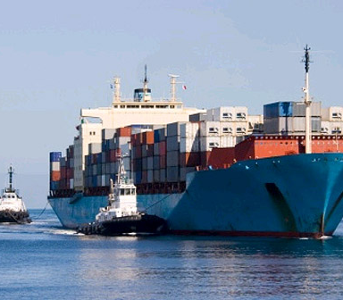
I.
INTRODUCTION
THROUGH THIS SECTION, WE EXPLAIN THE DESCRIPTION OF THE JOB THAT A MARINE CARGO SURVERYOR HAVE TO DO.

Slide 29

DEFINITIONS OF INSPECTIONS AND SURVEYS
The root word for “inspection” is “inspect” which Webster's New World Dictionary defines as :
(1) to look at carefully; examine critically, especially in order to detect flaws, errors, etc.
(2) to examine or review.
“inspection” is then defined as :
(1) critical examination
(2) official examination or review.

Slide 30
DEFINITIONS OF INSPECTIONS AND SURVEYS
The Oxford English Dictionary defines “Survey” and “Surveyor” as:
Survey. sb.
The act of viewing, examining in detail especially for some specific purpose; usually for the official inspection of the particulars of something e.g. of a ship or its stores
Survey. v.
for look carefully into or through; to view in detail; to examine,inspect, scrutinise.
Surveyor. n.
One whose business it is to inspect or examine, One who views or looks at something.

Slide 31

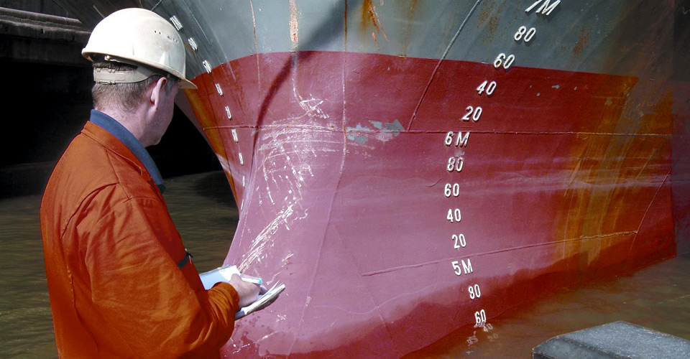
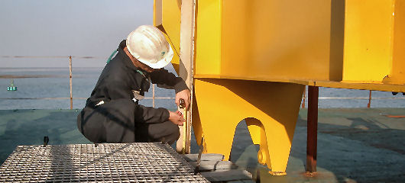
DIFERENCE BETWEEN INSPECTORS AND SURVEYORS

Slide 32
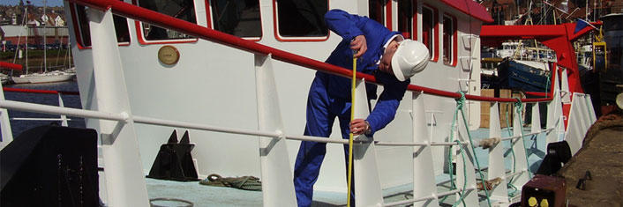
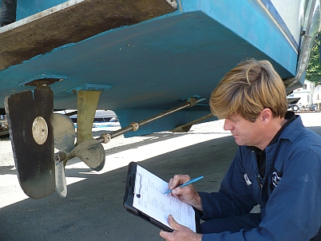
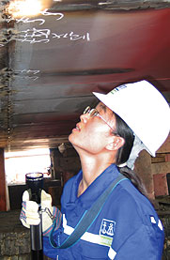
DIFERENCE BETWEEN INSPECTORS AND SURVEYORS

Slide 33
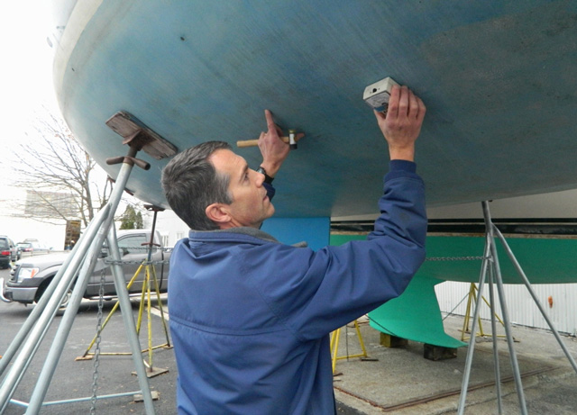
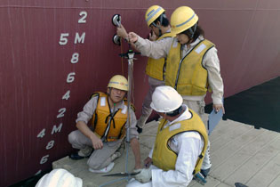
DIFERENCE BETWEEN INSPECTORS AND SURVEYORS

Slide 34
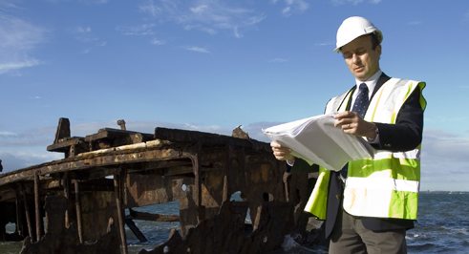
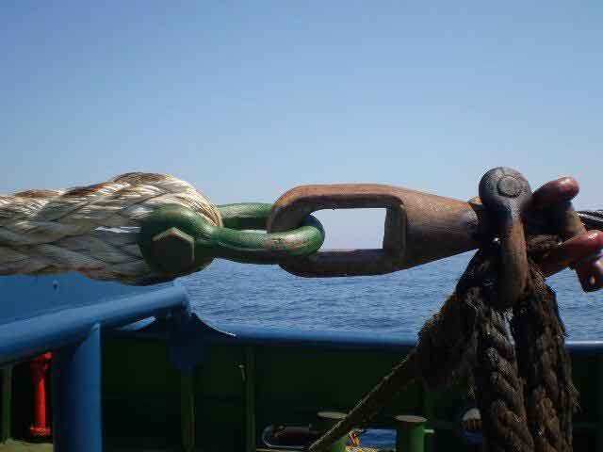
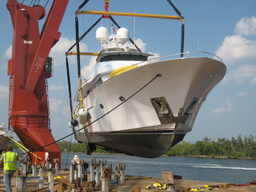
DIFERENCE BETWEEN INSPECTORS AND SURVEYORS

Slide 35
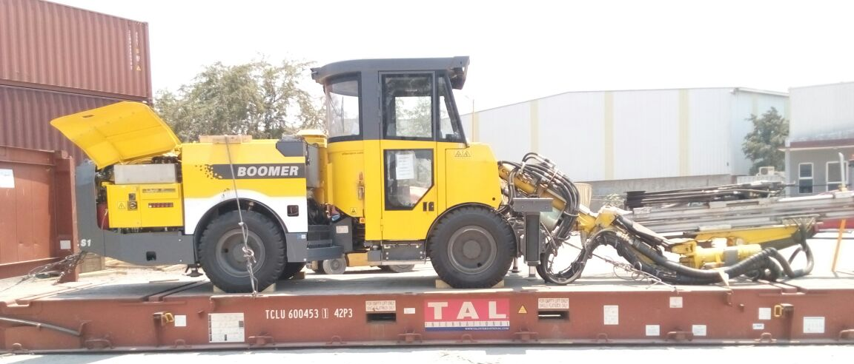
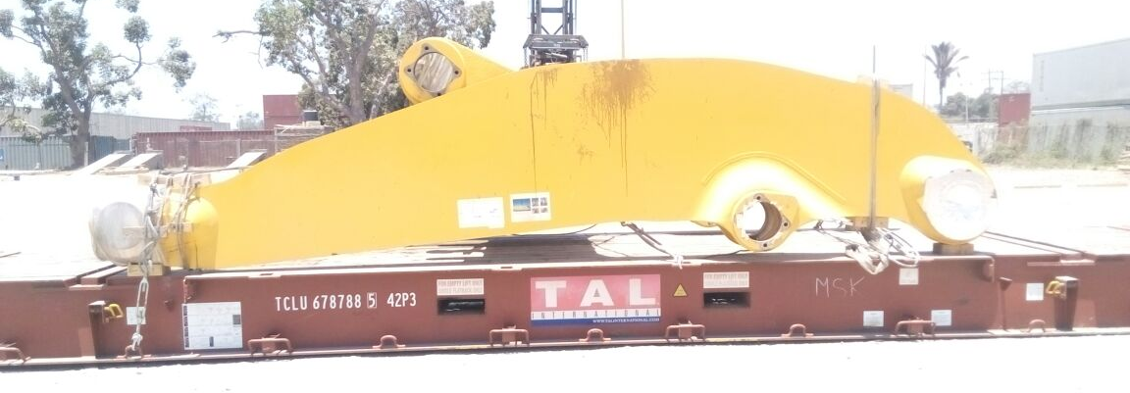
DIFERENCE BETWEEN INSPECTORS AND SURVEYORS

Slide 36
DIFERENCE BETWEEN SURVEYS AND SURVEYORS
What is a Survey?
What is a Surveyor?
Importance of both
Participants’ general questions

Slide 37
DAY
ONE
PREGUNTAS
Y COMENTARIOS
Notes:
No permitir responder a las preguntas de manera sencilla y corta. En los comentarios no permitir que se extienda mucho. Duracion Maxima 15 minutos.

Slide 38
DAY
ONE
RECESO
(10 MINUTOS)

Slide 39
WHAT IS A
MARINE
CARGO SURVEYOR?
The past definition of surveyor is fairly basic and for our consideration of the marine surveyor in this course a reasonable definition might be :
“One who applies the skills of a discipline appropriate to the subject of the survey to the observing and recording of facts to enable him, or someone else later, to draw conclusions and apply them to a situation which required the survey to be carried out”

Slide 40
WHAT IS A
MARINE
CARGO SURVEYOR?
Cargo surveyors, generally those based in the larger ports or insurance markets, are experts in their own particular field, typically commodities such as tea, coffee, cocoa or manufactured products such as steel, but in many of the smaller ports they are individuals who have built up a general knowledge of cargoes and shipping practices and have the ability to investigate and record their observations accurately.
They largely rely on their ability to judge the integrity and competence of consignees and others with whom they are dealing and they often obtain independent expert advice when required.

Slide 41
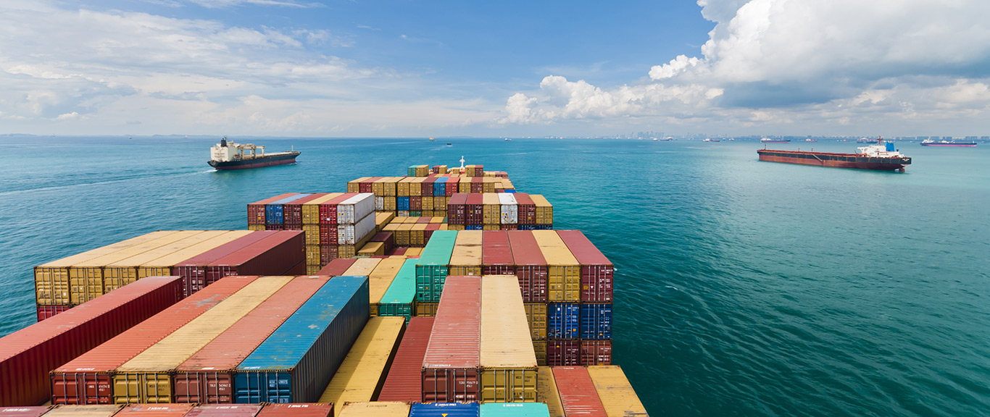
WHAT IS A
MARINE
CARGO SURVEYOR?
Marine surveyors become involved in all types of marine surveys and may have a background of several different disciplines. The principal types are:
Type of surveyor | Principal surveys carried out
Nautical | Cargo and casualty investigation, draught and ullage, navigation and safety equipment.
Engineer | Machinery and hull structure
Yacht | Pleasure craft, wood, GRP, alloy, steel and Ferro-cement.
Naval architect | Stability, structure and design.
Cargo | Containers, Goods, Stowage

Slide 42

MAIN FUNCTIONS OF AN
MARINE
CARGO SURVEYOR
Summarizing, the surveyor traditional role is to :
1. Investigate,
the nature of the claim
its extent
its probable cause
2. Advise the consignee on,
mitigation of loss
claims procedure, (cargo and pleasure craft hulls.)

Slide 43
MAIN FUNCTIONS OF AN
MARINE
CARGO SURVEYOR
3. Report as fully as necessary to enable,
The liability of the underwriter under the policy to be determined.
The liability of the carrier and third parties to be determined
The claim to be adjusted under the policy
Preventative measures to be taken for future shipments

Slide 44
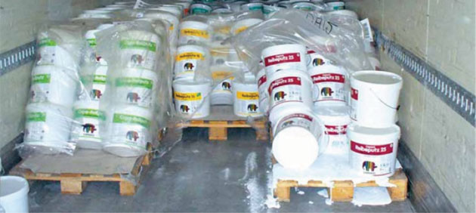
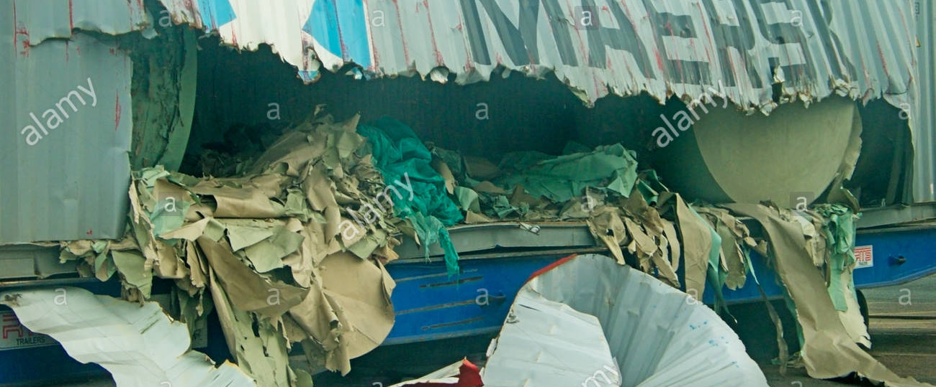
MAIN FUNCTIONS OF AN
MARINE
CARGO SURVEYOR

Slide 45
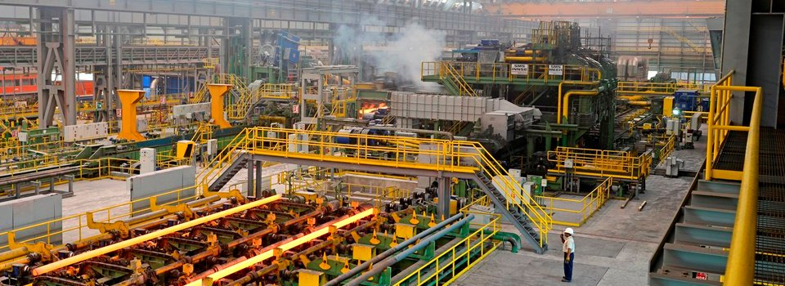
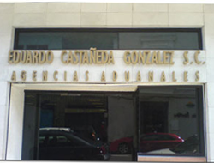
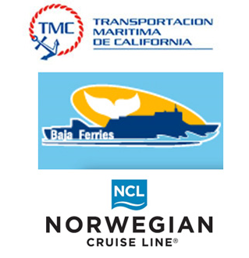
MAIN FUNCTIONS OF AN
MARINE
CARGO SURVEYOR

Slide 46
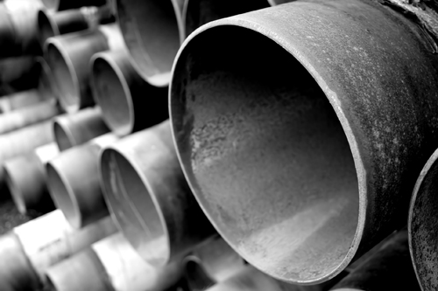
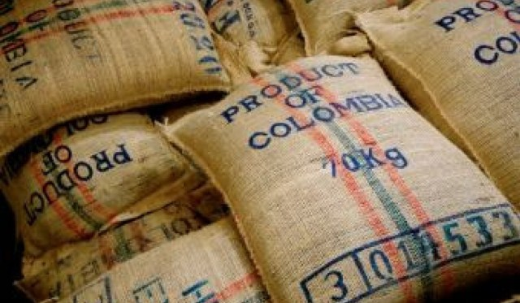
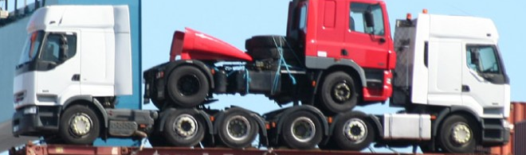

MAIN FUNCTIONS OF AN MARINE
CARGO SURVEYOR

Slide 47
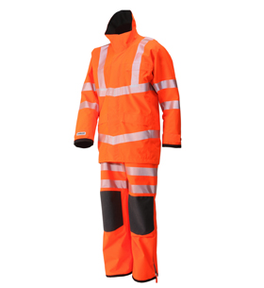
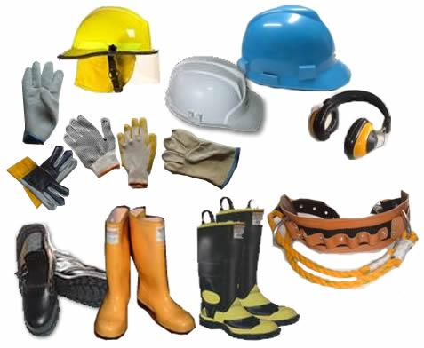
MAIN FUNCTIONS OF AN MARINE
CARGO SURVEYOR

Slide 48
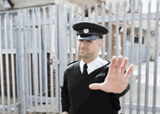


MAIN FUNCTIONS OF AN MARINE
CARGO SURVEYOR
Notes:
Mencionar el uso del Enlace para acceder a los recursos del curso.

Slide 49
TERMS AND WIDE ROLE
The surveyor's role is confined almost entirely to the consideration of the nature, extent and cause of the loss and in presenting the facts, with soundly based opinion if necessary, in a report to the party that appointed him. This report is usually prepared in such a manner that it can later be trade available to any other party with an interest in the property.
In practice however this role is often very much wider and it might well be said that, in widening it, the role is no longer simply that of a marine surveyor. Since this wider role is sometimes required by those who appoint surveyors to assist in the resolution of marine insurance claims.

Slide 50
TERMS AND WIDE ROLE
The extent to which a surveyor extends beyond his traditional role is a matter for his principal to determinate and much emphasis has been laid throughout this course upon the prime importance of careful observance of the principal's instructions. It is in fulfilment of his principal's.
instructions that the surveyors earn their fees, and whilst there must be ethical principles to which any self respecting surveyor must adhere, he must carefully consider his principal's wishes.

Slide 51
REGULAR AND OCASIONAL SURVEYORS
Those who carry out marine surveys tend to fall into two distinct categories as far as their time commitment to surveying is concerned, those who are more or less fully engaged in survey work as a full time occupation and those who, perhaps because of, their narrow specialist skills or because of a largely full time occupation in another role, or because of their remoteness in geographical regions where surveys are only infrequently required, are only occasionally called upon.

Slide 52
PERSONAL PROTECTIVE EQUIPMENT
Notes:
Mencionar el uso del Enlace para acceder a los recursos del curso.

Slide 53
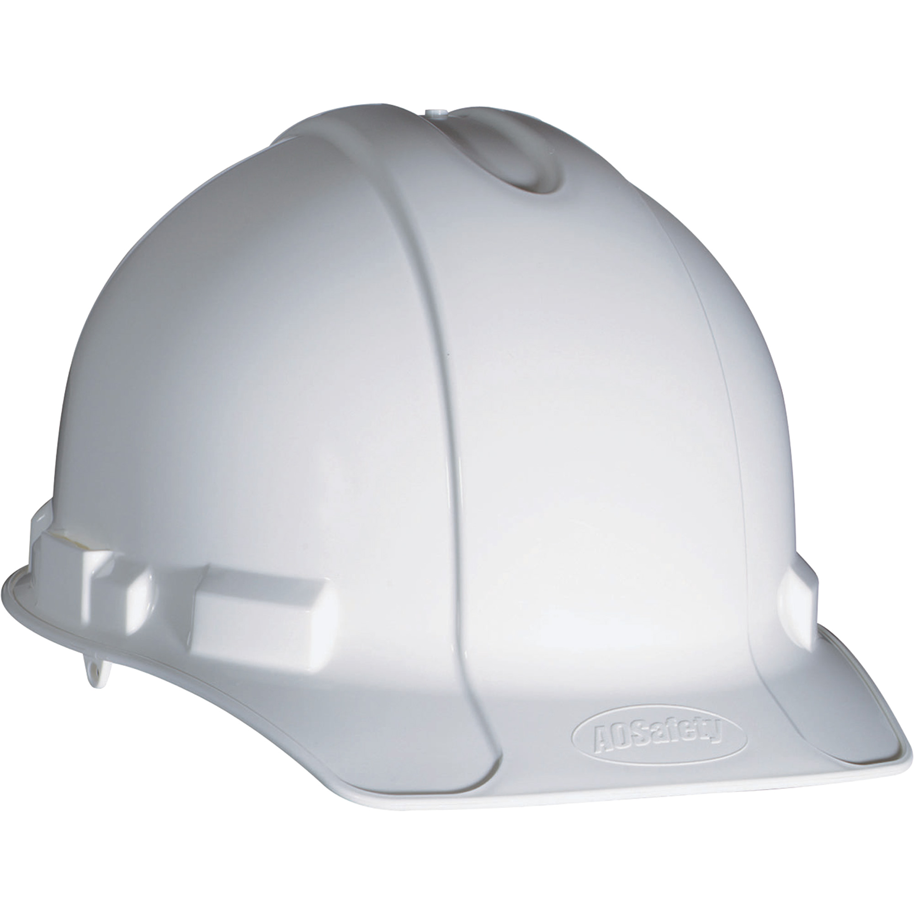
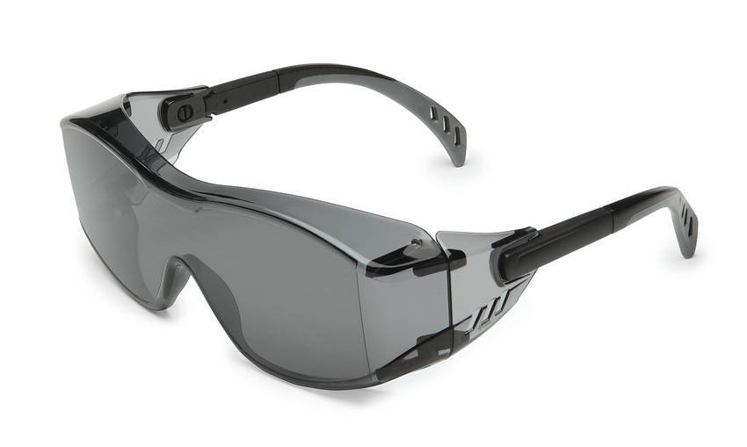
PERSONAL PROTECTIVE EQUIPMENT
HARD HAT
Resist penetration by objects.
Absorb the shock of a blow.
Be water-resistant and slow burning.
SAFETY GLASSES
Ability to protect against specific workplace hazards.
Should fit properly and be reasonably comfortable to wear.
Should provide unrestricted vision and movement.
Should be durable and cleanable.
Should allow unrestricted functioning of any other required PPE.

Slide 54
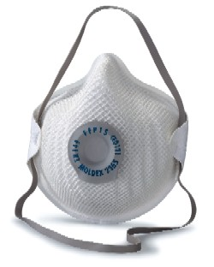
PERSONAL PROTECTIVE EQUIPMENT
RESPIRATORS
Respirators serve to protect the user
from breathing in contaminants in the
air, thus preserving the health of one's respiratory tract.
There are two main types of respirators. One type functions by filtering out chemicals and gases, or airborne particles, from the air breathed by the user. The filtration may be either passive or active (powered).
Gas masks and particulate respirators are examples of this type of respirator

Slide 55
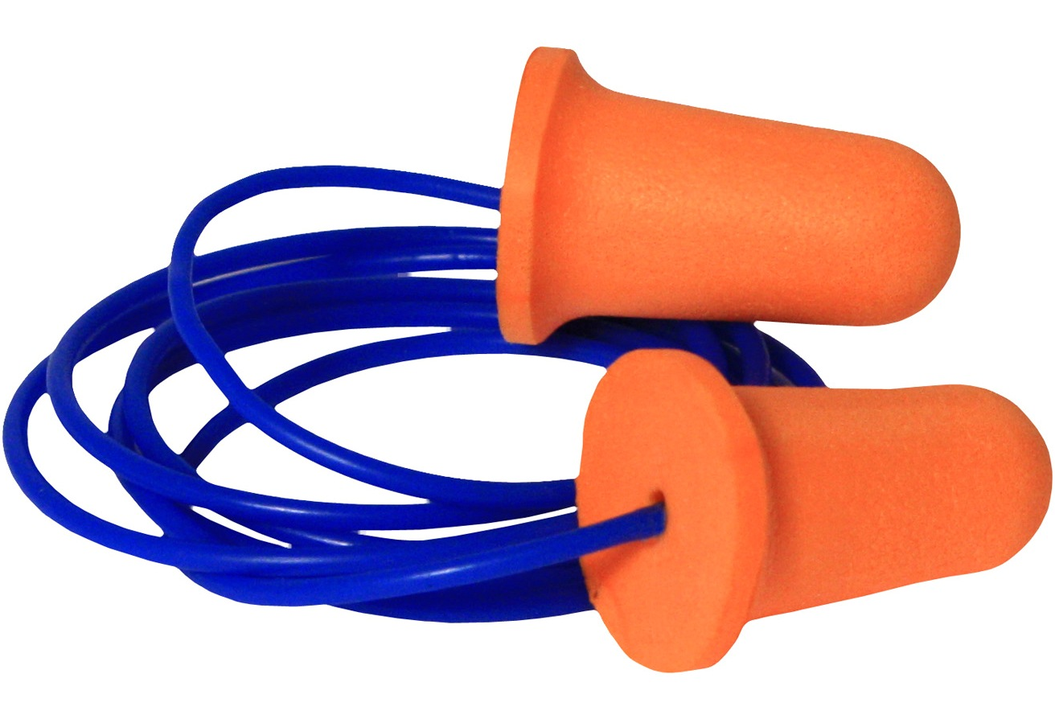
PERSONAL PROTECTIVE EQUIPMENT
HEARING PROTECTION
The loudness of the noise as measured in decibels (dB).
The duration of each employee's exposure to the noise.
Whether employees move between work areas with different noise levels.
Whether noise is generated from one or multiple sources.

Slide 56
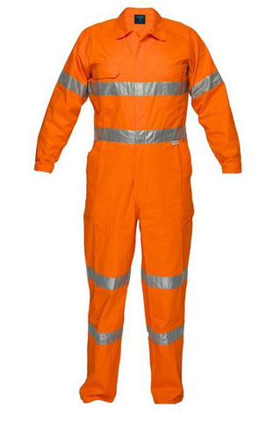
PERSONAL PROTECTIVE EQUIPMENT

Slide 57
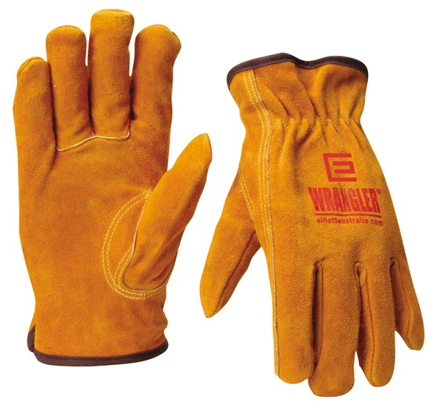
PERSONAL PROTECTIVE EQUIPMENT
GLOVES
Type of chemicals handled.
Nature of contact (total immersion, splash, etc.).
Duration of contact.
Area requiring protection (hand only, forearm, arm).
Grip requirements (dry, wet, oily).
Thermal protection.
Size and comfort.
Abrasion/resistance requirements.

Slide 58
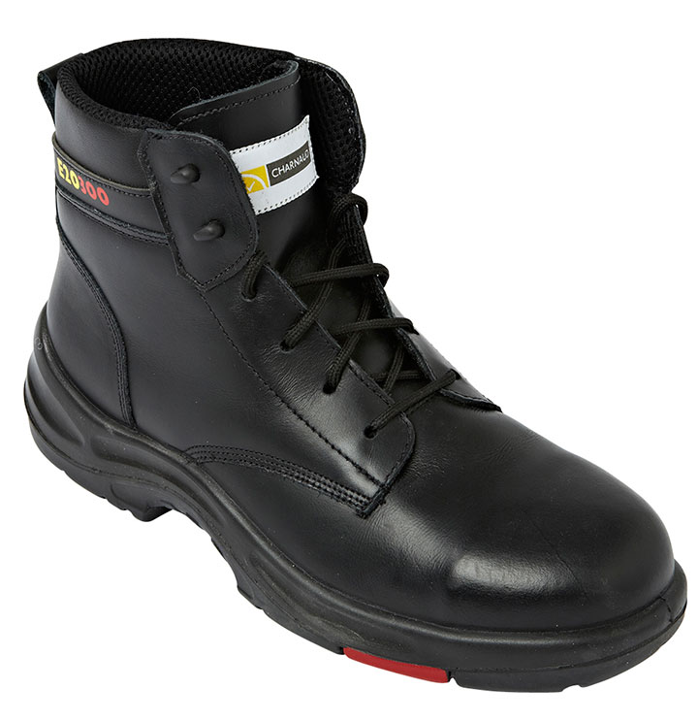
PERSONAL PROTECTIVE EQUIPMENT
BOOTS
When heavy objects such as barrels or tools might roll onto or fall on the employee's feet;
Working with sharp objects such as nails or spikes that could pierce the soles or uppers of ordinary shoes;
Exposure to molten metal that might splash on feet or legs;
Working on or around hot, wet or slippery surfaces; and
Working when electrical hazards are present.

Slide 59
EXAMPLE OF
REQUISITES OF SECURITY MEASSURES ON ABOARD
The following access controls shall be employed aboard at all times:
Crew members shall carry at all times a photo identification document issued by the security officer. All such documents shall be strictly controlled by the security officer, who shall be responsible for maintaining a record of all documents issued and destroyed. Documents of crew members permanently departing the vessel shall be destroyed. Documents of crew members temporarily departing the vessel for periods exceeding two weeks shall be retained on board by the security officer and reissued to the crew member upon his return.

Slide 60
EXAMPLE OF
REQUISITES OF SECURITY MEASSURES ON ABOARD
When visitors to the ship are permitted, their embarkation and debarkation shall be strictly controlled. All visitors shall be searched and their .carry-on baggage inspected prior to boarding. Visitor passes shall be issued only by the security officer and shall be prominently displayed on the person of the visitor at all times. No visitor shall be allowed to debark until his security pass has been returned to the security officer. AII visitors shall be escorted at all times while on board by a member of the crew.

Slide 61
EXAMPLE OF
REQUISITES OF SECURITY MEASSURES ON ABOARD
All vendors or cargo handlers shall be treated as any other visitor, with the following exceptions:
If visitor is alone at time of embarkation, he shall display an identification document with sufficient information to allow the security officer to verify his identity and employment.
If he is a member of a work gang, the gang leader shall be required to present a list of gang members with sufficient information to verify the identity of each. Only those gang members properly identified shall be issued visitor passes.

Slide 62
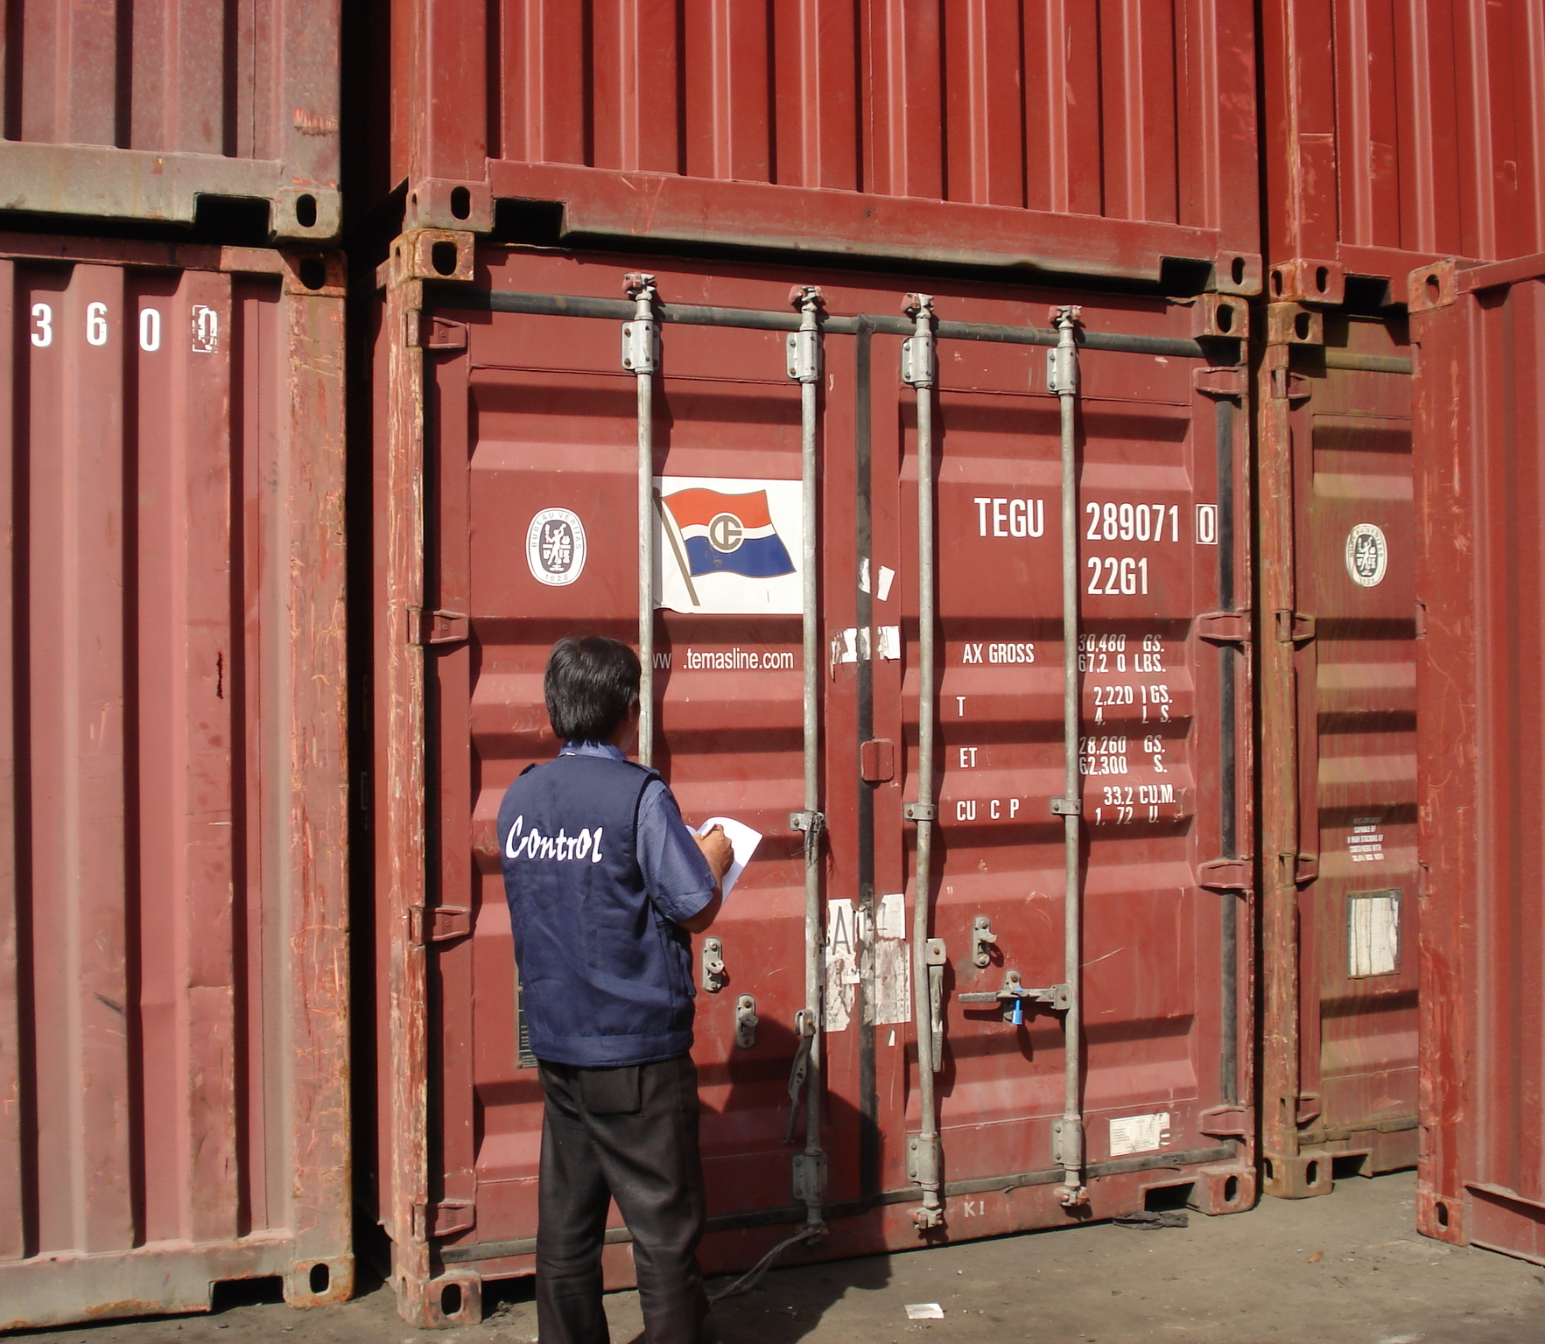
II.
INTRODUCTION TO MARINE CARGO SURVEYING
THROUGH THIS SECTION, WE EXPLAIN THE PRINCIPLES AND PARTICULARITIES OF THE SURVEYS.

Slide 63

INTRODUCTION TO
MARINE
CARGO SURVEY
Marine surveys cover a very wide spectrum and no surveyor can expect to be competent in all types of surveys. ln the larger ports of the world there is invariably a wide choice of specialist surveyors to cover the field but in the smaller ports those seeking to appoint surveyors have to choose between appointing local surveyors who are more likely to be “Jacks of all trades”, or seeking the services of specialist surveyors from elsewhere often overseas.
These “Jacks of all trades” vary considerably in their competence but in the case of the more experienced ones, usually those whose early training was seafaring or marine insurance oriented.

Slide 64
INTRODUCTION TO
MARINE
CARGO SURVEY
TYPES OF SURVEYS
Indeed the whole scope of marine surveying is very broad but the majority of marine surveys would be carried out for the following reasons:
For statutory purposes, particularly those concerned with the maintenance of ships, equipment and operational standards.
To facilitate trade, commodity quantity and quality surveys.
For insurance purposes, classification, condition and damage surveys.
For sale and purchase contracts and chartering contracts.

Slide 65
INTRODUCTION TO
MARINE
CARGO SURVEY
PREVENTION AND CERTIFICATION SURVEYS
Different types of surveys require surveyors with different skills to carry them out and many are required either for the purpose by preventing a loss or damage from taking place or, if it has already occurred, for investigating its nature, extent, cause and for mitigating the loss.
These two classes of surveys are largely performed by the surveyor in an independent and impartial capacity and without any immediate thought of establishing liabilities on any parry In most such surveys the surveyor will be drawing heavily upon his technical knowledge and experience in a primary discipline in which he has been trained.

Slide 66
INTRODUCTION TO
MARINE
CARGO SURVEY
PREVENTION AND CERTIFICATION SURVEYS
Having completed the survey a report will almost always be required to state the survivor findings, usually for three purposes. These may be to short:
That reasonable preventative measures have been taken.
That there has been compliance with a specific requirement, that of a specific standard, code of good practice, or the requirements of another party, Epically that of a Letter of Credit, or that of the surveyor.

Slide 67
INTRODUCTION TO
MARINE
CARGO SURVEY
PREVENTION AND CERTIFICATION SURVEYS
A datum from which to consider any subsequent findings:
Where evidence will be removed or cease to be available.
Which may be at variance with an earlier situation due to any number of possible causes, i.e. deteoration in goods due to decay i.e. remaiping wet, etc.

Slide 68
INTRODUCTION TO
MARINE
CARGO SURVEY
INVESTIGATION SURVEYS
This class of survey is usually required after an event has taken place more often than not, to determine the nature, extent and cause of loss or damage for the purpose of considering prevention in a similar situation in the future, the extent of repair or compensation required and or to establish the liability of some party.
Typically such surveys are required for insurance purposes to facilitate the settlement of a claim under a policy. They may also be used in support of, or in rebuttal of, a claim under a contract of carriage or against a tortfeasor such as the owner of a colliding vessel.
It is with investigation surveys this course is principally concerned where the instructing principals will usually be underwriters, shipowners and charterers or marine lawyers acting on behalf of one of them.

Slide 69
INTRODUCTION TO
MARINE
CARGO SURVEY
TYPE OF SURVEY EXAMPLES
PREVENTION
Pre-shipment, towage, voyage and lay-up approvals, loading/discharging, superintendence, fitness for purpose, and securing.
CERTIFICATION
Confirmation of quality quantity, packing standards, fitness for purpose, compliance with construction standards, pre-purchase condition, on hire / off hire.
INVESTIGATION
Loss / damage, gear failures, out-turn liabilities, collision liabilities.
Note: There is some communality between “prevention” and “certification” and between “certification” and “investigation”.

Slide 70
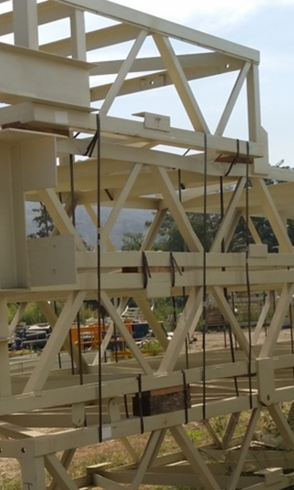
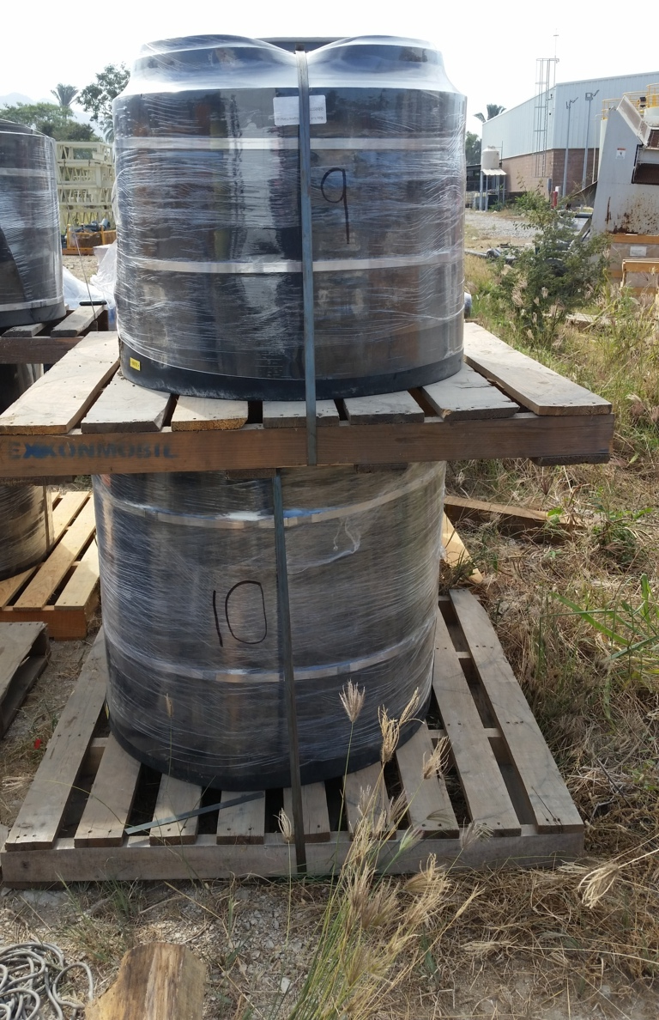
INTRODUCTION TO
MARINE
CARGO SURVEY
SURVEY EXAMPLES

Slide 71
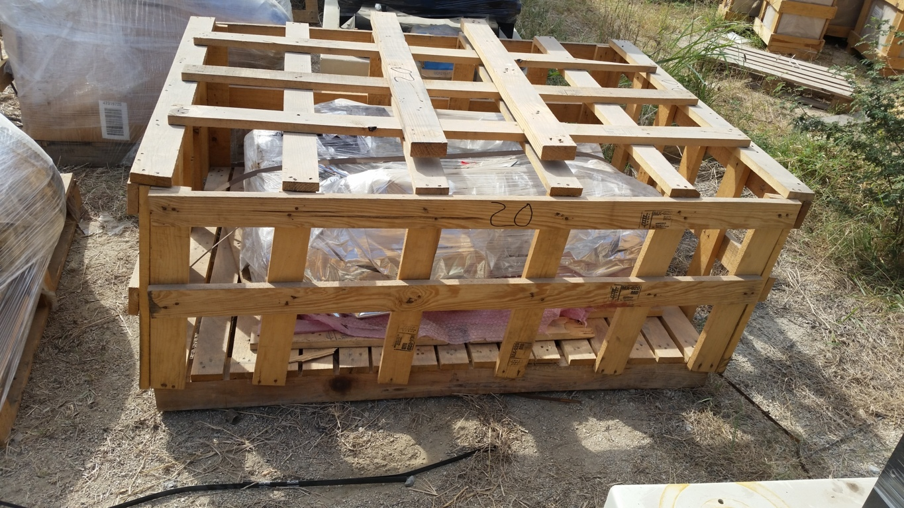
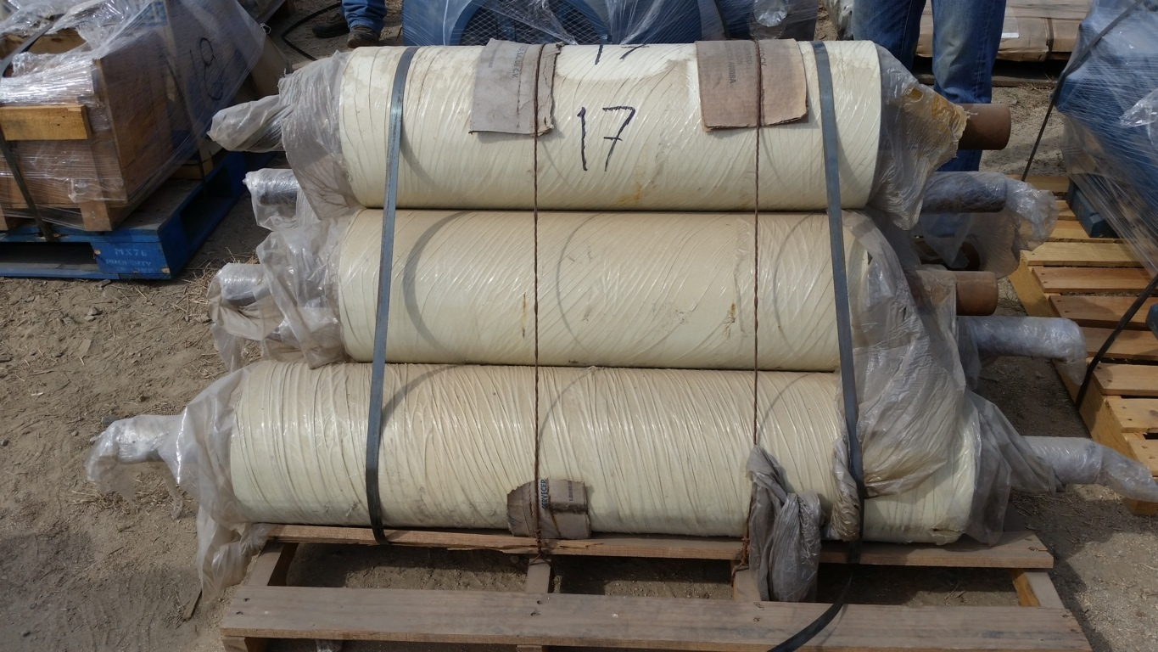
INTRODUCTION TO
MARINE
CARGO SURVEY
SURVEY EXAMPLES

Slide 72
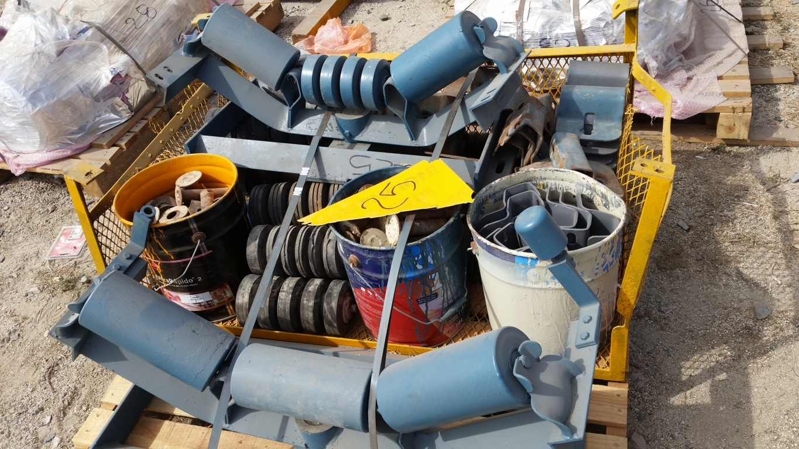
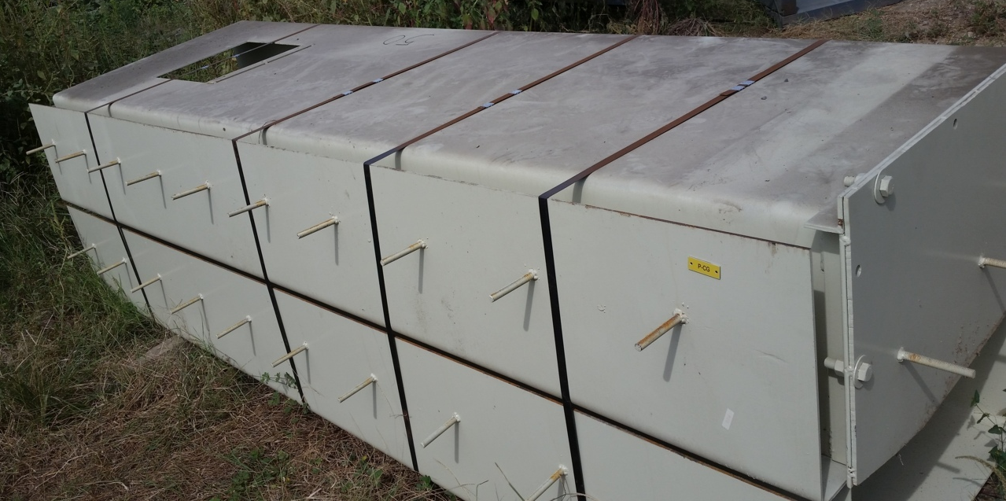
INTRODUCTION TO
MARINE
CARGO SURVEY
SURVEY EXAMPLES

Slide 73
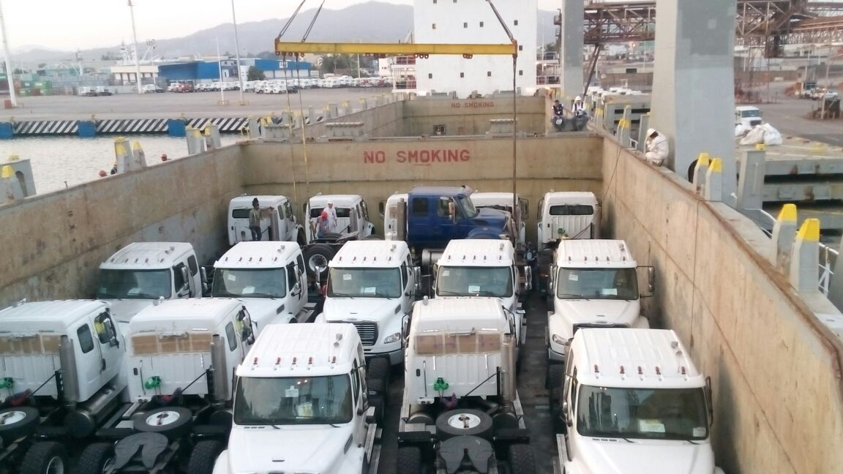
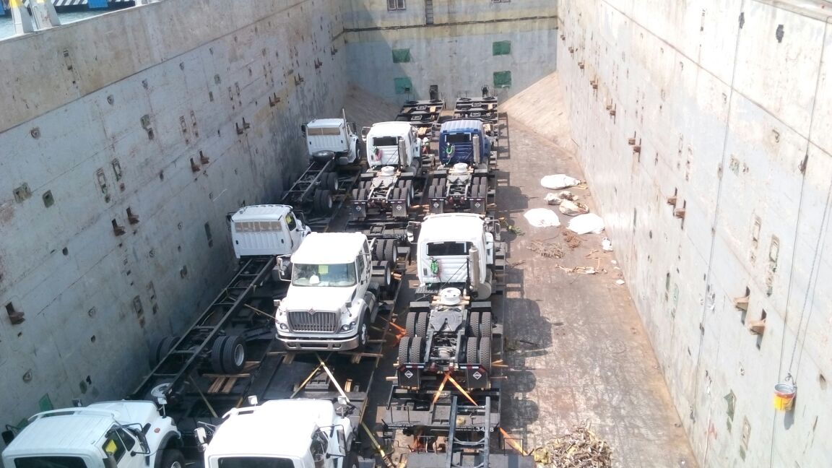
INTRODUCTION TO
MARINE
CARGO SURVEY
SURVEY EXAMPLES

Slide 74
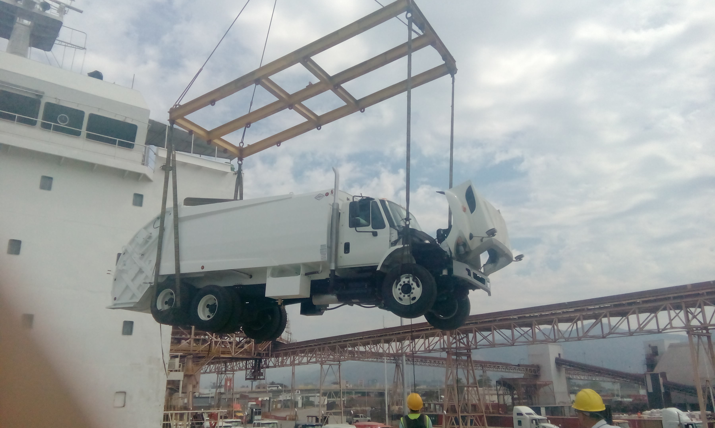
INTRODUCTION TO
MARINE
CARGO SURVEY
SURVEY EXAMPLES

Slide 75
INTRODUCTION TO
MARINE
CARGO SURVEY
UPSTREAM / DOWNSTREAM
Insurance surveys in some form, whether concerned with prevention of damage, loss or with the assessment of damage, loss already sustained, play a large part in the total number of all marine surveys carried out and the terms "upstream" and "downstream", are used in connection with them.
Prevention is "upstream".
Investigation after damage is "downstream"
Certification may be either "upstream" or "downstream"

Slide 76
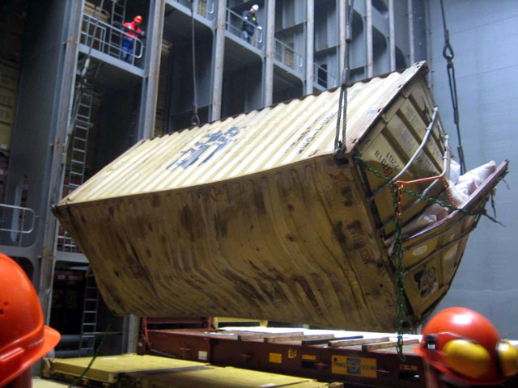
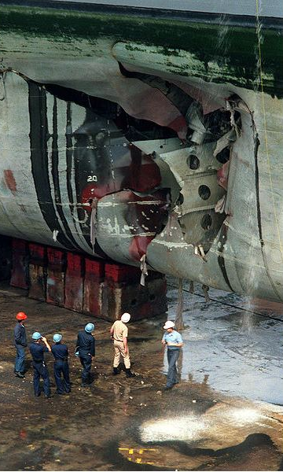
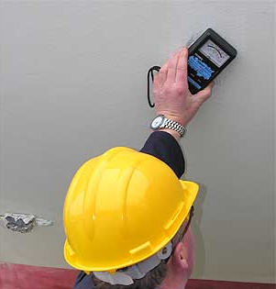
INTRODUCTION TO
MARINE
CARGO SURVEY
TYPES OF SURVEYS

Slide 77
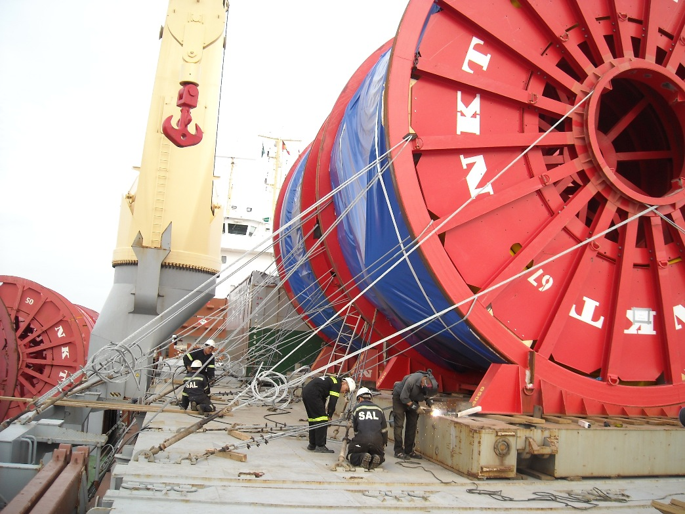
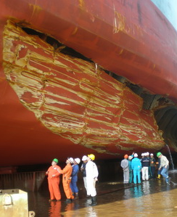
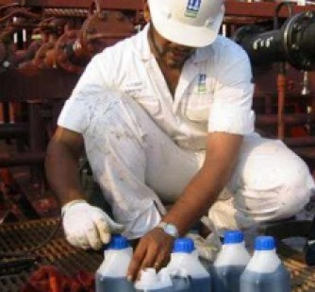
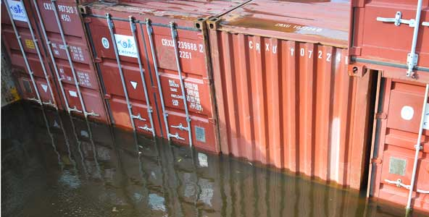
INTRODUCTION TO
MARINE
CARGO SURVEY
TYPES OF SURVEYS

Slide 78

Evaluation
Day
1
Congratulations !!
You finished the day 1.
Now we are going to make this small evaluation.
Please click on the following link to open the file
Evaluation File
Notes:
El tiempo maximo para realizar la evaluación es de 10 minutos.

Slide 79
DAY
ONE
Fin
del
Modulo
Notes:
Se da por terminado este modulo.

Slide 80
DAY
ONE
PREGUNTAS
Y COMENTARIOS
Notes:
No permitir responder a las preguntas de manera sencilla y corta. En los comentarios no permitir que se extienda mucho. Duracion Maxima 10 minutos.

Slide 81
DAY
ONE
DESPEDIDA
Notes:
Recordar el curso siguiente reiterar el horario y solicitar puntualidad.

Slide 82
DAY
ONE
OVERVIEW
In this day, the topics about what is TransGlobal SOS and what is your job are discloused.
MATERIAL REFERENCES
Capt. C.B. Thompson, SURVEYING MARINE DAMAGE, Edited by Witherby Publishers.
Kenneth Gale, MARITIME SECURITY, Edited by Cornell Maritime Press.

