Slide 1

MARINE CARGO SURVEYORS TRAINING

Slide 2


DAY
TWO
OVERVIEW
In this day, the topics about what is TransGlobal SOS and what is your job are discloused.
SURVEYING MARINE DAMAGE

Slide 3

INDEX
I N D E X
APPENDIX A. CONTAINERS
DEFINITION
FEATURES
PROS & CONS
TYPES
CONSTITUTION
TYPES OF CONTAINERS (DESCRIPTION)
CONTAINER CODE
INSPECTING A CONTAINER
EXAMPLES OF INSPECTIONS
STOWAGE
LASHING
CONTRACT TYPES
III.INTRODUCTION TO MARINE DAMAGE SURVEY
MARINE DAMAGE SURVEY
CARGO DAMAGE
APPOINTMENT OF THE SURVEYOR
PRINCIPLES OF SURVEYING AND REPORTING THE NATURE OF DAMAGE AND LOSS

Slide 4
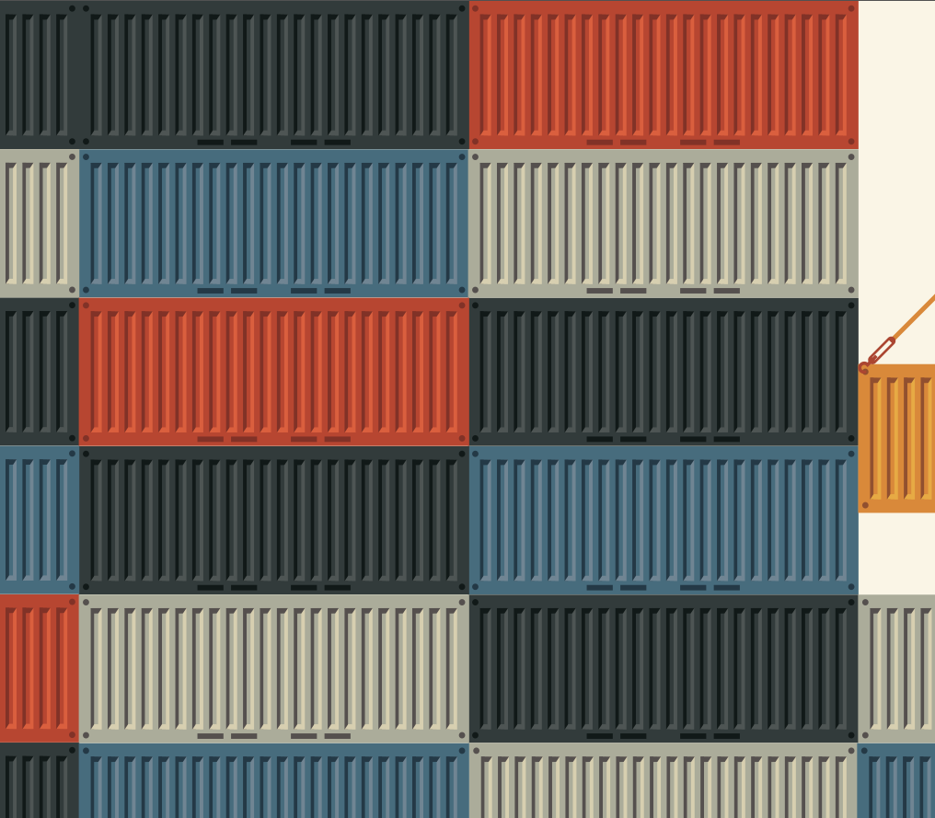
APPENDIX A.
CONTAINERS
IN THIS APPENDIX, THE FEATURES AND TYPES OF CONTAINERS FOR CARGO ARE EXPLAINED.

Slide 5


DEFINITION
Definición Según ISO
Articulo del equipo de transporte:
De carácter Permanente, y por consiguiente lo Suficientemente fuerte como para ser usado repetidamente.
Diseñado especialmente para facilitar el transporte de mercancía por uno o más modos de transporte sin necesidad de volver a cargar las mercancías.
Provisto de dispositivos que permiten su fácil manejo, particularmente su transferencia de un medio al otro.
Que tiene un Volumen de un Metro Cúbico o Más.

Slide 6
DEFINITION
Según la ISO 830:1981, el contenedor es:
un equipo de transporte de carácter permanente y por tanto, lo suficientemente fuerte para ser utilizado varias veces, especialmente diseñado para facilitar el transporte de productos por uno o varios modos de transporte suprimiendo el proceso intermedio de manipulación entre los modos, provisto de dispositivos para una manipulación rápida en su transferencia de un modo a otro, concebido para ser llenado y vaciado de manera expedita y con un volumen interior de 1 m³ (35,3 pies cúbicos) o más.

Slide 7
FEATURES
    Servir como unidad de carga para el transporte combinado y en particular, para el transporte multimodal.
    Servir como embalaje.
    Facilitar el apilamiento
    Agilizar la manipulación.

Slide 8
PROS & CONS
    VENTAJAS
    No contaminante.
    Fácil manipuleo.
    Permite obtener primas de seguro más favorables.
    Se reduce considerablemente el número de operaciones de manipulación en las terminales de transbordo.
    Mayor protección de la carga contra daños, robos y contaminación.
    Ahorros en costos de embalaje.
    Menor inventario requerido debido al menor tiempo de tránsito que permite un mejor control del mismo, lo que resulta en reducción de costos.

Slide 9
PROS & CONS
    VENTAJAS
    Reducción de los costos de transporte interno y manipuleo.
    Servicio puerta a puerta.
    Reducción del tiempo en puerto que resulta en una mayor rotación del buque y de otros medios de transporte.
    Facilita la implantación de la carta de porte directa.
    La contenerización facilita el funcionamiento de transportistas públicos no operador de buques (NVOCC) para prestar servicios de:
    Consolidación
    Transporte puerta a puerta
    Distribución

Slide 10
PROS & CONS
    DESVENTAJAS
    Alta inversión de capital.
    Se reduce la utilización de mano de obra.
    A pesar de que se ha luchado para lograr la normalización de los contenedores, existe en la actualidad un por ciento de contenedores, que no puede ser considerado despreciable, que tienen especificaciones técnicas diferentes a las establecidas por la ISO.
    Desequilibrio del flujo de importación y exportación de contenedores.

Slide 11
TYPES

Slide 12
CONSTITUTION
Un contenedor esta compuesto por un marco rígido usualmente construido en acero o aluminio, con paneles entre los miembros del marco. El marco es la parte estructural principal y esta compuesto por las vigas, los rieles y cuatro postes esquineros con cuatro acoples de donde puede ser manipulado el contenedor. Hacen también parte del marco los travesaños los cuales soportan el piso que normalmente esta hecho de madera.
En la parte trasera del contenedor hay dos puertas, las cuales están normalmente compuestas de paneles lisos o corrugados sobre el exterior, soportados por un marco desde el interior.

Slide 13
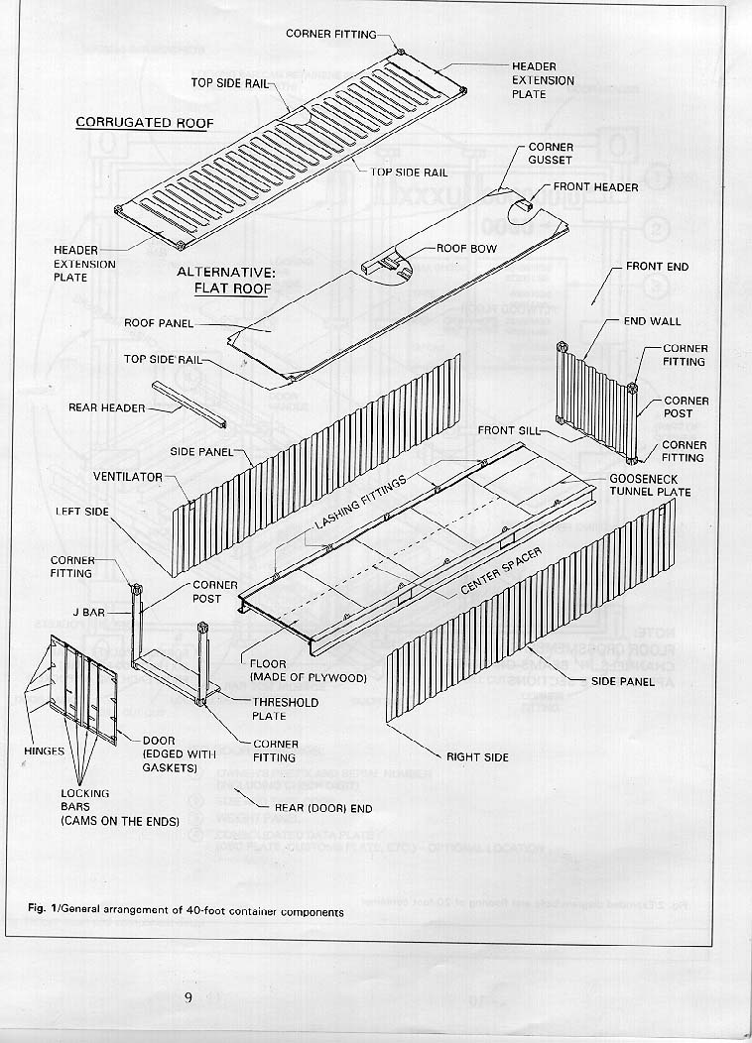
CONSTITUTION

Slide 14
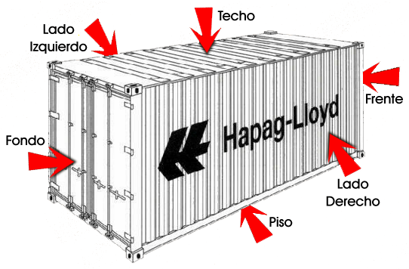
CONSTITUTION

Slide 15
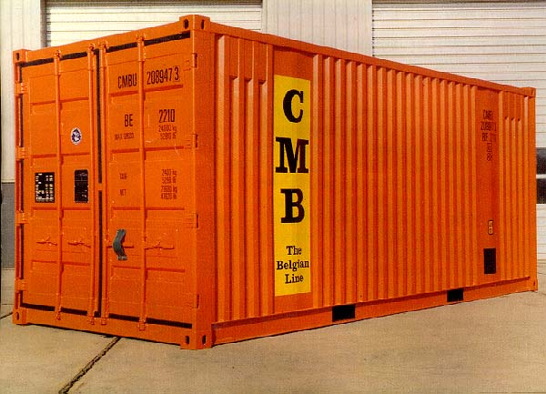
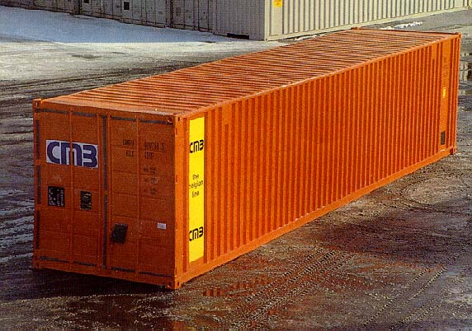
TYPES OF CONTAINERS
(DESCRIPTION)
ESTANDAR 20 O 40
Contenedor en forma de caja metálica. 20 o 40 pies. Se utiliza para transportar carga convencional, paletizada, bultos, cajas, general. Sin ventilación, ventilados o hiperventilados.

Slide 16
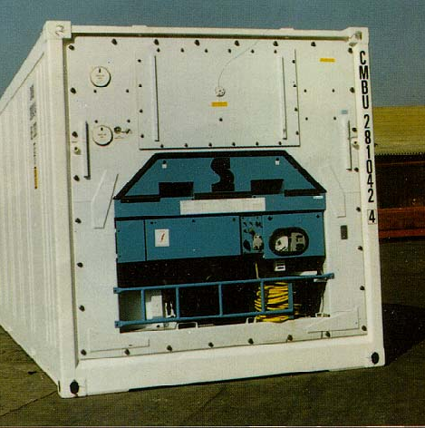
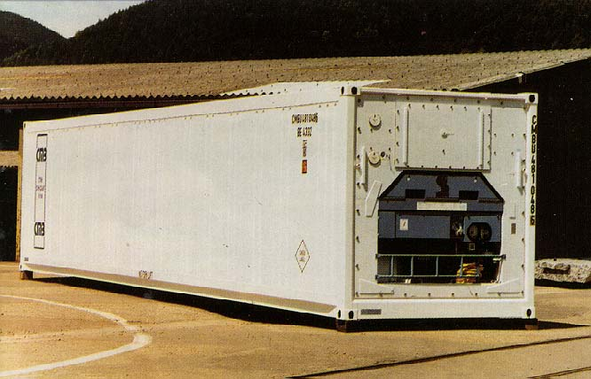
TYPES OF CONTAINERS
(DESCRIPTION)
REFRIGERADO
Unidad de refrigeración o Gen-set, generador. Utilizado especialmente para carga perecedera.

Slide 17
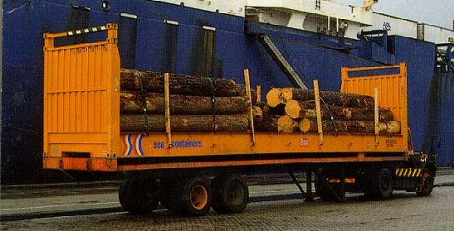
TYPES OF CONTAINERS
(DESCRIPTION)
FLAT RACK
No tienen techo y no tienen lados el frente y la parte de atrás abatibles. Utilizado para Cargamentos especiales no uniformes, CKD, maquinaria pesada. Se manipula con equipos frontales ayudados por cadenas.

Slide 18
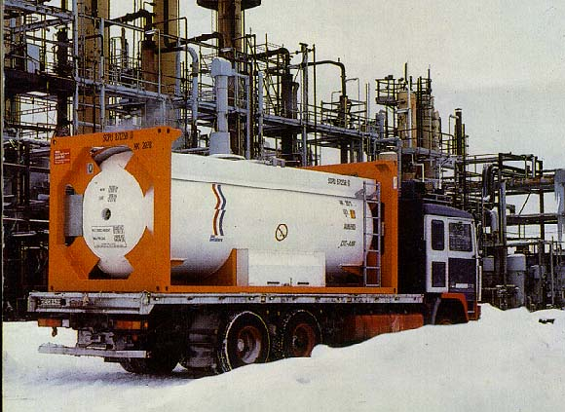
TYPES OF CONTAINERS
(DESCRIPTION)
TANQUE
Container en forma cilíndrica para cargar fluidos. Capacidad entre 19000 y 23000 litros, tienen un manejo y un tipo de reparación especializado.

Slide 19
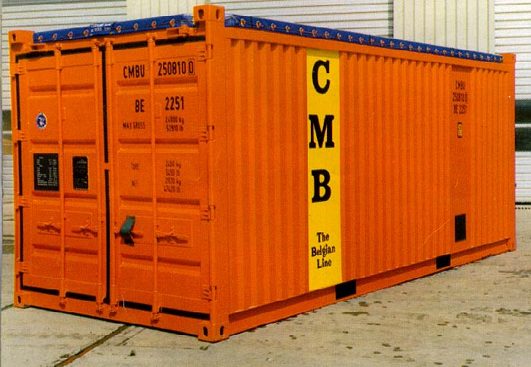
TYPES OF CONTAINERS
(DESCRIPTION)
OPEN TOP
Destapado en su parte superior, carpa, cordón, viga trasera superior y arco de techo removible. Se utiliza generalmente para trasportar carga sobredimensionada, maquinaria mediana.

Slide 20
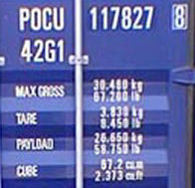
CONTAINER CODE
1. Código del Propietario……………………….4 Letras
2. Número de serie…………………................6 Números
3.Dígito de comprobación…………………..…1 Número
4. Código del País………………………………...2 Letras
5. Código de Dimensiones y tipo.................4 Números
4310 o el ISO nuevo 42G1

Slide 21
INSPECTING A CONTAINER
FALLAS COMUNES
Deformaciones del recubrimiento.
Penetración de la oxidación.
Rajaduras del piso y de las vigas.
Desgaste de las aberturas de los esquineros.
Defectos en las puertas.
Marcas de identificación faltantes o ilegibles.
    INSPECCIONES COMUNES
    On Hire.
    Off Hire.
    Pre y pos reparación.
    Control de calidad.
    Restauración o reacondicionamiento.
    Control de Inventario.
    Control de intercambio (INTERCHANGE).
    Avería en la carga.

Slide 22
INSPECTING A CONTAINER
El objetivo de la inspección de contenedores es revelar condiciones o daños que pueden ser riesgosas o las cuales reducen la eficiencia del contenedor. Los cuales deben ser reparados.
El interés de todas las partes involucradas es asegurarse que se están realizando inspecciones apropiadas que certifican que las reparaciones también tienen una calidad aceptable.
EL PAPEL DEL INSPECTOR: El es el responsable de asegurar que cualquier daño encontrado sea reparado y que los métodos de trabajo sean los mas apropiados desde el punto de vista técnico y económico. Deberá identificar las condiciones de desgaste y deterioro y hacer las reparaciones oportunas que maximicen la vida del contenedor.

Slide 23
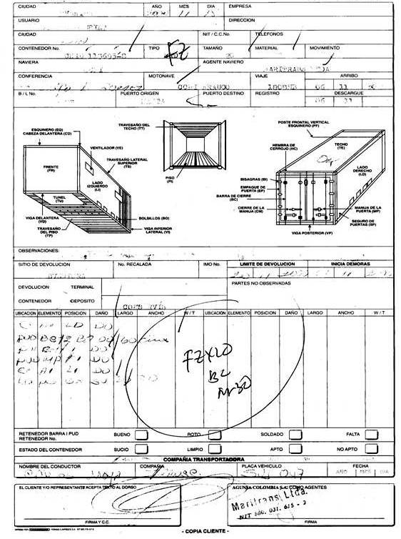
INSPECTING A CONTAINER
NOTA DE INSPECCION
Documento donde se anota la condición en la cual se entrega el contenedor ya sea vació para ser embalado para exportación o lleno para ser desembalado por el Importador.

Slide 24
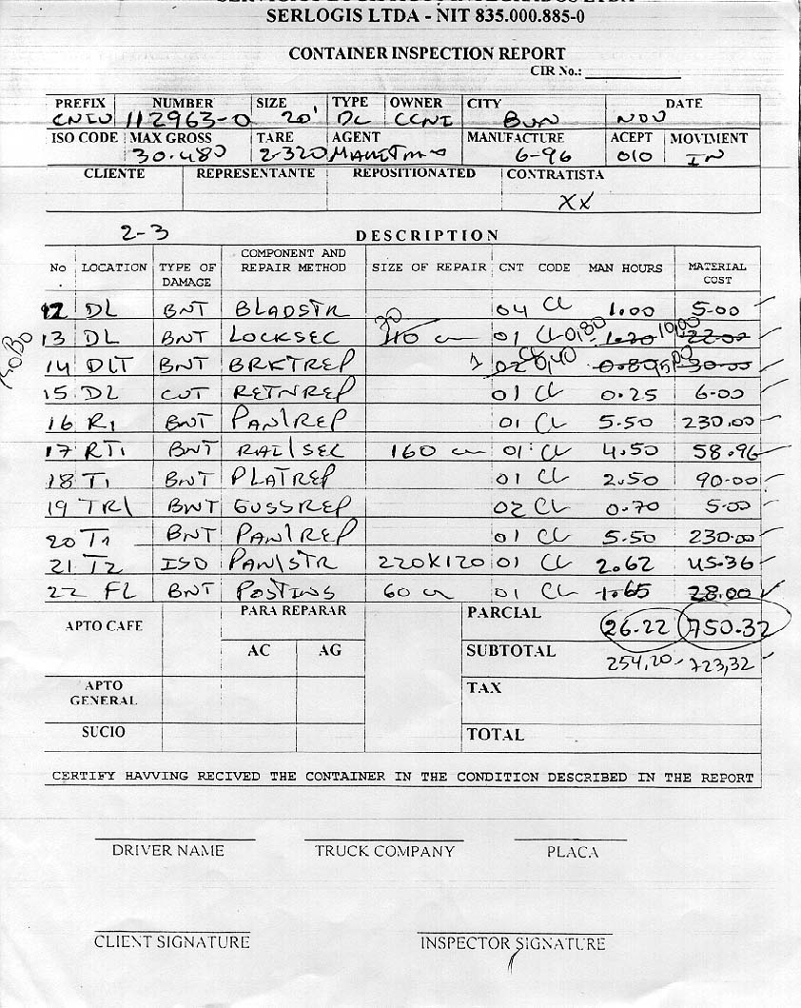
INSPECTING A CONTAINER
CONTAINER INSPECTION REPORT
Documento interno de los Depósitos de Contenedores donde se codifican los daños del contenedor al igual que su tamaño si aplica, su ubicación y el método de reparación.

Slide 25
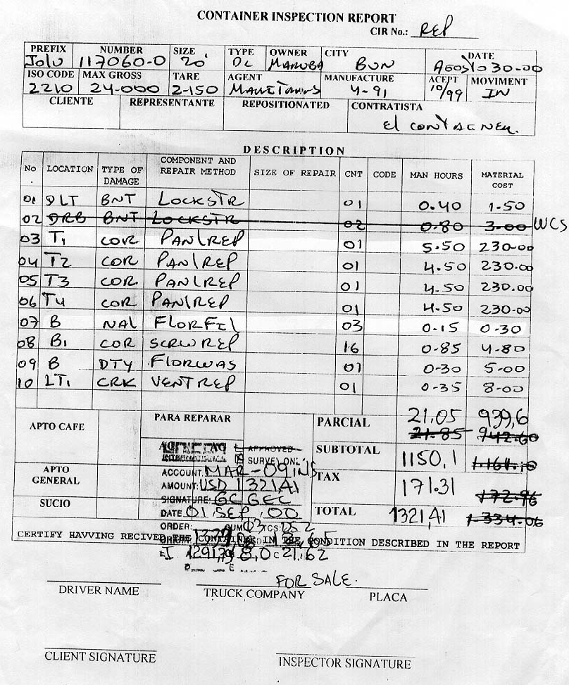
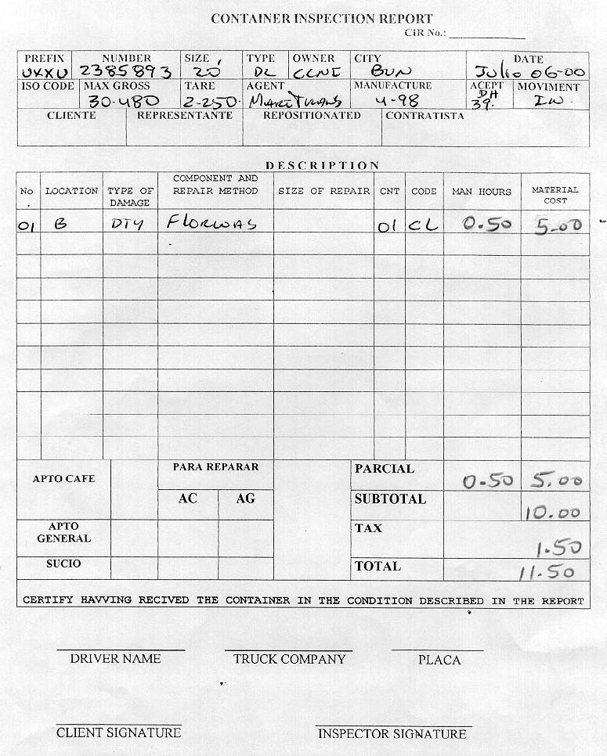
INSPECTING A CONTAINER
CONTAINER INSPECTION REPORT

Slide 26
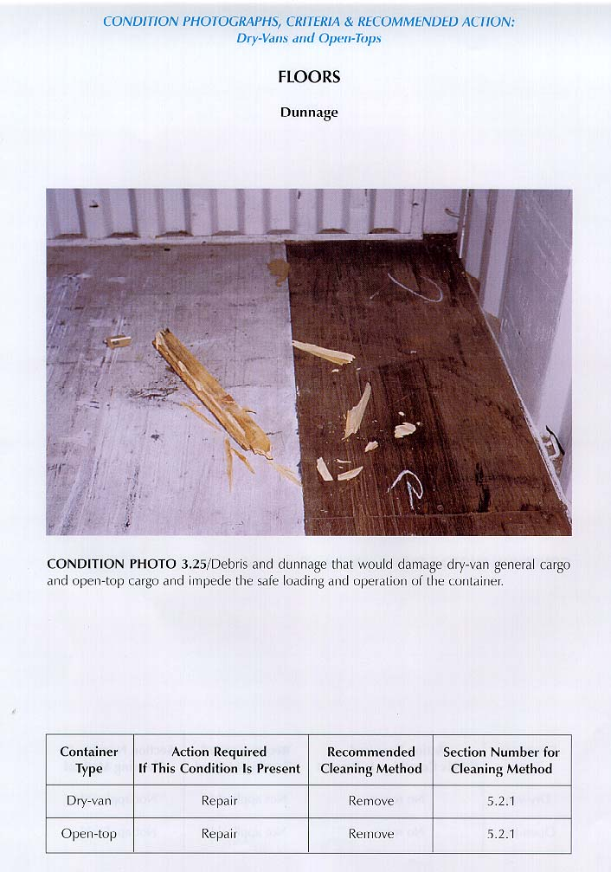
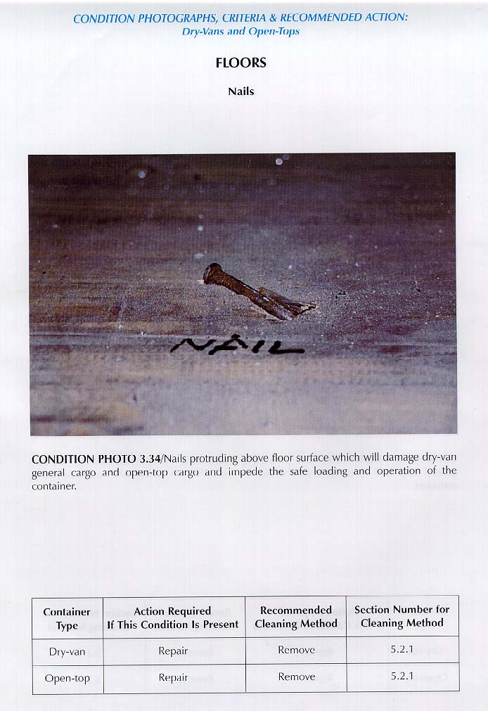
EXAMPLES OF INSPECTIONS

Slide 27
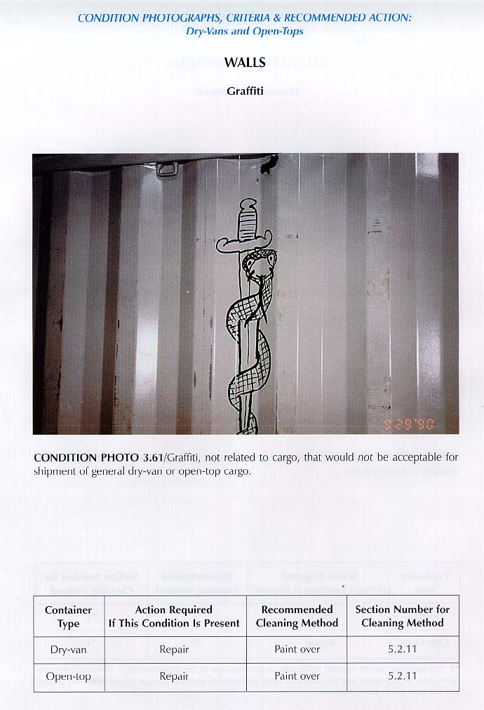
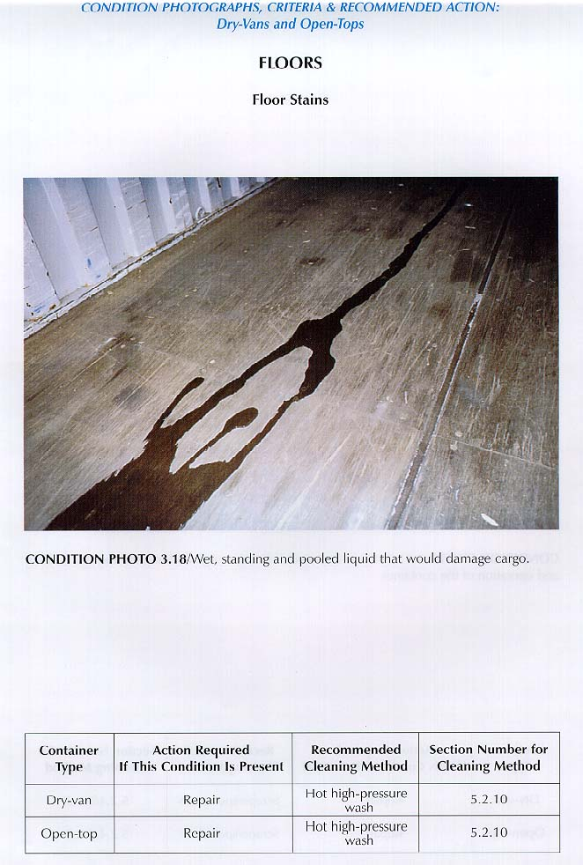
EXAMPLES OF INSPECTIONS

Slide 28
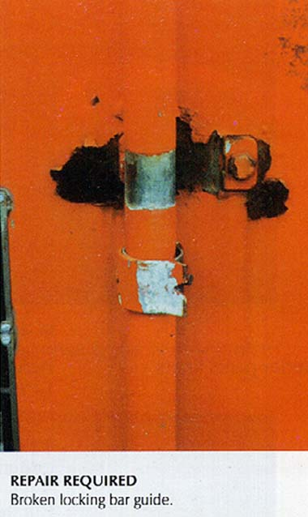
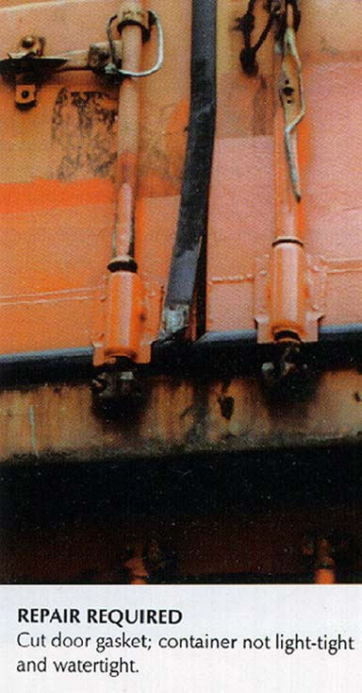
EXAMPLES OF INSPECTIONS

Slide 29
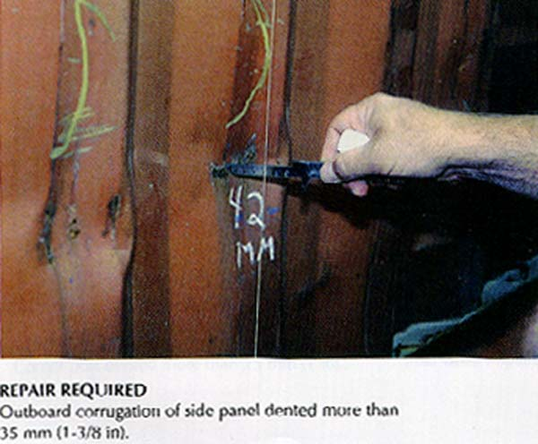
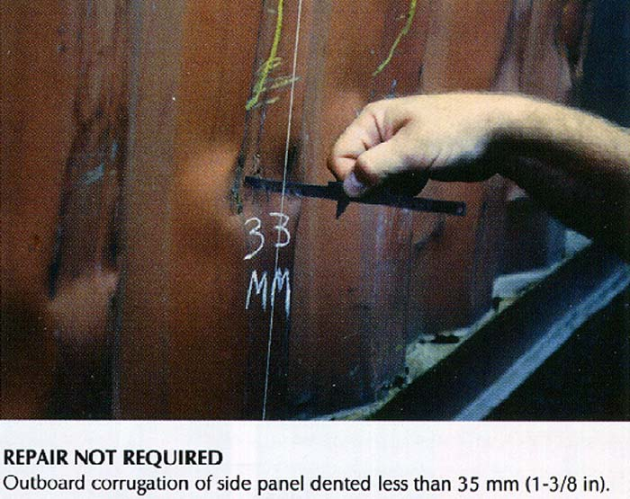
EXAMPLES OF INSPECTIONS

Slide 30
STOWAGE
    Al colocar las mercaderías dentro de contenedores deben tenerse en cuenta las siguientes medidas:
    Verificar si el peso de carga la carga no sobrepasa la capacidad de carga del contenedor.
    Distribuir la carga en forma pareja sobre el piso del contenedor.
    Observar cuidadosamente las reglas generales para la estiba de mercaderías embaladas en cajas de cartón.
    Los espacios vacíos deben llenarse con maderas u otros materiales, que eviten el desplazamiento.
    Las barras de soporte o las esquinas de embalajes rígidos no deben ubicarse de manera tal que presionen sobre las paredes del contenedor.
    Debe prevenirse la posible caída de bultos contra las puertas del contenedor.
    Las reglas relativas al transporte de mercaderías peligrosas deben ser seguidas rígidamente.

Slide 31
STOWAGE
    Los contenedores pesados deben ubicarse en las bodegas o celdas inferiores de un buque porta contenedor celular y hacía popa.
    Deben ubicarse los contenedores de tal manera que no se produzca escora.
    La ubicación definitiva de los contenedores debe contemplar la rotación de puertos que tendrá el buque con el fin de evitar remociones.
    Los contenedores con cargas peligrosas deben estibarse sobre cubierta.
    Debe ser pareja la distribución de contenedores a lo largo del buque con el fin de aprovechar mejor los medios de manipulación ubicados en el terminal (grúas pórtico).
    Para la estiba de contenedores en los buques tiene especial significado el trincaje.

Slide 32
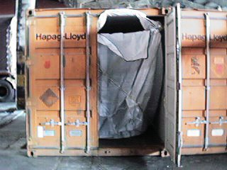
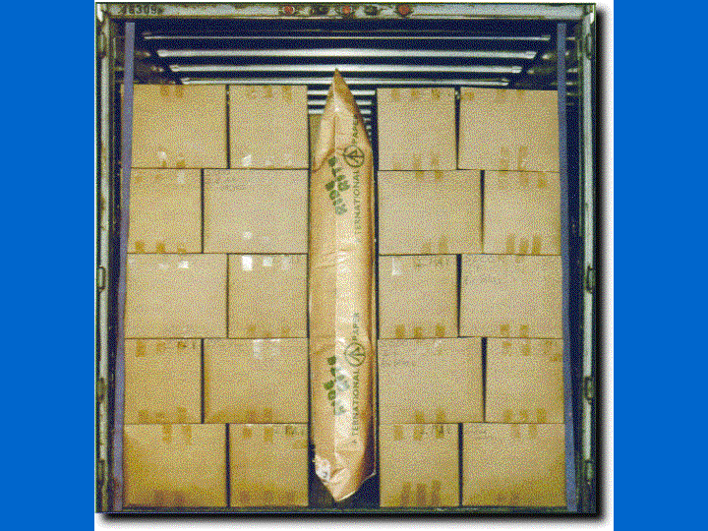
STOWAGE
EXAMPLE

Slide 33
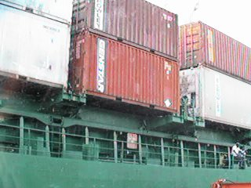
LASHING
Los sistemas de aseguramiento para los contenedores están diseñados para asegurar una estiba eficiente y segura de los contenedores en los compartimientos o en cubierta, haciendo que sean una parte integral del buque de modo que las fuerzas debidas a los movimientos propios de la travesía marítima, no causen daños a los mismos, a sus contenidos, a la nave o a la tripulación.

Slide 34
CONTRACT TYPES
Alquiler o arriendo
FCL y LCL (Variantes)
Otro modo (CY-CY ó CFS-CFS)
Alternativas (FCL, LCL, FCL-LCL y LCL-FCL)
Servicios de líneas regulares (Pier/Pier, Pier/House, House/Pier, House/House, Grupaje y Ship’s Convinience)

Slide 35
CONTRACT TYPES
CONTRATO DE COMODATO
Contrato en que las partes entrega la otra gratuitamente un bien en este caso un contenedor, para que haga uso del y el cual debe restituir en la misma forma como le fue prestado y dentro del plazo y bajo las condiciones que se establezcan en él.
  Se perfecciona con la entrega de la cosa en este caso el contenedor.
  Es un préstamo donde una parte le entrega a otra un contenedor confiriéndole el derecho de servirse del con el compromiso de restituirlo tal como se le entrego.
  El prestamista o comodante o el representante del mismo, conserva el dominio sobre el Contenedor y el prestamista o comodatario se convierte en el deudor de un cuerpo cierto con unas características especificas.
  La gratuidad es la esencia de este contrato. Si se pide una contraprestación por el servicio se convierte en un tipo de contrato diferente (Contrato Diverso)

Slide 36
CONTRACT TYPES
LIMITACIONES AL COMODATARIO (Caso Fortuito)
Tiene que tener el mayor cuidado con la conservación del contenedor, pues responde hasta por culpa Levísima.
  Responde por todo el deterioro que no provenga de la naturaleza, o del uso legitimo del contenedor.
  Si el deterioro es tal que el contenedor quedo inservible para su uso ordinario, podrá exigir el precio de restitución de este.

Slide 37
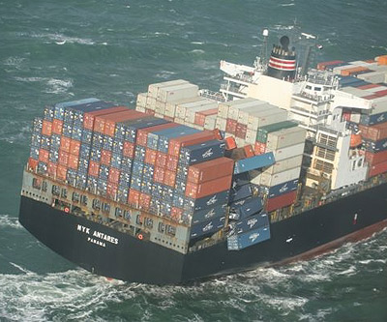
III.
INTRODUCTION TO
MARINE DAMAGE
SURVEY
THROUGH THIS SECTION, WE EXPLAIN THE ROLE OF THE SURVEYOR ON CARGO DAMAGE EVENTS

Slide 38
MARINE DAMAGE SURVEY
Damage is suffered by ships and cargoes from a number of different causes and to varying extent. When damage occurs, whether to sea or air freight, it is usually necessary to have the circumstances and the degree of damage verified and carefully recorded.
This is necessary so that firstly, consideration can be given to the possible restoration to sound condition, and secondly, so that the financial losses can be recovered from others who may be responsible for causing the damage, carriers and other third parties and, those who agree to indemnify the owners, or others having a financial interest, for their losses, i.e. underwriters and financiers.

Slide 39
CARGO DAMAGE
Cargoes are damaged by a number of different causes which affect different ones in different ways. Whilst determining the cause is an important part of the surveyor role, an equally important one in many cases can be mitigation of loss.
In some cases specialist surveyors are appointed by underwriters in very large claims, particularly those on commodities and machinery, with mitigation often as the first consideration and their expertise is provided to assist the consignee in his duty to mitigate the loss.

Slide 40
CARGO DAMAGE
The surveyor who is not experienced in the type of cargo with which he is confronted needs to acquire as much information as possible as quickly as he can. There are several sources often available to assist him of which the closest at hand is usually, in a well provided office, Lloyd Survey Handbook. This reference book should be one of the first sources of enquiry.
Apart from text books and technical papers which the surveyor may have accumulated, reference should be made to local experts for advice. These may be importers of, similar goods or trade associations, and the universities can often provide a great deal of assistance. Even the classified pages of the telephone directory may help. Having located the expert it may be necessary and possible to retain his services to attend the survey, or it may be sufficient simply to seek his advice.

Slide 41
CARGO DAMAGE
DAMAGE BY WETTING
This type of damage is common with goods in transit and the nature of the wetting may be relevant to the remedial treatment required and to liability under the policy or of third parties. The surveyor therefore needs to do his utmost to determine the origin of the wetting.
The silver nitrate test is well known as being a simple test to determine whether chlorides are present or not and this can eliminate the possibility of salt water if they are absent. Their presence however does not prove that salt water is involved as there are many sources of chlorides, cardboard packing can often be responsible for their presence.
There may also be chlorides in the commodity itself.

Slide 42
CARGO DAMAGE
DAMAGE BY WETTING
If sea water is suspected a sample of the wetted packing or goods should be submitted to an analyst who should be able to stare the chemical content of the contaminant, provided an uncontaminated sample of the packing or the goods is also submitted to him.
When obtaining samples of damaged material it is always important to obtain a check sample from an undamaged area so that a proper comparison can be made. There may be chlorides in similar quantities in the undamaged check sample and this will then clearly indicate that the contaminant was not necessarily the cause of the introduction of the chlorides.

Slide 43
CARGO DAMAGE
DAMAGE BY WETTING
If sea water is suspected a sample of the wetted packing or goods should be submitted to an analyst who should be able to stare the chemical content of the contaminant, provided an uncontaminated sample of the packing or the goods is also submitted to him.
When obtaining samples of damaged material it is always important to obtain a check sample from an undamaged area so that a proper comparison can be made. There may be chlorides in similar quantities in the undamaged check sample and this will then clearly indicate that the contaminant was not necessarily the cause of the introduction of the chlorides.

Slide 44

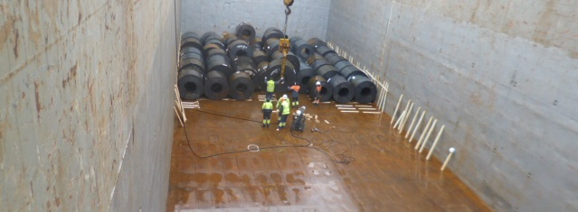
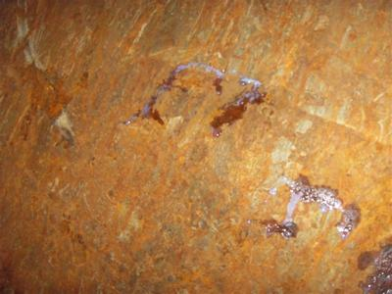
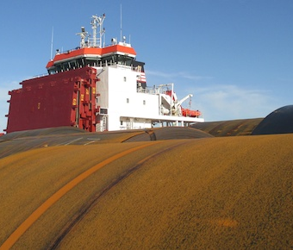
CARGO DAMAGE
DAMAGE BY WETTING

Slide 45
CARGO DAMAGE
DAMAGE AND LOSS BY OTHER CAUSES
(IMPACT)
Certainly wetting is one of the most prolific causes but others of major significance are impact and pilferage
Impact
Impact damage arises from several causes. In non-containerised items damage often results from either the items, or the packages containing them, being struck by fork hoists or, whilst in stow, by other cargo striking them in the course of loading or discharging. Similarly the items, or their packages, come into contact with other cargo or the ship structure whilst they are being handled.

Slide 46
CARGO DAMAGE
DAMAGE AND LOSS BY OTHER CAUSES
(IMPACT)
Timber can be very resilient and may absorb impact if not too severe. Sometimes the packing cases will fracture and the presence of internal damage will be evident but plywood panels will often yield to a blow and spring back into place leaving little external evidence to give an indication of likely internal damage.
Cardboard, in association with some internal material such as polystyrene foam, is often used as packaging. The latter is very effective 'cushioning' and if an impact is over a large area neither the cardboard nor the polystyrene may show external evidence of damage.

Slide 47
CARGO DAMAGE
DAMAGE AND LOSS BY OTHER CAUSES
(IMPACT)
The surveyor, perhaps already alerted to the knowledge that there is damage to the contents, will often have to search for evidence of impact damage internally. The inspection of the inside surface, rather than the outside of the packaging, is therefore most important.
The inner surfaces of the packaging will often provide the only clue to impact damage when it has arisen in goods shipped in containers where there will rarely be external packing damage in spite of sometimes severe damage to contents.

Slide 48
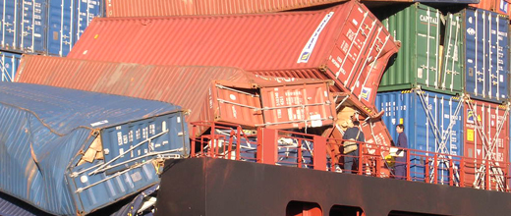
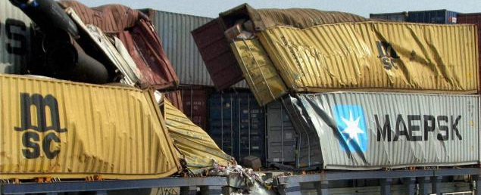
CARGO DAMAGE
DAMAGE AND LOSS BY OTHER CAUSES
(IMPACT)

Slide 49
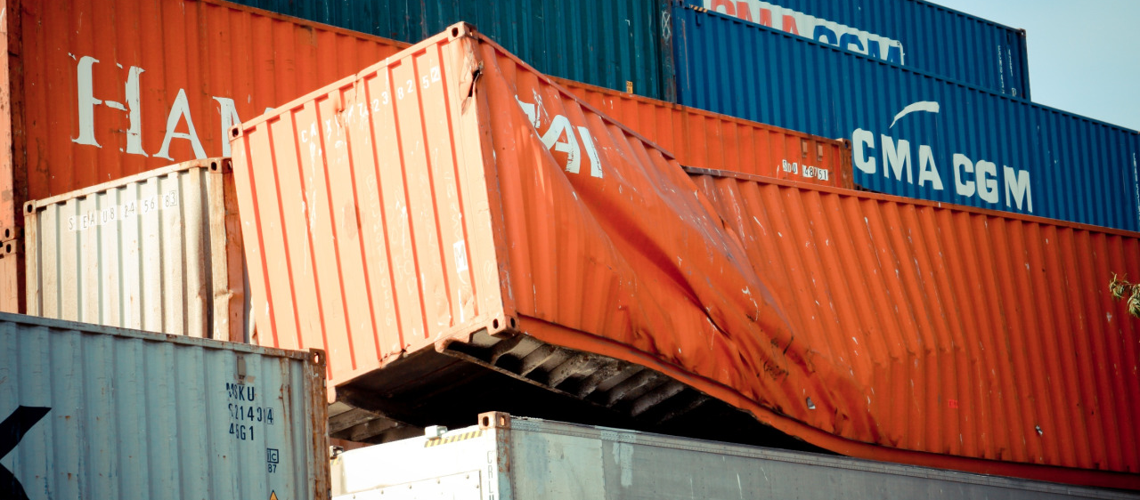
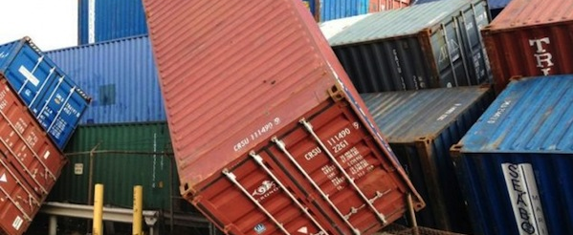
CARGO DAMAGE
DAMAGE AND LOSS BY OTHER CAUSES
(IMPACT)

Slide 50
CARGO DAMAGE
DAMAGE AND LOSS BY OTHER CAUSES
(PRE-SHIPTMENT AND NON-FORTUITOUS LOSSES)
The surveyor has to be constantly alert to detect damage which was either caused before shipment, i.e. before the insurance attached, or as a result of natural causes which do not constitute fortuitous losses, excluded under most policies.
Amongst the common ones are rust and corrosion resulting from the use of green timber, and sometimes other packing materials with a high moisture content. They result in the release of moisture in warm conditions and, within the confines of the packing unit, will often result in significant condensation on the contents.

Slide 51
CARGO DAMAGE
DAMAGE AND LOSS BY OTHER CAUSES
(PRE-SHIPTMENT AND NON-FORTUITOUS LOSSES)
Damage can actually be caused in the course of packing and this requires careful consideration. Furthermore damage can arise in transit where the packing has allowed movement i.e. machinery in which a moving part has not been secured and is affected by the ship's movement in a seaway.
Inherent vice is a condition which often gives rise to claims and requires the surveyor consideration. It may however be covered under some policies but this is not the surveyor's concern as he is only required to report the cause of the loss.

Slide 52
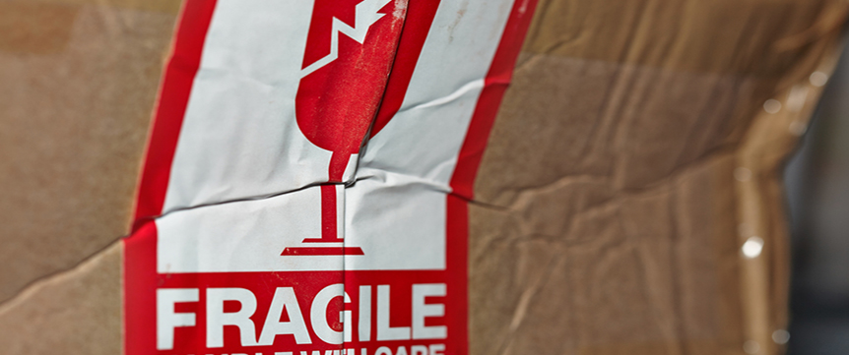
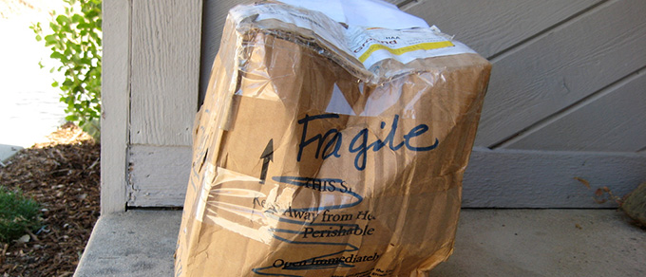
CARGO DAMAGE
DAMAGE AND LOSS BY OTHER CAUSES
(PRE-SHIPTMENT AND NON-FORTUITOUS LOSSES)

Slide 53
CARGO DAMAGE
DAMAGE AND LOSS BY OTHER CAUSES
( SHORT DELIVERY AND SHORT LANDING)
Goods may be short delivered in their containers, the term 'container' is used here in its wider sense, due to either short shipping or pilferage.
Surveyors will sometimes find upon investigation that there was enough space in the container for the quantity shown on the invoice or packing list , in which case the missing items could clearly never have been packed.
It is not uncommon for pilferage to occur before or during shipment and often careful investigation is necessary to determine, if possible, at which stage it did occur.

Slide 54
CARGO DAMAGE
DAMAGE AND LOSS BY OTHER CAUSES
( SHORT DELIVERY AND SHORT LANDING)
When time permits items can be removed from well-secured packing cases with almost no external evidence, or with evidence that can only be obtained by very careful and knowledgeable examination of the packing. Weight and space lost are often compensated by the substitution of other items such as bricks, newspaper or rubble.
Sealed containers are by no means free of pilferage, and surveyors, when they have the opportunity need to check seals for tampering and substitution.

Slide 55
CARGO DAMAGE
DAMAGE AND LOSS BY OTHER CAUSES
( SHORT DELIVERY AND SHORT LANDING)
Short landing of the entire packages can arise from pilferage, bur quite often by misplacement by carriers, due to incorrect stowage and discharge at the wrong port, often as the result of inadequate marking.
Efforts to trace them will usually be made by carriers who send enquiries, known as “tracers”, to their agents at other likely ports.
Efforts by surveyors in checking carriers premises, container depots, and port authorities stores will often produce results. Some port authorities send out regular lists of cargo remaining in their stores long after the departure of their carrying vessels and surveyors are advised to have themselves placed upon mailing lists for these lists where possible.

Slide 56
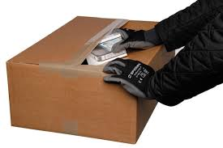
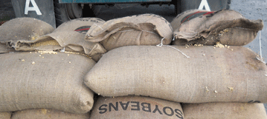
CARGO DAMAGE
DAMAGE AND LOSS BY OTHER CAUSES
( SHORT DELIVERY AND SHORT LANDING)

Slide 57
CARGO DAMAGE
DAMAGE AND LOSS BY OTHER CAUSES
(UNNEIGHBOURLY CARGOES)
Traditionally ship’s officers were very conscious of the often unfortunate effects of stowing unneighbourly cargoes together in a hold, i.e. tea with essential oils, but the lowering of standards at sea and the problems of container stowage by inexperienced persons has resulted in an increase of this type of contamination claims against carriers and consolidators.
Surveyors, when investigating this type of damage, will frequently be assisted if they obtain copies of ship and container manifests.

Slide 58
APPOINTMENT OF THE SURVEYOR
The surveyor appointed for the survey and report is required to determine the nature, extent and cause of the loss or damage, usually with two principal objectives in mind. They are :
To provide the facts and/or sound technical opinions in an impartial and unbiased manner so that a proper assessment of loss and liabilities can be made.
Represent the parry appointing him in the event that the facts indicate that he has a potential liability for the costs of making good the loss or damage or that he may have a case against another party.

Slide 59
APPOINTMENT OF THE SURVEYOR
In practice the surveyor, particularly if appointed by the underwriter and after assessing the loss or damage, may be required to go much further by investigating the liabilities of other parties and in so doing will then be seen more than ever as being the agent of the underwriter.
This however will be after the role of loss assessment has been completed and should not concern the assured with whom the surveyor will have previously acted with impartiality, since the further investigation will usually be required to establish the liability of the other parry.

Slide 60
PRINCIPLES OF SURVEYING AND REPORTING
THE NATURE OF DAMAGE AND LOSS
Most damage or loss falls within five distinct categories. It is either :
Mechanical - breakage or deformation
Organic - decomposition
Chemical - corrosion or change of state
Disappearance - pilferage or misplacing
Performance - failure to achieve

Slide 61
PRINCIPLES OF SURVEYING AND REPORTING
THE NATURE OF DAMAGE AND LOSS
One of the surveyor's principal roles is to establish and record, for the use of others, the cause of damage or loss so that the following can be considered :
Its mitigation
Its prevention in future
Who, if anyone, is responsible
Whether its direct or consequential costs are recoverable from any party i.e. as an insured peril under an insurance policy, as a breach of contract by a carrier, or as a tort on the part of a third party.

Slide 62
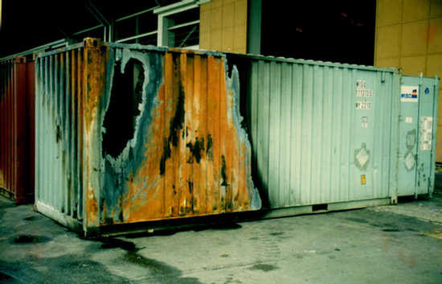
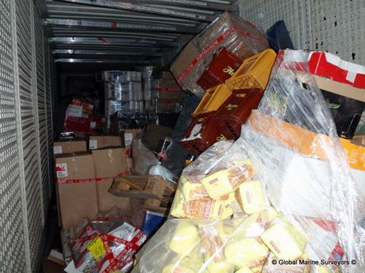
PRINCIPLES OF SURVEYING AND REPORTING
THE
NATURE OF DAMAGE AND LOSS

Slide 63
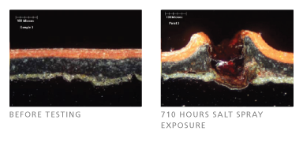
PRINCIPLES OF SURVEYING AND REPORTING
THE NATURE OF DAMAGE AND LOSS

Slide 64
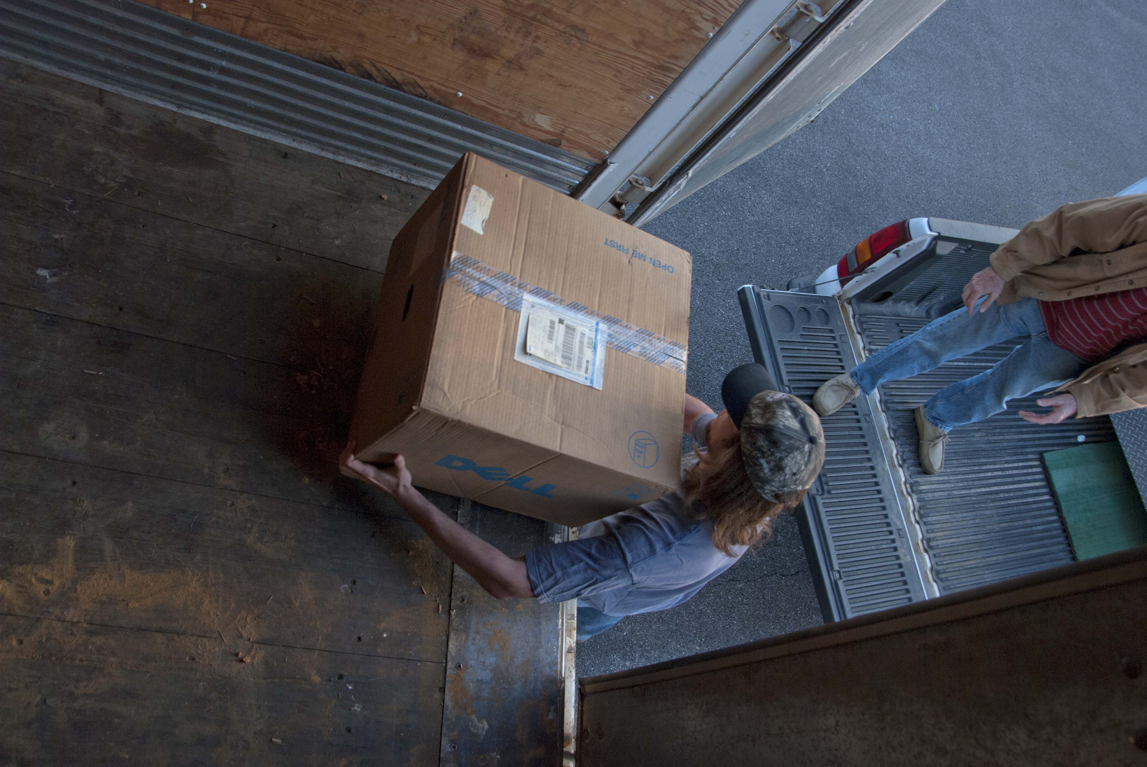
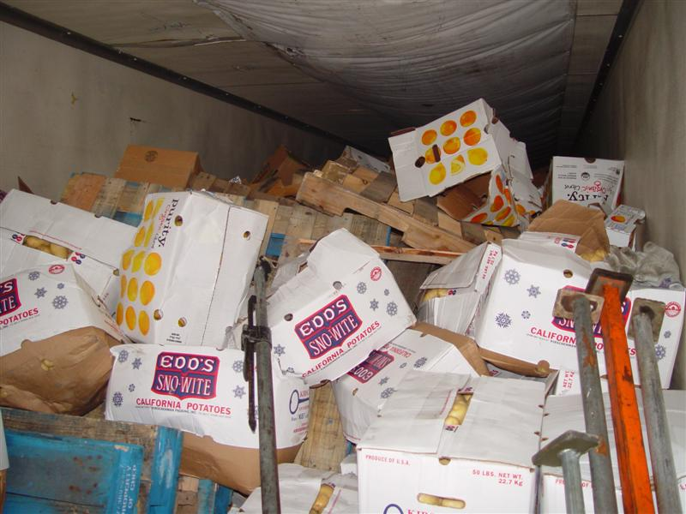
PRINCIPLES OF SURVEYING AND REPORTING
THE NATURE OF DAMAGE AND LOSS

