Slide 1

MARINE CARGO SURVEYORS TRAINING

Slide 2


DAY
THREE
OVERVIEW
In this day, the topics are about reporting principles and claims adjustments, and the role of the surveyor in them.
MATERIAL REFERENCES
Capt. C.B. Thompson, SURVEYING MARINE DAMAGE, Edited by Witherby Publishers.
R.A. Cady, MARINE SURVEY PRACTICE COMPENDIUM.

Slide 3

INDEX
I N D E X
PRINCIPLES OF SURVEYING AND REPORTING
DISTINCTION BETWEEN COMMERCIAL AND NON-COMERCIAL CLAIMS
APPENDIX B SURVERYOR EYE
EXAMINATION EXAMPLES
CASUALTY ENQUIRIES - SURVEY AND INVESTIGATION
SURVEYS AND REPORTS IN MARINE INSURANCE CLAIMS
CARGO CLAIMS
QUANTIFYING LOSSES
IMPORTANT STATEMENT IN REPORTS
REPORTS: CONTENTS
REPORTS: STANDARD FORMS
REPORTS ON-HIRE / OFF-HIRE
REPORT ON CONTAINER DAMAGE
REPORTS: CARGO CLAIMS
REPORTS:NARRATIVE REPORTS

Slide 4
INDEX
I N D E X
IV.MAYOR CASUALTIES
MAJOR CASUALTIES AT SURVEY
MAJOR CASUALTIES BEFORE THE SURVEYOR'S DEPARTURE
LOG BOOK AND OTHERS RECORDS
SALVAGE
EXTENSION OF THE SURVEYOR RESPONSABILITY
SURVEYS: DAMAGE TO ASSURE CRAFTS
SURVEYS: DAMAGE TO ASSURE CRAFTS REPAIR PROCEDURE
AVERAGE ADJUSTER

Slide 5


PRINCIPLES OF SURVEYING AND REPORTING
There are a number of fairly basic principles which relate to almost all surveys when the purpose of the survey is to examine and report upon ships and their cargoes.
These principles relate to the arrangements for examining the property the actual survey itself and the subsequent reporting of the surveyor findings.
These three elements are almost always present in all marine damage surveying and whether the subject of the survey be hull or cargo the essentials of the modus operandum are much the same.

Slide 6
PRINCIPLES OF SURVEYING AND REPORTING
THE PRIME OBJECTIVE OF MARINE DAMAGE SURVEYING
The majority of marine damage surveys are carried out for the purpose of pursuing or defending claims for liability be they under insurance policies or against other parties.
Many such surveys also have the objective of determining the extent of damage to property so that repair or reinstatement can be undertaken, and where appropriate, reimbursement made.

Slide 7
PRINCIPLES OF SURVEYING AND REPORTING
THE PRIME OBJECTIVE OF MARINE DAMAGE SURVEYING
Associated with these two requirements there is often also a requirement for the surveyor to advise on mitigation and future prevention of loss.
The liability usually arises under:
A contract of marine insurance
A contract of carriage
Tort

Slide 8
PRINCIPLES OF SURVEYING AND REPORTING
THE PRIME OBJECTIVE OF MARINE DAMAGE SURVEYING
Following a casualty resulting in damage to marine property there will frequently be grounds for considering the liability of a parry or parries, possibly in more than one of the mentioned categories.
To enable the property to be reinstated and the claims to be considered the damage will have to be surveyed, the survey being required to :
Determine the nature and circumstances and cause of the loss.
Quantify the loss.
Providing the survey and report to satisfy the above two requirements constitutes the fundamental role of the surveyor although there are usually secondary matters which receive his attention at the survey, subsequently.

Slide 9
PRINCIPLES OF SURVEYING AND REPORTING
ESTABLISHING A CLAIM
When a party suffer a loss or damage to its property and wishes lo have it replaced or repaired, it is that Party's own responsibility or that of its agent if the responsibility is delegated, to arrange it.
If the party then wishes to recover the costs from any party which may have a liability for them, carriers, third parties and or underwriters, this too is its responsibility to initiate.

Slide 10
PRINCIPLES OF SURVEYING AND REPORTING
ESTABLISHING A CLAIM
In attempting to recover these losses it is necessary for the party to establish the amount, the quantum, of that loss and that the party against whom it is claimed has a liability the onus, or burden, of proof falls upon the injured party to prove its loss and that the other party has the liability . It is then the responsibility of this other party if it can do so, to show that it does nor have that liability or if it does have some liability then possibly that the amount claimed is overstated.
This is a fundamental principle applicable to almost all claims which are made by one party against another for loss. With marine property it is usually a marine surveyor who is required to ascertain the facts from a survey which will be used as the basis for establishing the claim.

Slide 11
PRINCIPLES OF SURVEYING AND REPORTING
THE SURVEY
A survey should be approached with an open mind and with the object of taking four clearly defined steps during the survey itself.
Observe and listen
Record
Evaluate and analyze
Draw conclusions
The surveyor's attention to these aspects is usually confined to ascertaining the cause of the loss rather than any liabilities attached

Slide 12
DISTINCTION BETWEEN COMMERCIAL AND NON-COMERCIAL CLAIMS
The property insured the, insured interest, under marine insurance policies is either of a commercial or a non commercial, or private nature, and similarly with the liabilities that may also be covered under the policies.
In theory this should make little difference to the surveyor's approach to the task which is, traditionally, to carry out his investigations impartially and objectively. However in practice, since the underwriters tend to consider their liabilities under the two categories of claim slightly differently, there is perhaps a natural tendency for surveyors to do so and it might reasonably be said that most underwriters would wish them to adopt a slightly different approach to commercial and non commercial claims.

Slide 13
DISTINCTION BETWEEN COMMERCIAL AND NON-COMERCIAL CLAIMS
Commercial claims are nearly always concerned with a business enterprise having a profit motive. The claimants are professional people and they are expected to understand the operation of their businesses.
This is particularly so with ships and the larger cargo claims so that the surveyors can expect to be dealing with knowledgeable representatives of the operators and claimants.

Slide 14
DISTINCTION BETWEEN COMMERCIAL AND NON-COMERCIAL CLAIMS
with non commercial claims, principally household and personal effects claims and pleasure craft claims, the assured is rarely experienced and knowledgeable with regard to insurance or in the making good of their losses, and consequently underwriters tend to view his problems, in presenting his claim, more sympathetically.
This, in turn, tends to influence the surveyor's approach and a less rigid or “correct” procedure can often be quite acceptable with the surveyor often being seen as being more helpful towards the assured.

Slide 15
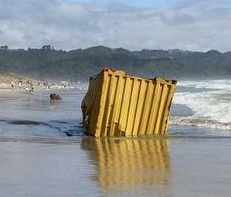
APPENDIX B
SURVERYOR EYE
IN THIS QUICK SECTION, OUR SURVEYORS TEST THEIR SKILLS FOR DETERMINATE DAMAGE EXTENSION AND REPORT IT

Slide 16

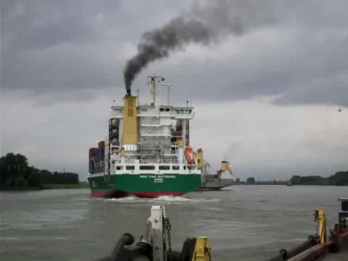
EXAMINATION
EXAMPLE #1

Slide 17
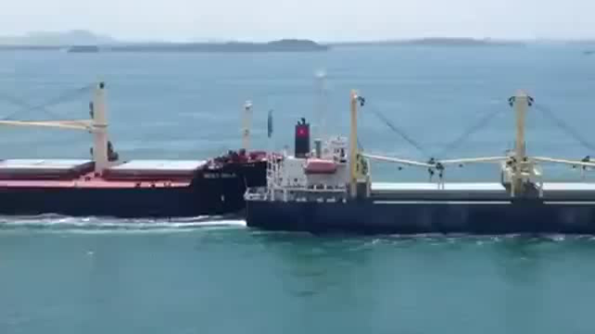
EXAMINATION
EXAMPLE #2

Slide 18
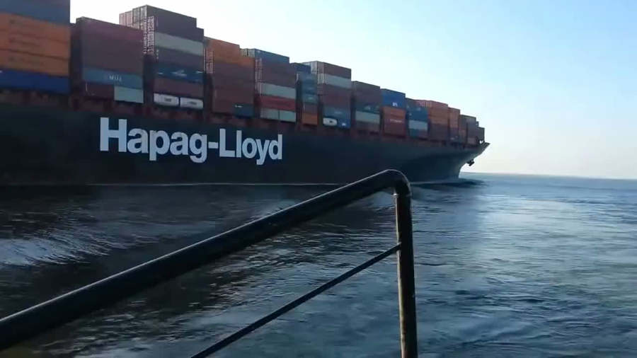
EXAMINATION
EXAMPLE #3

Slide 19
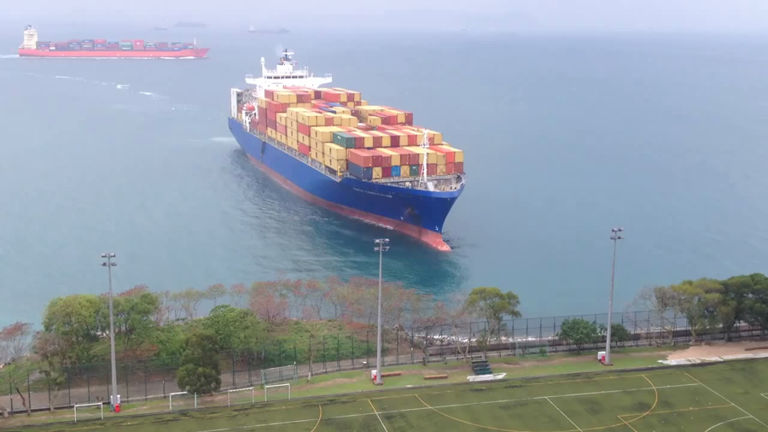
EXAMINATION
EXAMPLE #4

Slide 20
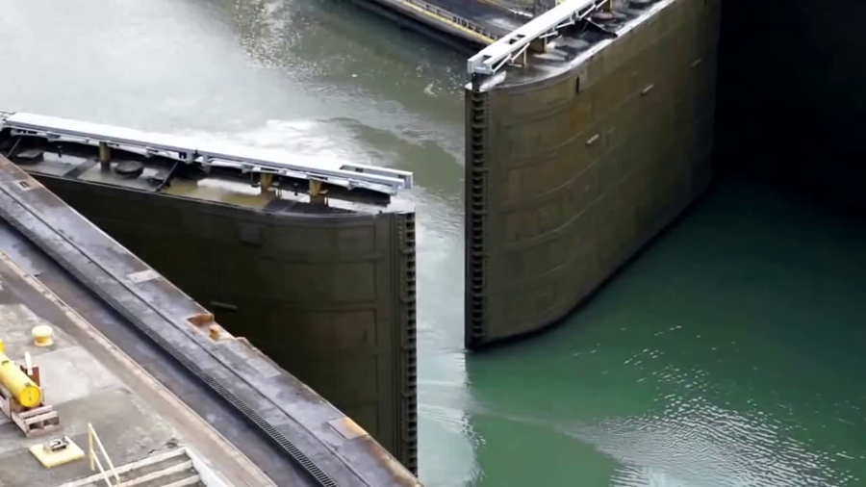
EXAMINATION
EXAMPLE #5

Slide 21
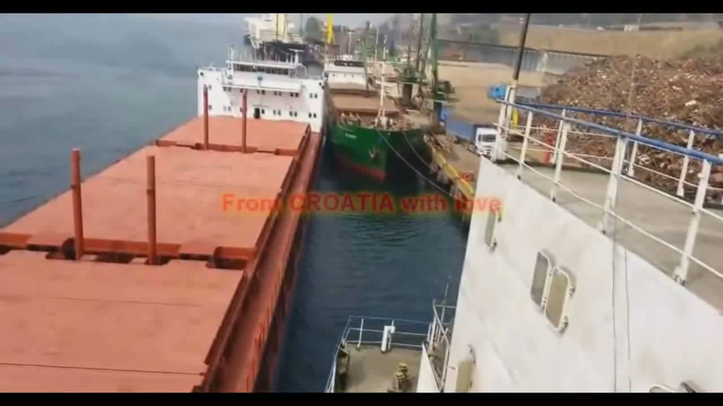
EXAMINATION
EXAMPLE #6

Slide 22
PRINCIPLES OF SURVEYING AND REPORTING
CASUALTY ENQUIRIES - SURVEY AND INVESTIGATION
An enquiry into any casualty involving property may have at least three facets, and it is frequently necessary to consider at least two of them in each case. They are :
to ascertain the nature, extent and cause of damage or loss
to determine who, if anyone, has a responsibility for meeting the cost of making good that damage or loss i.e. establishing liability
when there is a statutory requirement for the enquiry, to ascertain the facts to determine whether punitive steps should be taken against any of those involved.

Slide 23
SURVEYS AND REPORTS IN MARINE INSURANCE CLAIMS
There are now basically two different ways in which an underwriter may handle a claim.
The traditional procedure is to start by appointing a surveyor, following notification of a loss, to survey and report. This appointment may be by direct instructions from the underwriter, through the broker or may follow a survey request from a consignee to a survey agent such as a Lloyd's Agent.

Slide 24
SURVEYS AND REPORTS IN MARINE INSURANCE CLAIMS
The survey report will be received by the underwriter and unless the claim is a relatively small one the report will usually then be passed, in the case of a hull claim, to the appointed average adjuster or, if a cargo claim, to the underwriter's own claims adjuster. The role of these adjusters is to determine whether the claim is recoverable under the policy and, if so, then the amount of the settlement due to the assured.

Slide 25
SURVEYS AND REPORTS IN MARINE INSURANCE CLAIMS
If there are grounds for seeking a recovery against a third party the underwriter will usually then pass the documents to a lawyer, hull or cargo claims, or to a recovery agent, cargo claims only.
The alternative to the above procedures is for the underwriter, sometimes through the broker, at the outset. to appoint one firm, or occasionally an individual, to carry out the adjustment and often the third function of recovery agent.

Slide 26
CARGO CLAIMS
As has already been pointed out the surveyor appointment will generally follow the notification of loss or damage by an assured or consignee to an underwriter or to a survey agent. Occasionally a consignee will appoint a surveyor without reference to these parties if, he is not in possession of an insurance policy or certificate.
Assuming that he has been instructed to perform the traditional role and has not been specifically instructed to look after the underwriter's interests, his duties, will be very much the same whether appointed by consignee, survey agent or underwriter.

Slide 27
CARGO CLAIMS
If, the surveyor knows that in due course he will be required to adjust the claim or pursue recoveries he will probably make more extensive enquiries and give some thought to these later requirements at the time of survey, but otherwise they will not affect his conduct of the survey.
One of the surveyor's secondary roles is usually to advise the consignee on claims procedure if he needs it even though the latter should look primarily to his insurance broker, if he has one, or if the business is placed direct, to the underwriter, if he is a local one.

Slide 28
CARGO CLAIMS
If he is the consignee of, a CIF shipment he may not have a broker or an underwriter to whom he can turn but if the surveyor was appointed by a survey agent then this parry should be able to assist him.
The insurance certificate usually has a claims procedure clause in it and this should give the consignee much of the information that he requires.

Slide 29
CARGO CLAIMS
Whether to arrange survey upon first notification, or whether to await certain action being taken by the consignee, is for the surveyor's judgment in the circumstances. He must also judge whether to encourage or dissuade the consignee from taking any action with the goods prior to survey, particularly in the case where the surveyor may be unable to attend prompt survey himself.
However, he should not overlook the importance of giving the carrier or other third parry the opportunity of attending promptly if, he so wishes.

Slide 30
CARGO CLAIMS
As a general rule it must be said that it is always prudent and desirable to attend survey as soon as possible after the notification of the damage or loss because the consignee, apart from having a duty to mitigate the loss, also has a contractual responsibility under the policy to cake certain steps to claim against and endeavor to recover from the carrier or Bailee responsible.
A delayed survey however does not justify delay in making a pro-forma claim.

Slide 31
QUANTIFYING LOSSES
When goods are damaged and become the subject of a claim the extent of the loss has to be determined. This is usually done in one of two ways :
By considering the reasonable costs of repairs, refurbishing and generally reinstating them to sound condition.
By considering their loss of value, i.e. depreciation.
The former method is straightforward and generally these costs, if reasonable, will be recoverable from underwriters, subject to their admitting the claim under the policy.

Slide 32
QUANTIFYING LOSSES
Depreciation, however, may be more difficult to determine but it is basically the loss in value between what the goods would have been sold for at a given time in a sound condition and what they will sell for in damaged condition, assuming the market value not to have fluctuated in the intervening period.
If the surveyor is competent to place a value on the damaged goods, and if the consignee is satisfied as to his competence, then this method of determining depreciation may be the most satisfactory.

Slide 33
QUANTIFYING LOSSES
Whilst theoretically either of these latter two methods is sound, in practice they often do not recover the best price; this is particularly the case with auction. It may then be better to have the consignee offer the goods to his regular clients, or to other regular purchasers of, similar goods in a private sale, but before doing so the surveyor may wish to sound out the market himself, and perhaps then agree a suitable discount with the consignee for the sale to his customers.
Whatever alternative method of disposal is used, it may be prudent for the surveyor to take some active part in locating the best market for the sale, but it must be made clear that he is only doing so “without prejudice" and on behalf of the consignee with whom rests the final decision over the sale. The surveyor will have assisted by bringing together the parties to a possible sale, bur no more.

Slide 34
IMPORTANT STATEMENT IN REPORTS
For the surveyor to demonstrate to his principal that he has considered matters which concern a fair basis for a claim in the event of underwriters considering settlement with the assured, his report must include certain statements which certify essential facts.
Where they apply and are appropriate they are :
“In my opinion
(a) (i) The claimant has/has not taken proper steps to mitigate the loss.…
If he has not taken them then the report should recommend the steps which should be taken and give reasons why they have not been taken. The surveyor should also recommend steps which may assist in avoiding similar loss or damage in the future.

Slide 35
IMPORTANT STATEMENT IN REPORTS
(ii) The sound market value upon which the adjustment will be / has been made is realistic
(iii) The loss is attributable to the alleged cause of.....
(iv) The delay, if any, in reporting the claim to underwriters, and reason for it, did / did not result in aggravation of damage.
(b) If instructed to consider the liability under the policy :
(v) The claim does / does not fall within the terms and conditions of the policy
(c) If the claimant requests payment on his behalf to another party :
(vi) The name and address of the parry to whom settlement is to be forwarded on behalf of the assured.

Slide 36
REPORTS:
CONTENTS
Dates of exchanges of custody, receipts, surveys etc.
Condition of goods and packaging at exchanges of custody, the documentary evidence as to condition and whether the condition could have been expected to have been readily observable on delivery at destination.
Reasons for delays on the part of the claimant.
Condition of container seals.
Careful description of packaging, whether customary and whether considered suitable by surveyor, if not, his reasons.
The possibility of inherent vice.

Slide 37
REPORTS:
CONTENTS
Considerations of whether damage, was caused by conditions and events before or after transit. If the latter, reference should be made to conditions in the warehouse, store, etc.
Claimant’s efforts made to mitigate the loss.
Claims made on carriers.

Slide 38
REPORTS: STANDARD FORMS
REPRESENTATIVE

Slide 39
REPORTS ON-HIRE / OFF-HIRE
These reports are almost always in narrative form and should include :
Particulars of the vessel
Date and time of survey, berth and purpose.
Parties present
List and details of certificates sighted
Bunkers on board, Fuel oil and diesel oil
Condition of all relevant structures
Cleanliness of holds, To the extent required
Stores on board, by the survey
Other inventories.
In addition to stating the quantities of fuel a full schedule should be attached showing quantities in each tank, specific gravities, temperatures, list and trim. Stores and other inventories should also be detailed

Slide 40
REPORTS ON-HIRE / OFF-HIRE
The surveyor's comments should be factual and not opinion as to suitability, etc. The report should not contain general comment such as “poor condition” or “worn and unserviceable”.
All remarks relating to condition should be specific but the following types of remarks are acceptable :
"Scattered minor indents, heavily indented at ......"
"Number of frames corroded, approx...in number or approx. .....%, corroded." Detail severely wasted ones.
".....% of spar ceiling missing"
"Hatch beams, minor indents in many flanges and ..... in number flanges." Detail damage
Wire rope marks in coamings and beams may be ignored unless excessive with failure or deformation occurring

Slide 41
REPORT ON CONTAINER DAMAGE
For container surveys there is a choice of narrative, printed verbal or printed diagrammatic format, the latter two having much merit

Slide 42
REPORTS: CARGO CLAIMS
ADDENDUM TO SCHEDULE C No. Dated
Consignee:
Interest :
Vessel :
Arrived : Port and date.
THE LOSS
Details of the loss showing how it has been dealt with and, including any costs incurred by the consignee relating to it. The sound arrived value should also be stated here.
Signed
Surveyor.
Date :

Slide 43
REPORTS:
NARRATIVE REPORTS
Some claims do not lend themselves too readily to reporting on a standard form and for these the narrative report style is more suitable.
The writing of narrative reports requires surveyors to be well disciplined in their thinking and to stick to a set format as far as possible, using clear subject headings and locating all appropriate information in the paragraphs which have been "signposted".

Slide 44
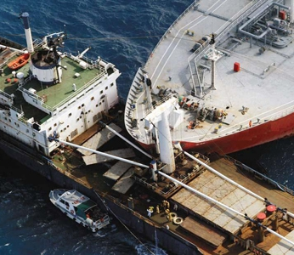
IV.
MAYOR CASUALTIES
THROUGH THIS SECTION, WE EXPLAIN THE ROLE OF THE SURVEYOR ON MAYOR CASUALTIES

Slide 45
MAJOR CASUALTIES
AT SURVEY
As soon as possible the surveyor should enquire the identity of other surveyors acting for the different parties. He should discuss aspects where they can work together and co-operate in areas where there is no conflict of interest but in which there may be a common need for information and for assistance in taking the best and quickest steps to mitigate the loss.
The surveyor’s role at the surveys will depend to a large extent upon the requirements of the party whom he represents but, assuming a role with cargo interests only; the following matters are some with which he is almost certain to be concerned.

Slide 46
MAJOR CASUALTIES
AT SURVEY
He may be required to determine the following:
The cause of the casualty.
Whether a general average has been declared or not, and if so, the grounds.
Whether the shipowner or charterer is abandoning the voyage, and the grounds.
Whether cargo is being on-carried in the same or another vessel in the same or different ownership or charterer.
Cargo on board at the time, some may have been discharged at an earlier port or earlier at the casualty scene or at the port at which the surveyor is attending or it may even have been jettisoned.
Cargo is damaged and the cause of damage.

Slide 47
MAJOR CASUALTIES
AT SURVEY
An estimate of the extent of damage under each bill of lading.
Liability of any parry
Consideration of mitigation of cargo damage
CIF values
What cargo has been jettisoned, lightered or warehoused.
Quantities of cargo damaged and cause if during discharge and reloading.

Slide 48
MAJOR CASUALTIES
BEFORE THE SURVEYOR'S DEPARTURE
As soon as possible the following documents should be obtained from the shipowner or charterer:
Cargo manifest
Stowage plan
Hatch stowage sheets
Container manifests
Specimen Bill of Lading, front and back
These documents will be valuable, almost essential, to the surveyor at the scene of the casualty and will subsequently assist identification of cargo and consignees.

Slide 49
LOG BOOK AND OTHERS RECORDS
Surveyor’s should sight log books if they are kept in a language which they understand and record relevant portions. In particular they are concerned with the recordings in the log of incidents which are related to the damage which they are to survey but they should usually refer back to the last dry docking date if relevant and note the period reviewed.
If any incidents occurred during the period they should be recorded too.

Slide 50
LOG BOOK AND OTHERS RECORDS
Other records of value are the class certificates and reports and on hire / offhire survey reports.
Copies should be attached to surveyor's reports where possible although there is a school of thought that considers that anything relevant from these documents should be stated in the report rather than be attached to it.
The practice of some surveyors of stating that reference should be made to the relevant log books or records if required, can cause considerable inconvenience where the ship is not easily contacted for these records and considerable delays can result in supporting a claim.

Slide 51
SALVAGE
"Salvage", as a legal concept, involves the saving of, marine property in strict conformity with a number of quite specific conditions. Essentially it is a voluntary act and is not performed under contract.
It is essentially carried out on "no cure no pay" terms and a voluntary salvor, if he is not otherwise rewarded after the successful conclusion of the salvage on a mutually acceptable basis, is entitled to apply, to the courts for their determination of an appropriate salvage award.
The parties may agree to resort to arbitration rather than to the courts and if the salvage is carried out under the terms of a Lloyd's open form this is always the case.

Slide 52
SALVAGE
SURVEYOR ROL
When instructed to enquire into either an ordinary cargo or hull claim, unless instructed to the contrary, a surveyor should always expect to approach his task with the assumption that the underwriter has not admitted liability and that he requires the facts to be established by the surveyor so as to enable him to consider his liability under the policy.
Hence the surveyor should make it clear that his survey is "without prejudice" until such time as the underwriter admits liability and, particularly if the damaged interest requires prompt attention so as mitigate the loss, he would advise the assured to act accordingly.

Slide 53
SALVAGE
SURVEYOR ROL
When instructed to enquire into either an ordinary cargo or hull claim, unless instructed to the contrary, a surveyor should always expect to approach his task with the assumption that the underwriter has not admitted liability and that he requires the facts to be established by the surveyor so as to enable him to consider his liability under the policy.
Hence the surveyor should make it clear that his survey is "without prejudice" until such time as the underwriter admits liability and, particularly if the damaged interest requires prompt attention so as mitigate the loss, he would advise the assured to act accordingly.

Slide 54
EXTENSION OF THE SURVEYOR RESPONSABILITY
The surveyor is concerned with the usual "nature, extent and cause“ but, unlike the commercial hull situation, the surveyor is likely to be expected to investigate the cause of the casualty himself at much greater length and not rely upon the claimant putting forth his own allegation surveyor's role. Provided the owner is satisfied, and provided there is no reason to doubt that the repair is satisfactory and the contract carried out with integrity the surveyor can be expected to approve the repair account if reasonable and consistent with the requirement.
If the surveyor becomes too deeply involved in arrange repairs for an owner, he tends to imply that this is his responsibility. Whilst he may assist he should make his position quite clear. This is particularly important in the case of a pleasure craft owner who may all too readily assume that once a surveyor takes an interest in a loss his insurer has accepted the claim and that all repairs carried out on the craft will be paid for by the insurer.

Slide 55
EXTENSION OF THE SURVEYOR RESPONSABILITY
One view of this matter is that the underwriters are not paying for a repair. They are indemnifying the assured for the reasonable costs of repair. The extension of this view is that the surveyor approval of the repair account is an approval of the amount of the account and that the approval should not be seen by either the assured, the repairer or the underwriter as being an approval of the standard of workmanship.
Whether this attitude can be fully supported where the surveyor holds himself out to be competent in the field of boat building is perhaps debatable, but surveyors would be wise never to state, nor even give the impression, that they are accepting any responsibility for overseeing the standard of the work being carried out unless this has been clearly understood at the time of his appointment as being included in his role.

Slide 56
SURVEYS: DAMAGE TO ASSURE CRAFTS
SURVEY PROCEDURE
The surveyors role is essentially that of considering the nature, extent and cause of damage, and agreeing the reasonable cost of repairs. He would use his experience to make recommendations but is it not his role to arrange for the repairs. The contract is between the owner and the repairer.
Ideally most surveys should be carried out with the owner, or his representative, and the repairer present so that the owner can make his submissions and can agree any repair recommendations made by the surveyor and discussed by him with the repairer .
He can then instruct the repairs to be carried out. Surveys carried out with only one of the parties to the contract being present require that the information be later conveyed to the missing party with the risk that, with second hand information, possible omission of important points can arise.

Slide 57
SURVEYS: DAMAGE TO ASSURE CRAFTS
SURVEY PROCEDURE
The owner should always nominate the repairer but advice may be offered cautiously by the surveyor on the choice of a satisfactory repairer. The surveyor should positively advise an owner against an unsuitable repairer, the underwriter has the right to veto under institute Yacht clauses in the same manner as under Institute Time clauses, but otherwise the choice of repairer is essentially that of the owner.
Full determination of the repair work to be carried out can often not be made at first survey as there may be a need for the damaged area to be opened up for a fuller examination. A second survey will often be necessary or possibly the extent of repairs may be then agreed by telephone if the repairer has the confidence of the surveyor. This information has then to be relayed back to the owner that he can specifically instruct the repairer.

Slide 58
SURVEYS: DAMAGE TO ASSURE CRAFTS
SURVEY PROCEDURE
Repairers and owners need to clearly understand that the surveyor appointed by the underwriters does not act as an agent of the owner and that he acts “without prejudice” to underwriter's liability. It is for the surveyor to make this clear to them.

Slide 59
SURVEYS: DAMAGE TO ASSURE CRAFTS
REPAIR PROCEDURE
The extent of the surveyor's involvement can vary considerably and this is largely determined by his instructions. In some cases surveyors may only be required to carry out the necessary survey and specify the appropriate repairs to make good any casualty damage.
Such a survey may take place in the presence of the owner and a repairer but in some cases one or both may be absent and the surveyor will rely heavily upon his own observations and knowledge in detailing the damage and in drawing up a recommended repair specification.

Slide 60
AVERAGE ADJUSTER
The surveyor in commercial hull claims is invariably an expert in his own field and the average adjuster likewise. The two functions are quite separate and there would be few who practice in either field who would claim to have more than a passing acquaintance with the others duties.
In relatively straight forward and non-contentious particular average claims the underwriter's own claims adjuster may adjust the claim following receipt of the surveyor’s report but more often than not the average adjuster will have been appointed by the shipowner and will be responsible for the adjustment, in some cases the underwriter may appoint the average adjuster but this is less common.

Slide 61
AVERAGE ADJUSTER
Thus there is generally a need for a good working relationship between the surveyor and the adjuster and it can be very helpful to the latter if the former has some knowledge and understanding of the adjustment role and of how the information provided by the surveyor will be used by the adjuster.
There is no doubt that if the surveyor does understand what the adjuster needs to know and why, and the form in which he needs it, then the surveyor can foresee what the adjuster is likely to require in a particular situation and provide it in his report in anticipation of that need rather than belatedly after further correspondence.

Slide 62
AVERAGE ADJUSTER
The adjuster has, at the start, to determine the same two basic points that have been considered in the chapter on cargo claims, namely:
Whether a liability attaches to the policy.
What is the quantum of that liability?
The first is dependent upon the causes of the casualty and the circumstances surrounding it so that the surveyor should have stated the claimant's allegation and his concurrence in his report, together with the dates and situation in which the casualty occurred.

Slide 63
AVERAGE ADJUSTER
The first part of the adjuster task may be relatively straight forward but the second part is often complex as he has to examine the costs incurred by the claimant in making good the loss. This often requires a detailed analysis of the costs and it is in doing this that the adjuster may have to call upon the surveyor to provide considerable detail and explanation.
The principle is exactly the same in hull claims although different factors influence whether there is justification for considering these costs as part of the recoverable claim. In commercial hull but not pleasure craft claims, air freight will often be justified. Overtime, depending upon the reason for it being incurred, will also often be acceptable in hull claims and it is this type of consideration that confronts the adjuster over a number of charges.

