Slide 1

MARINE CARGO SURVEYORS TRAINING

Slide 2


DAY
FOUR
OVERVIEW
In this day, the topics are about chartering , time chartering and adjustments with heavy lift appendix.
REFERENCE MATERIALS
J. Bes, Chartering and Shipping Terms: volumen 1 & 2, published by Baker & Howard Ltd
Capt. C.B. Thompson, SURVEYING MARINE DAMAGE, Edited by Witherby Publishers.

Slide 3

INDEX
I N D E X
V. CHARTTERING
TYPES OF CHARTERING
VOYAGE CHARTERING
MANNERS OF VOYAGE CHARTERING
CHARACTERISTICS OF VOYAGE CHARTERING
TIME CHARTERING
CHARACTERISTICS OF TIME CHARTERING
DISTINCT FEATURES OF VOYAGE AND TIME CHARTERING
TIME CHARTERING ON TRIP BASIS
COA (CONTRACT OF AFFREIGHTMENT)
CHARACTERISTICS OF A CONTRACT OF AFFREIGHTMENT
DIFERENCES OF A CONTRACT OF AFFREIGHTMENT
BAREBOAT CHARTERING
DISTINCTIVE FEATURES OF TIME CHARTERING AND BAREBOAT CHARTERING
CHARTER CHAINS
CHARTERING PARTICIPATORS
CHARTERER
SHIPOWNER
DISPONENT OWNER
CHARTERING BROKER
THE ROLE OF A CHARTERING BROKER

Slide 4
INDEX
I N D E X
NUMBER OF CHARTERING BROKERS INVOLVED
REMUNERATION OF A CHARTERING BROKER
INTERNATIONAL BROKERS COMISSION CONTRACT
DESCRIPTION OF THE VESSELS AND CARGOE
VESSEL’S DIMENSIONS
VESSEL’S TONNAGES
VESSEL’S CUBIC CAPACITY
CLASSIFICATION OF VESSEL
VESSEL’S NATIONALITY
TYPE OF VESSELS
DESCRIPTION OF CARGO
THE COMMODITIES TRADED BY SEA
BULK SHIPPING
GENERAL CARGO
STANDARD CHARTER PARTY FORMS
THE DEVELOPMENT OF STANDARD CHARTER PARTY FORMS
TYPES OF STANDARD CHARTER PARTY FORMS
GENERAL ASPECTS OF THE STANDARD CHARTER PARTY FORMS
STANDARD CHARTER PARTY FORMS
ADVANTAGES OF USING STANDARD CHARTER PARTY FORMS
CLASSIFICATION OF CONTRACTUAL TERMS

Slide 5
INDEX
I N D E X
PRINCIPLES OF INTERPRETATION OF CHARTER PARTY
CHARTER MARKET
CHARACTERISTICS OF THE CHARTER MARKET
INFLUENCE FACTORS OF THE CHARTER MARKET
CLASSIFICATIONS OF THE CHARTER MARKET
COMPARISON OF LINER AND CHARTERED SHIPPING
LINER SERVICE
CHARTERING AND LINER
ASSOCIATED SHIPPING ORGANIZATIONS

Slide 6
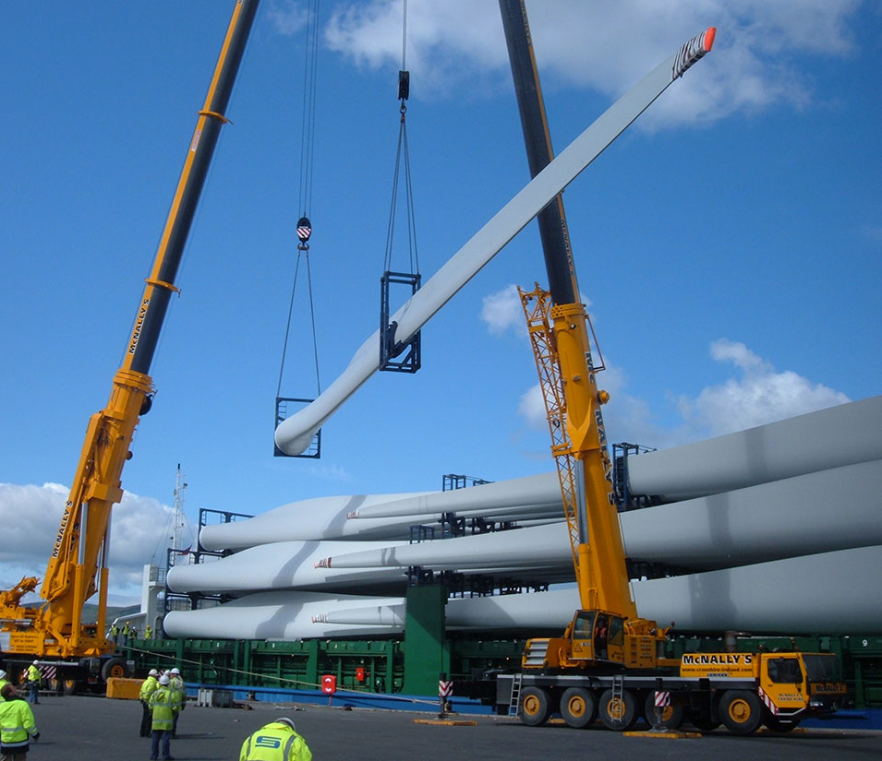
V.
CHARTTERING

Slide 7
Chartering
Chartering is an activity within the shipping industry. In some cases a charterer may own cargo and employ a shipbroker to find a ship to deliver the cargo for a certain price, called freight rate.
Freight rates may be on a per-ton basis over a certain route or alternatively may be expressed in terms of a total sum - normally in U.S. dollars - per day for the agreed duration of the charter.

Slide 8
Chartering
A charterer may also be a party without a cargo who takes a vessel on charter for a specified period from the owner and then trades the ship to carry cargoes at a profit above the hire rate, or even makes a profit in a rising market by re-letting the ship out to other charterers.
Depending on the type of ship and the type of charter, normally a standard contract form called a charter party is used to record the exact rate, duration and terms agreed between the shipowner and the charterer.

Slide 9
Types of chartering
Voyage chartering
Time chartering
Time charter on trip basis (TCT)
Contract of affreightment (COA)
Bareboat chartering

Slide 10
Voyage chartering
Meaning
The voyage chartering means that the ship-owner promises to carry on board a specific ship a particular cargo for a single voyage from one or more loading ports to one or more discharging ports.
The payment is called freight and the contract is called a voyage charter party. Voyage charters are concluded between the shipowner or disponent owner and the charterer. The person who charters the ship is known as voyage charterer. The person who charters out his ship is known as shipowner or disponent owner.
Usually this form of contract is selected when the charterer has no experience in the operation of ship or he has just one consignment of cargo needed to be transported from one place to the other.

Slide 11
Voyage chartering
Costs
Under a voyage charter, the shipowner retains the operational control of the vessel and is responsible for all the operating expenses such as port charges, bunkers, vessel’s insurance, taxes, etc.
The charterer’s costs are usually costs and charges relating to the cargo.
Loading and discharging costs are divided between the ship-owner and the charterer in accordance with the agreement from case to case.

Slide 12
Voyage chartering
Contents
A voyage charter party shall mainly contain the names of the parties, the name and nationality of the ship, its deadweight and bale or grain capacity, description of the goods to be loaded, port of loading and discharge, laydays, time for loading and discharge, payment of freight, demurrage, despatch and other relevant matters.

Slide 13
Voyage chartering
Forms
There are more standard forms of voyage charter party than any other form of contract of carriage.
The Uniform General Charter code name GENCON is the most popular and widely used general purpose voyage charter party on a global basis for all kinds of trades and for numerous types of cargoes.
When used these forms are likely to have several additional clauses attached to cover eventualities not covered by the printed clauses.

Slide 14
Manners of Voyage Chartering
Single Voyage Chartering
Return Voyage Chartering
Consecutive Single Voyage Chartering
Consecutive Return Voyage Chartering

Slide 15
CHARACTERISTICS of Voyage Chartering
Specific vessel, specific cargo, specific port and specific route.
Rights, duties and responsibilities of ship-owners and charterers are determined by the charter party.
The charterer should be responsible for the arrangement of the cargo, payment of freight calculated according to the quantity of the cargo loaded or carried and other expenses concerned.
The shipowner possesses and controls the vessel and takes charge of the operation of the vessel and the manning and management of crew.

Slide 16
CHARACTERISTICS of Voyage Chartering
The shipowner should bear the operational expenses of the vessel.
The payment by the charterer to the shipowner for chartered vessel is usually called freight instead of hire.
The ship-owner charters out the whole vessel or part of her space to the charterer.
There are the provisions for the laytime, demurrage and dispatch.

Slide 17
TIME Chartering
Meaning
The time chartering means that the ship-owner provides a designated manned ship to the charterer, and the charterer employs the ship for a specific period against payment of hire instead of for a certain number of voyages or trips. Time charter generally does not include loading and unloading costs in the charter rate.
Period
A single voyage
Several months or years

Slide 18
TIME Chartering
Reasons
The time charterer may be a shipowner who for a time needs to enlarge his fleet or a cargo owner with a continuous need for transport, who does not want to invest money in a ship but wants to have the control of the commercial operation of the vessel. The charterer may be a speculator taking a position in anticipation of a change in the market
Costs
The charterer is liable for costs directly connected with the use of the vessel, for example, bunker costs and port charges and pays for the loading and discharging. Under a time charter the crew is employed by the shipowner, who is also responsible for the nautical operation and maintenance of the vessel and supervision of the cargo.

Slide 19
TIME Chartering
Forms
Although considerably fewer in number than the wide choice available for voyage chartering, there is an adequate number of time forms for use in the time chartering business.
The two major forms are NYPE and BALTIME. When used these forms are likely to have several additional clauses attached to cover eventualities not covered by the printed clauses.
By far the largest number of time chartering are fixed on the basis of the NYPE Charter Party.

Slide 20
Characteristics of TIME Chartering
The shipowner should be responsible for the manning of crew and bears the wages and provisions thereof.
The master shall be under the orders and directions of the charterer as regards employment and agency. If the charterer shall have reasonable cause to be dissatisfied with the conduct of the master or officers, the ship-owner shall on receiving the complaint make a change in the appointments, if necessary.

Slide 21
Characteristics of TIME Chartering
The charterer should be responsible for the operation of the vessel and bear the variable operational costs such as bunkers, port charges, handling charge and canal tolls etc.
The shipowner should bear the fixed operational costs such as costs relating to the vessel capital, ship’s maintenance and stores, insurance premium and so on.
The ship is chartered as a whole/part and the hire is calculated and collected according to the duration of chartering and the agreed hire rate.
There are the provisions for the delivery/redelivery of vessel.

Slide 22
Distinct features of voyage and TIME Chartering
Use of ship
Voyage C/P, use vessel for one voyages
Time C/P, use vessel for period of time
Operation
Voyage C/P, the actual operation of the vessel is left to the shipowner.
Time C/P, the actual operation of the vessel is left to the charterer.
Operating costs
Voyage C/P, are borne by the shipowner.
Time C/P, are borne by the charterer

Slide 23
Distinct features of voyage and TIME Chartering
Remuneration
Voyage C/P, freight is fixed in proportion to cargo quantity
Time C/P, hire is fixed in proportion to the time occupied.
The risk of loss of time
Voyage C/P in principle borne by the shipowner
Time C/P is normally for the charterer’s account.

Slide 24
TIME CHARTERING ON TRIP BASIS
TCT means that the charterers employ vessels on a time charter basis for the period of a specific voyage and for the carriage of a specific cargo and this practice has given rise to the term time charter on trip basis: TCT.
TCT is similar to voyage chartering with regard to the fact that the intention of the parties is to employ the vessel for one or two voyages. The period of TCT is depend on the voyage and not fixed as time chartering. There the similarity ends and the roles of charterer and ship-owner are identical to those assumed for time charter.
There are no charter party forms designed purely for trip charters, and trip chartering is negotiated and basis on standard time charter forms and adapted slightly where appropriate.
The important feature of the time charter is still there, the charterer has to pay hire according to the time spent in performance of the voyage.

Slide 25
TIME CHARTERING ON TRIP BASIS
TCT means that the charterers employ vessels on a time charter basis for the period of a specific voyage and for the carriage of a specific cargo and this practice has given rise to the term time charter on trip basis: TCT.
TCT is similar to voyage chartering with regard to the fact that the intention of the parties is to employ the vessel for one or two voyages. The period of TCT is depend on the voyage and not fixed as time chartering. There the similarity ends and the roles of charterer and ship-owner are identical to those assumed for time charter.
There are no charter party forms designed purely for trip charters, and trip chartering is negotiated and basis on standard time charter forms and adapted slightly where appropriate.

Slide 26
TIME CHARTERING ON TRIP BASIS
The important feature of the time charter is still there, the charterer has to pay hire according to the time spent in performance of the voyage.
A time charter on trip basis is the simplest form of time charter. During the time the vessel is on charter the owner is paid an agreed daily rate, for example $20,000 a day. The vessel is directed by the charterer, who tells it where to load cargo, and where to discharge it. The advantage of the TCT is that it allows the charterer to provide greater flexibility than a voyage charter under which the contract involves the transport of a specific cargo.

Slide 27
COA (CONTRACT OF AFFREIGHTMENT)
Meaning
Contract of affreightment is a generic term which covers all contracts for the carriage of goods by sea ( both charter parties and bills of lading are contracts of affreightment).
It is also used in a more limited sense when it means a contract, by which the shipowner promises to satisfy the charterer’s need for transport capacity over a certain period of time, often one year or several years.

Slide 28
COA (CONTRACT OF AFFREIGHTMENT)
The advantage of such a contract to the shipowner is that security of employment is obtained for his vessel for duration of the contract, especially valuable if the shipowner considers that freight rates are about to fall.
But the charterers may also be able to obtain financial advantage (security of transportation) in the event that market freight rates rise once they have committed shipowner or operator on the contract.

Slide 29
CHARACTERISTICS OF A CONTRACT OF AFFREIGHTMENT
Contract of affreightment can often be related to voyage charter.
The length of the chartering period lies on the total quantity of cargo to be transported
Cargoes carried under COA are usually bulky dry/liquid cargoes
The risk of delay in sailing should be borne by the shipowner
The freight should be calculated based on the quantity of cargo
The partition of cost of loading and/or discharge is usually as same as that of voyage chartering.

Slide 30
DIFERENCES OF A CONTRACT OF AFFREIGHTMENT
At first glance a consecutive voyage contract and a contract of affreightment may appear to be almost identical but the vital difference is that the first is based around a named vessel whereas the latter is based around the cargo.
Should the named vessel become a total loss the contract would end because the contract become frustrated and the shipowner would not be under any further obligation to the charterer. In the second case it may be that the shipowner had intended to carry the cargo in his own vessel even though he had the option to use any vessel. If his vessel becomes a total loss he could not terminate the contract and would be obliged to charter in tonnage to fulfil his contract with the charterer.

Slide 31
BAREBOAT CHARTERING
Meaning
The bareboat chartering is a charter of a different type. This contract amounts to a lease of the ship from the shipowner to the charterer.
The bareboat chartering ordinarily means that the vessel is put at the disposal of the charterer for a long period employment without any crew.
The charterer thus will take over almost all of the shipowner’s functions except for the payment of capital cost. This means that the charterer will have the commercial as well as the technical responsibility for the vessel and will pay for maintenance, crew costs and insurance, etc.

Slide 32
BAREBOAT CHARTERING
REASON
Bareboat chartering is less common than other types of contract.
It is sometimes used where a shipowner or ship operator wishes to operate ships or to supplement his fleet for a period of time without incurring the financial commitments of actual ownership, but at the same time requires to have full control of the chartered vessel, including control of its navigation and management.
Further, bareboat chartering is sometime employed in connection with the financial arrangements for purchase of the vessel on installment terms. The bareboat charter then serves as a hire/purchase contract, by which the shipowner/seller retains formal ownership and thereby security in the vessel until the full purchase price is paid.

Slide 33
BAREBOAT CHARTERING
FORM
There is only one standard form of bareboat charter party used to any great extent and that is the BARECON form designed by BIMCO.
A close examination of this form will show up the fact that there are a number of clauses, which are commonly found in time charter parties. In particular the clauses relating to delivery, canceling, trading limits, surveys, inspections, hire, redelivery, general average, war, commission and law and arbitration would be equally effective if used in a time charter party.

Slide 34
DISTINCTIVE FEATURES OF TIME CHARTERING AND BAREBOAT CHARTERING
A time charter is distinguished from a bareboat charter by the employment of the master and crew. With a time charter the master and crew remain the employees of the shipowner, although they will be subject to the directions of the time charterer.
The time charterer therefore does not take possession of the vessel. With a bareboat charter the master and crew are employed by the charterer, therefore he takes possession of the vessel.

Slide 35

CHARTER CHAINS
RIGHT OF SUB-LETTING
It is customary to stipulate in both voyage and time charter parties that the charterer has the right of sub-letting the whole or part of the vessel, subject to the charterer remaining responsible to the shipowner for the due fulfillment of the original charter party.
This right is of considerable importance to the charterer since it gives him a certain freedom to utilize the vessel in the way that is most economical to him. Sub-letting frequently occurs in practice;

Slide 36
CHARTER CHAINS
REASONS FOR SUB LETTING
The charterer may have chartered the vessel for the sole purpose of making a profit by re-chartering or otherwise sub-letting it;
The charterer may find that the cargo which he intended to ship is not available or, alternatively, that he is not in a position to utilize the vessel for the original intended purpose, in which case he will seek other employment for it in order to be covered for the freight which he is due to pay the shipowner;
The charterer may also find, because of a rise in freight market rates, that it is more profitable for him to re-charter the vessel than to utilize it in the way originally intended.
A vessel may at the same time be involved in several different contracts. The following example illustrates such a chain.

Slide 37
CHARTER CHAINS
A is the registered or real owner of the vessel. Since he is only interested in investing money in shipping, he may have made a bareboat charter with B.
B, in his turn, has time chartered the ship to C. In the relation B/C, B is act as a disponent owner, while C is the time charterer.
C in his turn has chartered the vessel to D under a voyage charter. In the relationship C/D, C is the time chartered owner, and D is the voyage charterer.

Slide 38
CHARTER CHAINS
POSITION
It is common that such charter chains exist, and it is important that each party makes clear his respective position when something happens. The action of each party must be based on the contract in which he is involved. It is also important for a charterer negotiating a sub-charter to be careful and take into consideration the framework set by his charter with the shipowner.
An important factor from a practical point of view which can lead to complications is the use of bills of lading. This may involve one or several of the parties directly in relation to the owner of cargo or consignees. The connected questions will be discussed later.

Slide 39
CHARTERING PARTICIPATORS
CHARTERER
SHIPOWNER
CHARTERING BROKERS

Slide 40



CHARTERER
Meaning
The person entering into the charter party with the shipowner is known as the charterer who in search of vacant cargo space for transporting his commodity.
Kinds of charterers
Individuals operating small corporations
Major international trading-houses
The owner of the goods to be carried.

Slide 41
CHARTERER
Kinds of charterers
The seller or the buyer of a commodity.
Intermediary between buyer and seller(third party)
Shipowners/NVOCC/MTO
Forwarders

Slide 42




SHIPOWNER
MEANING
The person entering into the charter party with the charterer is known as the shipowner or owner who owns or operate ships.
KINDS OF SHIPOWNERS
Some owners are of a single ship, others of large fleets. Some concentrate on ships of a particular type or size. Many ships are owned, in the legal sense, by financial institutions. This is usually because the ships are being purchased under a hire purchase arrangement. Some shipowners are state-controlled or run their ships under the flag of the country in which they reside, while others operate ships under a ‘convenient’ flag.

Slide 43
DISPONENT OWNER
Operators who employ a ship and then re-employ that vessel for further business chartering her out in a new role are described as disponent owners or time charter owners.
A disponent owner is a party deemed to be the shipowner having control of the vessel by time charter.
We have seen that from time to time the party acting as the “owner” may, in fact be the “disponent owner” such as the party who has the ship on time charter. Occasionally there may be more than one link in the chain between the actual shipowner and the disponent owner involved in the immediate fixture.

Slide 44
CHARTERING BROKER
CONCEPT
The individuals or corporations who identify supply and demand for ships and cargoes and thereby help the main-players to secure cargoes for their ships and ships for their cargoes are called shipbrokers or chartering brokers.
The existence of chartering brokers greatly facilitates the speed and efficiency of the chartering process. The task of the chartering broker is to provide expertise and information at the time these are required by his clients. The expertise takes the form of a knowledge and understanding of ships and trades that enables him to meld the two to the mutual satisfaction of shipowner and charterer.

Slide 45

THE ROLE OF A CHARTERING BROKER
The chartering broker should keep both the shipowner and the charterer continuously informed about the market situation and the market development, about available cargo proposals and shipment possibilities.
The chartering broker should in all respects work loyally for his principal and should carry out the task of negotiations and other work connected with the charter scrupulously and skillfully.
The chartering broker should act strictly within given authorities in connection with the negotiations and they have no authority to quote q ship or a cargo, unless duly authorized by their principals.
The chartering broker may not withhold any information from his principal or give him wrong information.

Slide 46
NUMBER OF CHARTERING BROKERS INVOLVED
A typical deep-sea dry cargo fixture will involve at least two chartering brokers - one representing the shipowner, the other representing the charterer.
Sometimes there will be more brokers in the chain.
Whereas it is comparatively unusual for just one chartering broker to be employed on a deep-sea dry cargo fixture, for short-sea and some specialized trades occasionally only one chartering broker will be engaged between two principals.

Slide 47
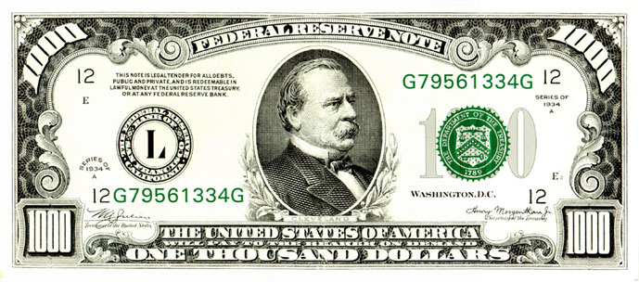
REMUNERATION OF A CHARTERING BROKER
The chartering broker’s income is in the form of the reward of commission or brokerage paid for a successful introduction and negotiation between shipowner and charterer leading to a fixture.
Even after hard work and expense, a negotiation that does not lead to a fixture will normally result in no payment of any kind to the broker in the middle. This is the shipping practice.

Slide 48
REMUNERATION OF A CHARTERING BROKER
Unless otherwise expressly agreed, commission is payable only on freight or hire earned and paid; it is customary in a voyage charter for this to be extended by agreement to allow commission to be payable on deadfreight and/or demurrage, if any. On time charter similarly it can be extended to a ballast bonus.
In chartering it is the usual (though not invariable) practice for a commission clause to appear in the contract (the charterparty) and the commission is customarily payable by the shipowner to the charterer's broker as well as to the owner's broker.

Slide 49
INTERNATIONAL BROKERS COMISSION CONTRACT
In order to protect the broker interests The Federation of National Associations of Ship Brokers and Agents (FONASBA) published an international brokers commission contract which was recommended by BIMCO.
NOW IT IS HEREBY AGREED AS FOLLOWS:
1. The Owner shall pay commission to or otherwise remunerate the Broker:
(Delete as appropriate)
(a) In accordance with the relevant provisions of the Charter Party.
(b) As follows_________________________________________
2. Any dispute arising out of this Contract shall be referred to Arbitration at _____________________and shall be subject to the law and procedures applicable there.
For and on behalf of For and on behalf of
(Owner) (Broker)

Slide 50
DESCRIPTION OF THE VESSELS AND CARGOE
Description of the Vessels
Dimensions
Tonnages
Cubic capacity
Classification
Nationality
Types of ships
Description of the Cargoes
Commodities traded by sea, Bulk cargo , General cargo

Slide 51
DESCRIPTION OF THE VESSELS
Description of the vessel is one of the most important items in a charter party. The need for the description of the vessel in the charter party very much depends on the circumstances. The type of cargo and the intended ports and sea-ways especially determine what details about the vessel must be mentioned during the negotiations and in the charter party.
Normally the vessel’s name, dimensions, year of build, flag of nationality, deadweight, gross and net tonnage, cargo capacity, number of hatches, type of hatch covering and length and breadth of hatch openings, and sometime the speed and bunker consumption (time chartering and bareboat chartering) are stated in the charter party.

Slide 52
VESSEL’S DIMENSIONS
For chartering purpose, we need to know the size and dimensions of ships. The most important dimensions of vessel are vessel’s length, beam, and draft.
Vessel’s length is, as the name suggests, the length of the vessel measured from the extremes fore and aft, which be expressed in terms of LOA (Length Overall).
Vessel’s beam is the breadth of the ship measured at the widest part of the hull, which be expressed in terms of BM (Breadth Molded).
Vessel’s draft is the distance from the waterline to the bottom of the keel. For chartering purposes it is usual to refer to the draft of the vessel when loaded to her maximum summer deadweight. The draft will determine whether a ship can get into a particular port, or transit a particular channel. The draught, of course, will vary with the amount of cargo, fuel etc, aboard at any one time.

Slide 53
VESSEL’S TONNAGES
The specification of the vessel’s tonnage is important, and it can be described in several ways such as the deadweight (DWT), summer deadweight (SDWT), deadweight all told (DWAT) and deadweight cargo capacity (DWCC). Gross Tonnage (GT), Net Tonnage (NT).

Slide 54
VESSEL’S CUBIC CAPACITY
The vessel’s cubic capacity is usually stated both in grain capacity and in bale capacity. The grain capacity, which is always bigger than the bale capacity, measured in either cubic feet or cubic meters. It is the total volume of cargo space contained inside the hull including also those parts of the cargo holds that can be filled out with floating cargo, such as grain, phosphates, etc.
The bale capacity is the volume of a vessels holds to carry packaged dry cargo such as bales, pallets, boxes, cartons etc. The bale capacity is therefore the grain capacity less any space unusable for such cargoes. The vessel’s cubic capacity is very important figures for the vessel loaded light cargoes.

Slide 55
CLASSIFICATION OF VESSEL
Classification of vessel in the charter party is applied to ensure the seaworthiness of the carrying vessel, because classification of a vessel could serve as the index indicating the technology condition of the vessel recognized by relative departments of inspection e.g. ship’s classification societies.

Slide 56
VESSEL’S NATIONALITY
The nationality of a vessel is demonstrated through its flag hoisting. It represents the relation between the vessel and the flag state.
All ships must be registered to one of the nations of the world in order that responsibility for violations of international law and convention may be assigned. These ships then fall under the jurisdiction of their nation of registry. Shipping concerns adopted the practice of shopping around for nations that would give them the best deal on taxes, wages, and legal restrictions.
They "conveniently" register their ships with these countries which include Liberia, Panama, Honduras, the Bahamas, and operate ships under a convenient flag.

Slide 57
TYPE OF VESSELS
Dry Bulk Carrier (Capesize, Panamax, Handymax, Handysize)
General Cargo Ship
Tanker (VLCC, ULCC)
Container Ship (TEU)
Other Ships

Slide 58
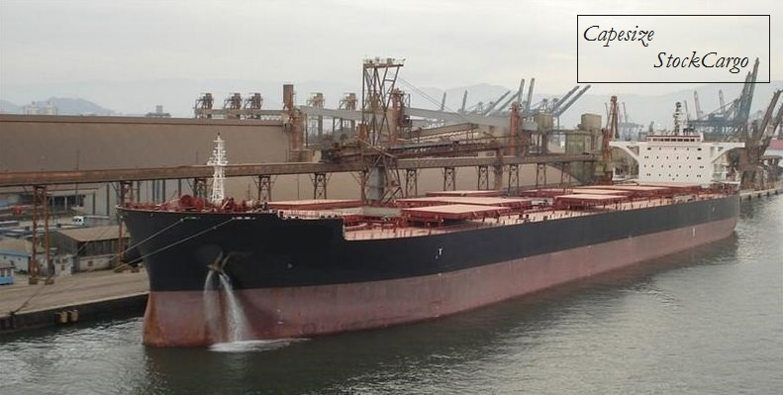

Slide 59
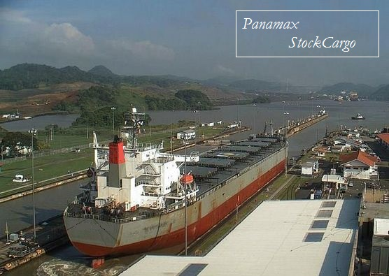

Slide 60
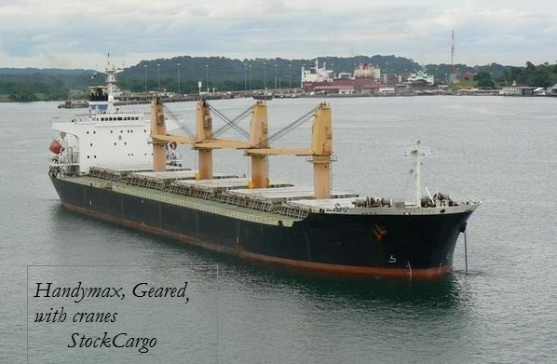

Slide 61
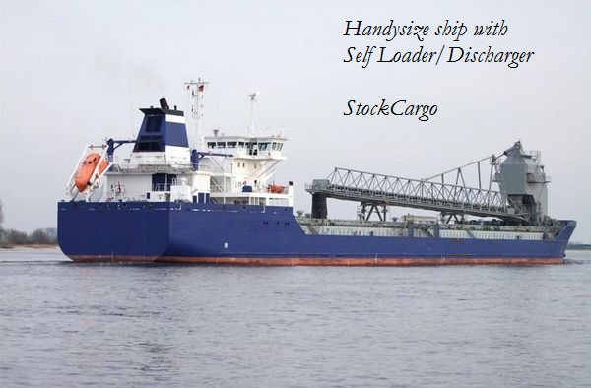

Slide 62
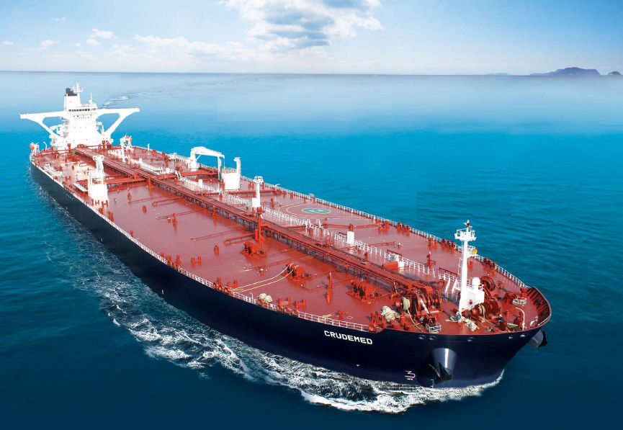
1504 ft and 226 ft 564,763 tons ULCC

Slide 63
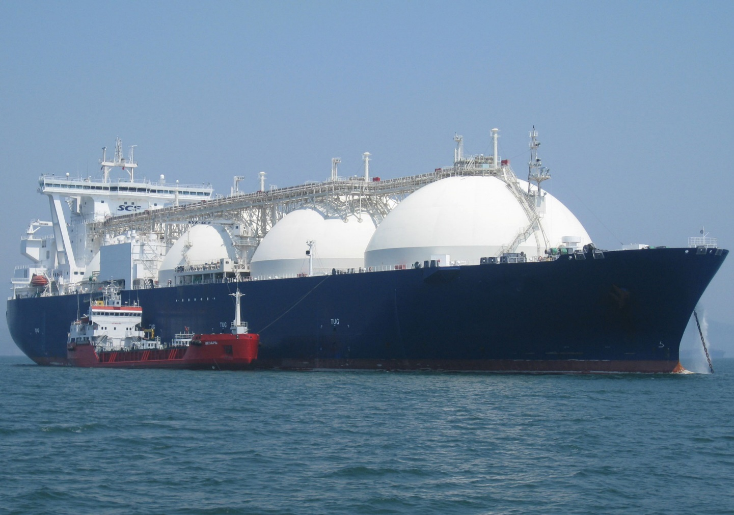

Slide 64
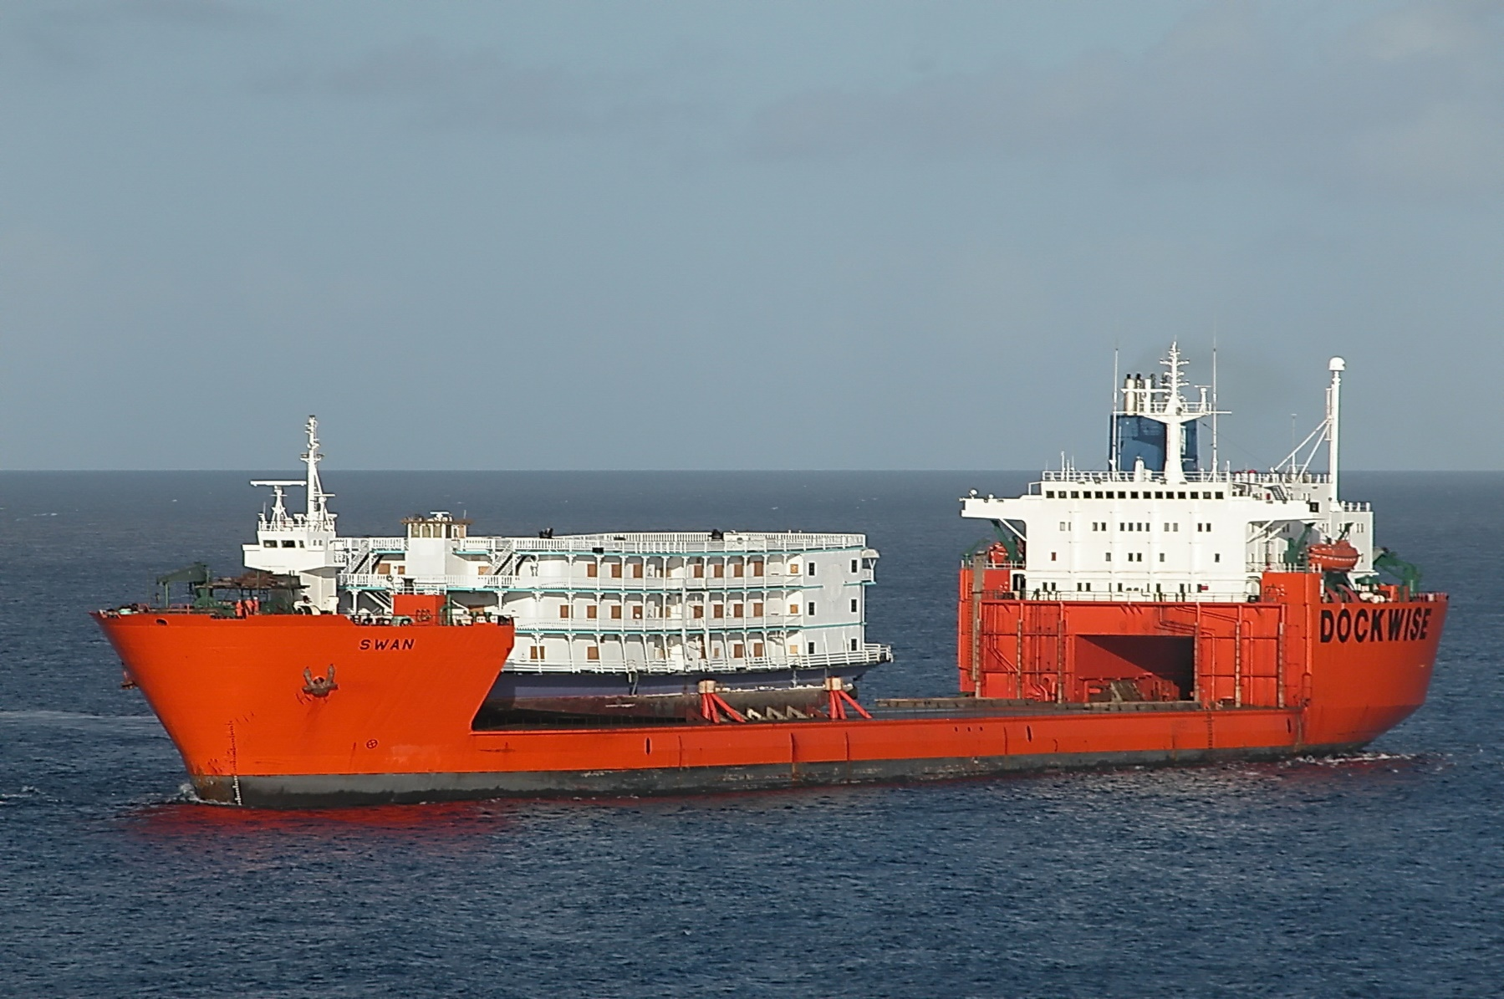

Slide 65
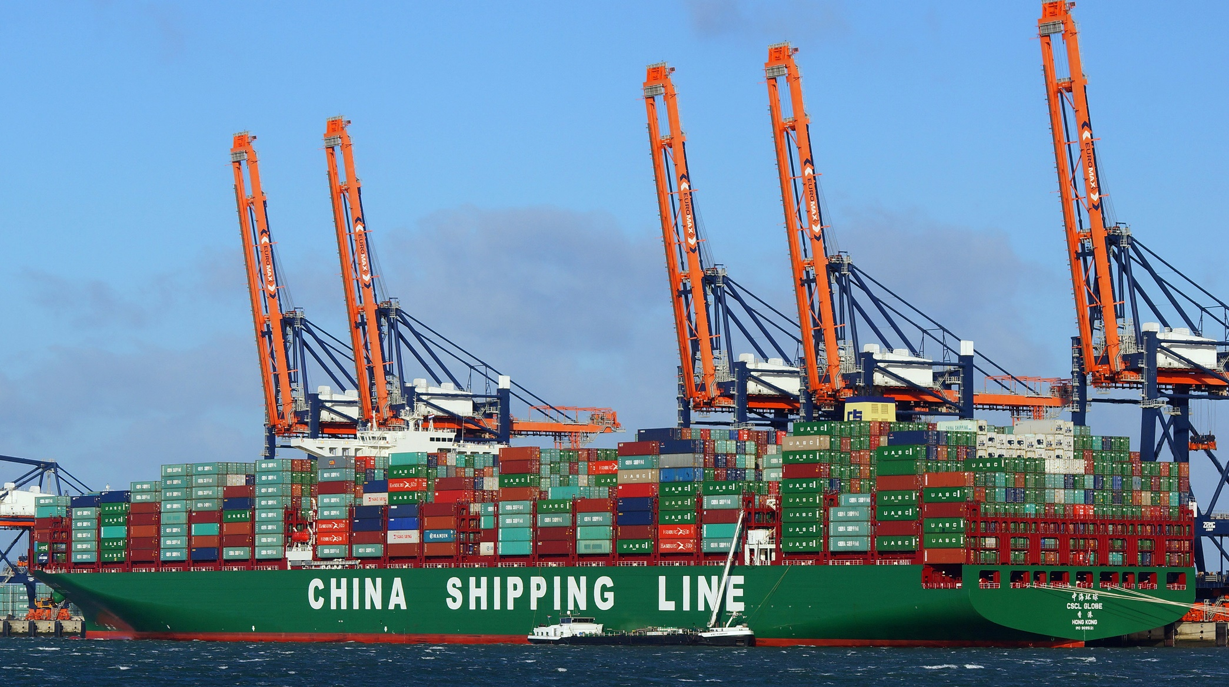

Slide 66
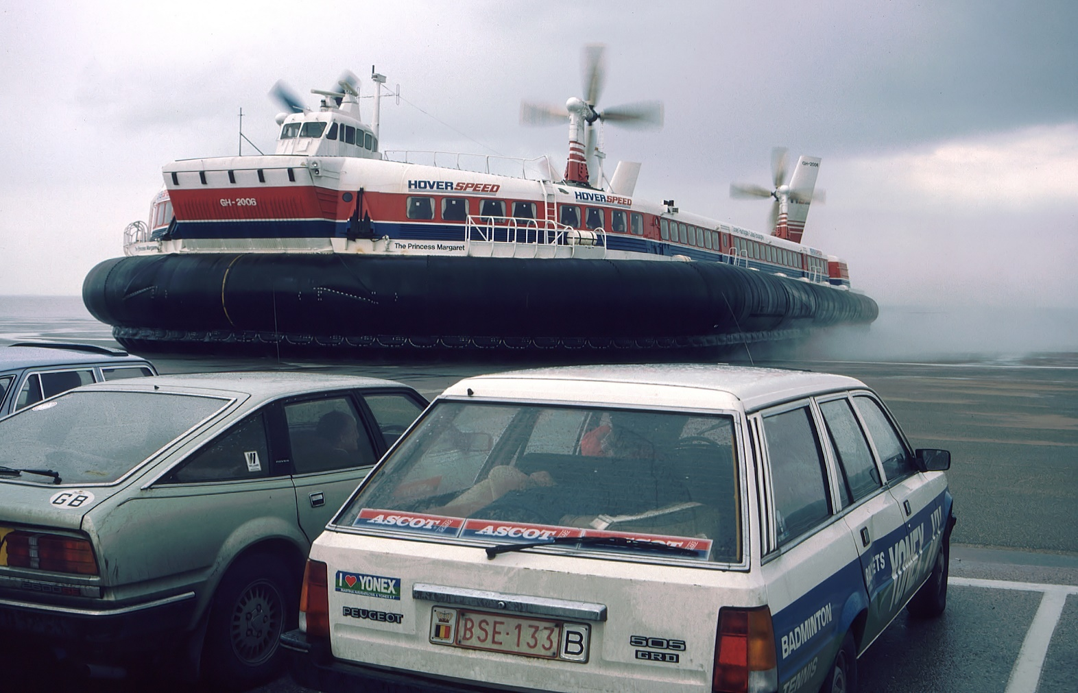

Slide 67
Description of cargo
The basis of the very existence of maritime transport is the cargo. Over 90% of world trade is carried by the international shipping industry. The maritime transportation industry is fundamental to international trade. Without shipping the import and export of goods on the scale necessary for the modern world would not be possible.
According to the form in which the cargoes are transported, cargoes may be classified bulk cargoes and general cargoes. Further more, the bulk cargo can be classified dry bulk cargoes and wet bulk cargoes. Chartering business mainly deal with this kind of cargoes.

Slide 68
The commodities traded by sea
Energy Trades
Agricultural Trades
Metal Industry Trades
Forest Products Trades
Other Industrial Materials
Other Manufactures

Slide 69
BULK SHIPPING
Dry Bulk Cargo
Dry bulk cargoes are used by many industries such as manufacturing and construction and are divided into major bulk commodities and minor bulk commodities. Major bulks consist of iron ore, coal and grain. Minor bulks cover a wide variety of commodities, such as forest products, iron and steel products, fertilizers, agricultural products, ores, minerals and petcoke, bauxite and alumina, cement, other construction materials and salt
Liquid Bulk Cargo
Crude oil and oil products vegetable and animal oils, wine, chemicals, etc.

Slide 70
GENERAL CARGO
General cargo refers to the commodities that are shipped wholly or partly by liner in accordance with the parcel size distribution function. The transport of general cargo is a very different business.
General cargo consists of consignments of less than ship or hold size and, therefore, too small to justify setting up a bulk shipping operation.
In addition there are often high-value or delicate cargoes that require special shipping service and for which the shipper requires a fixed tariff rather than a fluctuating market rate.
General cargoes usually loaded into containers and are carried by the container ships.

Slide 71
STANDARD CHARTER PARTY
FORMS
The economics of chartering business not only depend on the rates, but also on the transport terms and conditions stipulated in the relevant charter parties. In order to simplify negotiations between the parties, these charter parties are based on standard forms contract forms designed and published by international bodies containing specific clauses for a given trade.
Charter party forms are perhaps one of the most important facilitators of trade and transport. They are an essential tool for sea trading and the avoidance of disputes between the two parties that are involved, and they can be tailored to virtually every kind of trade or ship-type.

Slide 72
THE DEVELOPMENT OF STANDARD CHARTER PARTY FORMS
It was in the nineteenth century that shipowners and charterers first concerned themselves with the drafting of standard charter party forms. Such forms were originally drafted and employed by individual contracting parties, but joint action was later undertaken by groups of shipowners and charterers. An early development began with parties involved in chartering in particular trades co-operating on the joint issue of agreed documents.
BIMCO

Slide 73
TYPES OF STANDARD CHARTER PARTY FORMS
The international bodies have issued or approved a great number of charter party forms many of which are so-called standard charter party form, as they result from negotiations between charterer and shipper interests, on the one hand, and shipowner interests, on the other. These are generally referred to as “official” forms that they have been inspected and passed by an authoritative body.
A further type of standard charter party form is so-called “private” form, which is issued and employed by individual firms, usually charterers enjoying more or less of a monopoly in a particular trade and therefore in a position generally to impose their own form on the shipowner. Such private forms, of which there exist a great number, are common in, for example, the ore, fertilizer and oil trades.

Slide 74
GENERAL ASPECTS OF THE STANDARD CHARTER PARTY FORMS
The charter party is the written charter agreement. It contains all the terms and conditions which govern the relationship between the shipowner and charterer. Several charter parties have a code name, often printed at the top of the form. The clauses are numbered and sometimes every line is numbered, this is the case with, e.g., Gencon Form.
In the modern charter party forms the box layout system is used, which means that the written agreement is divided into two main parts, the box part with all specifications for the relevant vessel and the voyage, and the text part with all the printed clauses.
In most cases the charter party also has a third part, the rider and addenda, where additional, photocopied standard clauses or typewritten clauses are inserted by the parties if they think necessary.

Slide 75
STANDARD CHARTER PARTY FORMS
Name | Date | Code name | Publisher
Uniform General | 1922,1976,1994 | GENCON | BIMCO
North American Grain | 1973(amended 1989) | NORGRAIN 89 | ASBA
Uniform Time Charter | 1939(amended 1974) | BALTIME | BIMCO
New York Produce Exchange T/C | 1993 | NYPE 93 | ASBA
Standard Bareboat | 2001 | BARECON | BIMCO

Slide 76
ADVANTAGES OF USING STANDARD CHARTER PARTY FORMS
To standardize clauses.
To simplify the negotiation.
To reach international uniformity.
To reduce the risk of misunderstanding and disputes arising in respect of the matters covered by the contract.

Slide 77
CLASSIFICATION OF CONTRACTUAL TERMS
In determining whether the innocent party has the right to treat the contract as discharged it seems that regard must first be had to the nature of the contractual term that has been breached.
For this purpose the breached term may be placed in one of three categories, namely conditions, warranties and intermediate terms.

Slide 78
CLASSIFICATION OF CONTRACTUAL TERMS
CONDITION
A condition in this context is a term of the contract that is of such important that any breach of it will entitled the innocent party to treat the whole contract as discharged.
-Where the obligation is designated as a condition in a statute.
-Where the obligation is specifically designated in the contract as a condition.
-Where the obligation has been held to be a condition in another case.
-Where the supposed intention of the parties, as indicated from the terms and general background of the contract, so indicate.

Slide 79
CLASSIFICATION OF CONTRACTUAL TERMS
WARRANTIES
A warranty in this context is a term of the contract of such minor importance that no breach of it will entitle the innocent party to treat the whole contract as discharged. For breach of such a term the innocent party can make only a claim for damages.
The following express terms are usually held to be warranties; maintenance of vessel; redelivery of vessel; size of bunkers; vessel’s speed.

Slide 80
CLASSIFICATION OF CONTRACTUAL TERMS
INTERMEDIATE TERMS
Any term of the contract which cannot be classified as a condition or a warranty will be classified as an intermediate term.
Whether a breach of such a term does or does not entitle the innocent party to treat the contract as discharged depends on the nature and consequences of the particular breach that has occurred.
The court will enquire whether the event resulting has the effect of depriving the other party of substantially the whole benefit which it was the intention of the parties that he should obtain from the contract. If the event has this effect, The innocent party may treat the contract as discharged; otherwise he can make only a claim for damages.

Slide 81
PRINCIPLES OF INTERPRETATION OF CHARTER PARTY
Courts and arbitrators may apply various principles or methods in their interpretation.
The primary consideration in construing any contract is the intention of the contracting parties. Thus, a charter party must be construed in the light of the particular undertaking with which it is concerned.
One interpretation principles is generally considered to be that clauses hinged to stamped on or typewritten into the charter party will apply before the printed original text. In this cases the written, stamped on or typed clause should usually prevail, as clearly expressing the intention of the parties.

Slide 82
PRINCIPLES OF INTERPRETATION OF CHARTER PARTY
Where both clauses are printed or both typewritten, a clause specifically designed to deal with a limited range of circumstances will, so far as concerns matters falling within that range, prevail over a clause of general application.
Another principle that may be applied is that imprecise and ambiguous wording will be construed against the party who furnished the provision.

Slide 83
PRINCIPLES OF INTERPRETATION OF CHARTER PARTY
The rule of interpretation know as the “ejusdem generis” rule is often applied. That is to say, general words which are tacked on to specific words are to be construed as referring only to things or circumstances of the same kind as those described by the specific words. The ejusdem generis rule may be excluded by apt words in the document.
The words must be construed in their ordinary meaning, but technical words must be given their technical meaning. Where the words are capable of two constructions, the reasonable construction is to be preferred as representing the presumed intention of the parties.

Slide 84
CHARTER MARKET
Meaning of chartering market
The chartering market is a definite geographical area where demand and supply of tramp services are confronted with each other and a price of transport is established.

Slide 85
CHARACTERISTICS OF THE CHARTER MARKET
The charter markets are highly competitive
The charter market is complex and often volatile
Tramp shipping has relatively few barriers to entry .
Information systems in bulk shipping business are very open
Trade growth is influenced by the world business cycle and is very volatile and unpredictable.

Slide 86
INFLUENCE FACTORS OF THE CHARTER MARKET
Fleet supply
Commodity demand
Seasonal pressures
Bunker prices
Choke points

Slide 87
CLASSIFICATIONS OF THE CHARTER MARKET
According to ship type and size and to particular commodities
dry cargo market, heavy-lift market, reefer market, tanker market.
The chartering market is divided by length of charter
the short-term “spot” market ------ voyage charters or trip time charters.
the longer-term “period” market -------- consecutive voyage charters ; time charters and long-term bareboat charters.
Area
the Baltic Mercantile and Shipping Exchange in London Market
N.Y. Maritime Exchange in New York Market
North Europe Market Asian Markets including Tokyo, Hong Kong and Shanghai and Singapore.

Slide 88
CLASSIFICATIONS OF THE CHARTER MARKET
Area
the Baltic Mercantile and Shipping Exchange in London Market
N.Y. Maritime Exchange in New York Market
North Europe Market Asian Markets including Tokyo, Hong Kong and Shanghai and Singapore.

Slide 89
Comparison of liner and chartered shipping
Merchant shipping, considered from the standpoint of types of service provided, may be divided into two major categories: Liner Service and Tramp Shipping.
While there are some similarities, the differences in the theory and techniques of management of these two types of marine transportation are notable. The service rendered, the geographic area covered, the operating problems, the relationship between vessel owner and vessel user, and the actual employment of the ship, vary markedly between the two categories.

Slide 90
Liner Service
Liner shipping is to provide regular services between specified ports according to time-tables and prices advertised well in advance. The service is, in principle, open to all shippers and in this sense it resembles a public transportation service.
Liners are common carriers, required by law to accept without discrimination between offerers any legal cargo which the ship is able to transport.
Goods carried in liner-service ships usually are of higher value than the cargo hauled in tramps, and are charged higher freight rates.
A liner-service company issues a standard (or uniform) contract of carriage or bill of lading.
Freight rates in the liner-service are stabilized by setting identical charges for all shippers of the same item aboard a certain ship.
Carrier’s liability follows the principle of tackle to tackle.

Slide 91
Liner Service
CHARTERING
Sailings are based on cargo commitments that vary with the vessel’s employment, and are usually different for every voyage.
Tramps are contract (private) carriers, and normally carry full shiploads of a single commodity, usually in bulk.
Cargoes carried in tramps generally are those which can be transported in bulk and have low intrinsic value.
The owner of tramp ship must negotiate separate contract for each employment of his vessel, and the terms of the charter party vary from ship to ship, depending upon the bargaining abilities of shipowner and charterer, and the general trend of the market.
Freight rates for tramps vary according to the supply of and demand for ships. Rates and services are determined by negotiation between shipowner and charterer, and reflect the specific requirements of the contracting parties.

Slide 92
Cost elements in chartering and Liner
Bareboat charter
Time charter
Voyage charter
Master appointed &
directed by charterer
Master appointed by
owner, directed by charterer
Master appointed and
directed by owner
Revenue depends on:
Hire rate & duration
Revenue depends on:
Hire rate & duration
Revenue depends on:
Quantity of cargo & rate
Costs paid by owner:
Capital Capital Capital
Brokerage
Costs paid by owner:
Brokerage
Wages
Provisions
Maintenance
Repairs
Stores & supplies
Lube oil
Water
Insurance
Overheads
Costs paid by owner :
Brokerage Wages
Provisions Maintenance
Repairs Stores & supplies
Lube oil Water
Insurance Overheads
Port charges
Stevadoring charges
Cleaning holds
Cargo claims Light dues
Canal dues Bunker fuel

Slide 93
Associated Shipping Organizations
1. United Nations International Maritime Organization (IMO)
2. The International Chamber of Shipping (ICS)
3. The International Association of Dry Cargo Shipowners (INTERCARGO)
4. The International Association of Independent Tanker Owners (INTERTANKO)
5. The Baltic and International Maritime Council (BIMCO)
6. The Federation of National Associations of Ship Brokers and Agents (FONASBA)

