Slide 1

MARINE CARGO SURVEYORS TRAINING

Slide 2


DAY
FIVE
OVERVIEW
In this day, the topics discussed are about dangerous goods stowage and handling, chartering glossary and lashing introduction.
REFERENCE MATERIALS
International Maritime Organization, IMDG Code 2014: International Maritime Dangerous Goods Code, Incorporating Amendment 37-14, published by International Maritime Organization
J. Bes, Chartering and Shipping Terms: v. 1 & 2, published by Barker & Howard Ltd; 9th edition

Slide 3

INDEX
I N D E X
VI. A) ADJUSTMENTS
GUIDANCE OF CLAIMS ADJUSTMENTS
RULES
MEASURE OF INDEMNITY
REASONABLE COSTS OF REPAIRS
SEPARATE VALUES
THEFT, BURGLARY
HULL OR MACHINERY?
VI. b)THE SURVEYOR IN DISPUTE RESOLUTION
LITIGATION AND ARBITRATION
COURT PROCEDURES THE ORDER OF EVENTS
ADJUSTMENTS AND RECOVERIES IN MARINE INSURANCE CLAIMS
ALL RELEVANT ISSUES ABOUT ADJUSTMENTS
ALTERNATIVE ADJUSTMENTS BASED ON ESTIMATED DEPRECIATION
ALTERNATIVE ADJUSTMENTS BASED UPON THE INVOICE VALUE
ALTERNATIVE ADJUSTMENTS SALVAGE LOSS ADJUSTMENTS
RATES AND EXCHANGE
RATES AND EXCHANGE OVERSEAS POLICIES
RATES AND EXCHANGE CUSTOM DUTY

Slide 4
INDEX
I N D E X
QUANTIFYING CLAIMS
QUANTIFYING CLAIMS CLAIMS ON CARRIERS
QUANTIFYING CLAIMS RECOVERIES FROM CARRIERS BEFORE SETTLEMENT BY UNDERWRITERS
QUANTIFYING CLAIMS RECOVERIES FROM CARRIERS BEFORE SETTLEMENT BY UNDERWRITERS
QUANTIFYING CLAIMS CLAIMS ON UNDERWRITERS
RECOVERIES SURVEYORS COSTS RECOVERABLE AGAINST CARRIERS AND THIRD PARTIES
RECOVERIES CARRIERS’ LIABILITY
RECOVERIES TIME BARS
RECOVERIES PAYMENT FOR RECOVERIES
VIII. DANGEROUS GOODS
VII. CHARTERING GLOSARY
GENERAL EXPRESSIONS
SHIPPING TERMS
TONNAGE OF SHIPS
TYPES OF SHIPS
TONNAGE OF SHIPS

Slide 5
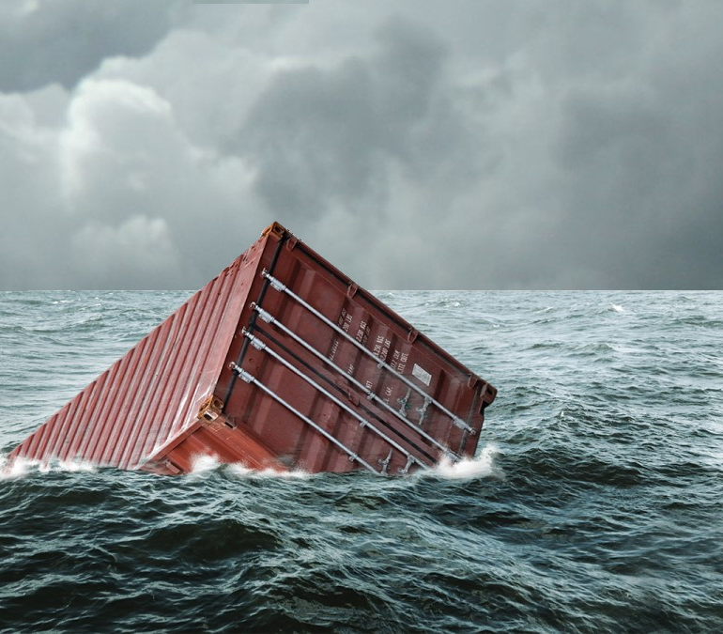
VI. a)
ADJUSTMENTS

Slide 6

GUIDANCE OF CLAIMS ADJUSTMENTS
As had earlier been cautioned the surveyor should generally await underwriters decision concerning his fundamental liability under the policy before attempting to submit an adjustment of the claim which may require consideration of which particular costs are, or are not, recoverable.
A policy may be quite specific on a point and it may be an easy matter to consider whether a particular cost attaches to a policy or not. But there is no such simple solution on many points connected with repairs for which the Marine Insurance Act provides that those costs recoverable are for "the reasonable costs of repairs".

Slide 7
GUIDANCE OF CLAIMS ADJUSTMENTS
The question then arises "what are the reasonable costs?" and these may vary from one claim to another depending on the circumstances. As the legal fraternity would say " it is a question of fact" in each case.
The allowable costs become a mater for the judgment of the adjuster and he exercises his judgment based upon the facts of the case, upon his experience, the practice of average adjusters and also upon any previous determination by the courts.
There are many items for consideration which fail within the "reasonable cost of repairs" but in pleasure craft claims there are many less variables to be considered than in commercial vessel claims.

Slide 8
GUIDANCE OF CLAIMS ADJUSTMENTS
As has been stressed before it is absolutely essential that the adjuster has a detailed knowledge of the contents of the policy since there is a considerable difference between the extent of cover provided by many modern pleasure craft policies.
Whilst fundamentally the principle of indemnity applies, this principle is significantly modified in many policies and those containing Institute Yacht Clauses are a particular example. At the other end of the scale are those which are very specific on the exclusion of costs which do not provide for true indemnity. Between the two extremes are many variations in the application of the principle of indemnity.

Slide 9
GUIDANCE OF CLAIMS ADJUSTMENTS
It is the surveyor's duty when acting as the adjuster, to carefully apply the terms of the particular policy under which the claim is being adjusted, as far as this as possible.
Whilst it is self evident that all claims, however small and simple, must be adjusted within the terms and conditions of the relevant policy it is well to remind the surveyor that he should be careful not to rely upon his memory for the application of any particular clause unless he is absolutely positive that his memory is serving him faithfully, It is so easy to be slightly in error over a clause's wording and to wrongly apply its provisions as a result. There are similarities, and also minor differences, between yacht and the Time Clauses.

Slide 10

RULES
Some guidance as to the practice to adopt in considering the adjustment of a claim is to be found in the rules of practice of the Association of Average Adjusters. The rules have been drawn up over many years and have been introduced to assist in bringing some measure of uniformity into the practice of adjusters. although they relate to the adjustment of general average than to particular average, there are rules which do apply to the latter and should be understood by any practitioner who has occasion to adjust PA claims.
These rules are, of course, supplementary to any specific stipulations in the policy but where the policy but where the policy is silent on a point, or where a point needs amplification, some help may be found in the rules. They are to be found generally on the appendix to many of the standard text books on marine insurance.

Slide 11
MEASURE OF INDEMNITY
The Marine Insurance act 1906 is reasonably specific on this subject, section 67 (1) and (2) are specific as to the measure of indemnity in valued and unvalued policies.
Pleasure craft hull policies may be either valued or unvalued policies and this may have a significant effect upon the adjustment of the claim and requires careful attention by the surveyor.
Where the loss is less than total, and in situations which usually confront the surveyor, the Marine Insurance Act 1906 states clearly in section 69 (1) that
“Where the ship has been repaired, the assured is entitled to the reasonable costs of the repairs less the customary deductions, but not exceeding the sum insured in respect of any one casualty”.

Slide 12
MEASURE OF INDEMNITY
Note the words “reasonable cost of repairs”. However, the determination of what is “reasonable” is something very much less specific. Also note the important words which appear at the beginning of section 68 “subject to the provisions of this act and to any express provisions of the policy”, because many policies clearly do make express provisions concerning the customary deductions i.e. Institute Time Clauses (Hulls), Institute Fishing Vessel Clauses and Institute Yacht Clauses, all of which delete or limit “new for old” deductions.

Slide 13
REASONABLE COSTS OF REPAIRS
What is reasonable in one situation may well not be so in another. For example, a well constructed, sound and carefully maintained yacht may warrant a high standard of repair with possibly extensive painting too of a high standard, whereas the same standards would not be collect for, and would be quite inappropriate, on a roughly built and poorly main rained boat.
In this example it is suggested that whilst the repair to the latter must still be to an adequate standard of workmanship it may well be carried out in a cheaper boatyard and, in particular, the painting will almost certainly call for less preparation or quality finish.

Slide 14
REASONABLE COSTS OF REPAIRS
Whilst the above is an extreme example, in other situations it often occurs that the determination of what is "reasonable" in the extent or nature of repair requires the Judgment of Solomon and occupies much thought on the part of adjusters. The test that can often be applied is the well tried and tested one of the standards of, a "prudent uninsured owner in the circumstances".

Slide 15
SEPARATE VALUES
It is very common in pleasure craft policies for separate values to be stated for the principal components of the insured vessel. For example, in a valued policy for $100,000 there maybe separate values allocated as follows :
Hull………………………………………..$50,000
Machinery……………………………….$15,000
Masts, spars, sails and rigging…….$25,000
Electronic navigation equipment…$10,000
TOTAL………………………………..$100,000
Some policies have still further separate variations which may include fixtures and fittings, personal effects, fishing gear and others suited to the type of craft involved.

Slide 16
SEPARATE VALUES
These separate valuations are usually intended to limit the indemnity to the stated sums so that each can be treated as a total loss at that figure when appropriate. It would not be uncommon, for example, to find that in the case of a sunken yacht the electronic navigation equipment could not be repaired within the stated sum and it would be “written off”.
For this reason proposal forms often provide for the proposer to show separate values for the different parts of the vessel. This also assists in placing a realistic value on the vessel as a whole but this breakdown of values, then transferred to the, schedule in the policy; will not achieve this without further attention to the policy wording. For these separate values to be effective it is essential that the policy be worded so as to make each part a separate insurance or to clearly limit the indemnity value in this manner.

Slide 17
THEFT, BURGLARY
This is a common cause of loss and often one which leaves the adjuster with uncertainly over the claim's validity, and particularly over its quantum.
Most pleasure craft policies make “forcible entry into the vessel or place of storage” a prerequisite for a claim. However the standard textbooks give no definition of the term “forcible entry” and there appears to be little judicial dictum on the subject. one commonwealth-country has a Crimes Act which states that:
“to break”, in relation to any building or ship, means to break any part, internal or external, of the ship or building, or to open by any means whatever, including lifting, in the case of things kept in place by their own weight, any door, window, shutter, cellar flap, port, hatch, scuttle, or any other thing intended to cover openings to the building or ship or to give passage from one part of it to another.

Slide 18
THEFT, BURGLARY
Clause 9.2.1.4 of the IYC provides for theft of the entire vessel or her boats, or outboards, provided the latter are securely locked to the vessel or her boats by an anti-theft device in addition to its normal method of attachment.
This clause also provides for the theft of machinery including outboard motors, gear or equipment, following forcible entry into the vessel or place of store or repair. This would exclude theft of items, other than boats or outboards which must be specially secured, which are left on deck i.e. a boat hook, but underwriters would not normally decline a claim for deck fittings i.e. a sheet winch which would require unbolting to remove it.

Slide 19
THEFT, BURGLARY
When a separate valuation appears in the policy for a dinghy, this should, be interpreted to include its oars and rowlocks, and it is prudent for the surveyor to check that the dinghy being claimed is the one shown in the policy. Owners have a habit of changing dinghies, and their outboards, without telling underwriters and the change may possibly alter the risk, and in any event, the insured interest is strictly not that which has been lost and underwriters would have justification in declining liability.
Outboard motors are a prime target for theft and there is a proviso relating to the forgoing that the assured has exercised due diligence. Outboards also find themselves excluded from any claim for “dropping off or falling overboard”.

Slide 20
THEFT, BURGLARY
The IYC excludes personal effects, consumable stores, fishing gear, and moorings from any claim. The former of these three items commonly receives the attention of thieves, bur note that personal effects and fishing gear may often be included in some modern yacht policies. If not covered the claimant may often have a claim under an extension to a householders all risks policy.
Where personal effects are involved, it is often difficult to decide whether certain items fall into this category or that of ship’s gear. The “vessel” is defined in the IYC cover as “the hull, machinery boats, gear or equipment such as would normally be sold with the vessel if she changed hands“.

Slide 21
THEFT, BURGLARY
Some items are more difficult to rule upon, and one has to bear in mind the type of craft and her value to give fair consideration to the equipment which would remain on board normally when changing hands. In a small runabout an anchor would normally be sold with her, but it is suggested that life jackets, which are rather more personal and transferable, would not, but then sometimes life jackets are sold with a runabout as part of a deal by dealers keen to make a sale.
Underwriters expect burglary losses to be reported to the Police and some proof of, reporting should generally accompany any claim. (See suggested form in Appendix D 18).

Slide 22
THEFT, BURGLARY
Whenever a loss is claimed for an item which is normally fixed in place, the surveyor should expect to sight the location in which it was alleged to have been positioned. This will allow him to check for some evidence of it having been there previously, i.e. screw holes, wiring, fading of surrounding areas etc.
If, after making customary enquiries, and if doubt still remains as to the claimant's integrity the use of a statutory declaration may be warranted and, in extreme cases, the briefing of a solicitor to witness the actual signing of the declaration preceded by his warning of the dire consequences of a false statement!

Slide 23
HULL OR MACHINERY?
This is a vexed question. There is no clear definition of where one begins and the other ends. It is reasonable to consider the propeller and the propeller shaft as being “machinery”, with the skeg, or strut, and fuel tanks as being “hull” in a motor cruiser or yacht but various instruments and wiring could be either, depending upon what they are associated with.
In a runabout, clearly the propeller and shaft are part of the ''machinery" as also is the skeg. The fuel tanks, if portable, as is frequently the case with outboard motors, would also be considered under the "machinery" valuation having usually been bought with the motor, but perhaps reasonably considered under the “hull” if they were fixed tanks.

Slide 24

VI. b)
THE SURVEYOR IN DISPUTE RESOLUTION

Slide 25
LITIGATION AND ARBITRATION
In the course of his work a surveyor quite frequently finds himself involved in a situation which is either leading up to a dispute between two parties or one which has already developed into dispute between them. Indeed it is not uncommon for him to find himself in a dispute of some sort directly involving the work that he has done himself. He is therefore no stranger to disputes and their causes.
If the surveyor's own work leads to a dispute as, for example, can arise where he is acting for an underwriter and forms an opinion, which conflicts with that of the assured, it may become necessary to involve an independent third party to assist in resolving that dispute.

Slide 26
LITIGATION AND ARBITRATION
Happily however, surveyors do not often find themselves being involved in major disputes in which they are one of the contesting parties but it is quite common for them to become involved as the independent third party in a dispute concerning others, or as an expert adviser or witness assisting one party; even to being that party's advocate in some cases.
Disputes can arise in contract, in tort and where statutory duties and obligations arise.

Slide 27
LITIGATION AND ARBITRATION
With contracts of carriage disputes frequently arise over liabilities of, the carrier but they may also arise where damage is caused by other parties. The vast majority of such claims are resolved by negotiation but occasionally it is necessary to resort to litigation to resolve them. In practice most such disputes are resolved without the need to go to court or arbitration so that the surveyor is not often called upon as an expert witness in court in cargo claims.
Hull claims can be a very different mater and, although many disputes are settled by negotiation between the parties, many still have to be resolved by third parties, usually by the courts bur often by arbitration.

Slide 28
LITIGATION AND ARBITRATION
These disputes would principally arise in contract between a ship or boat owner and a ship or boat builder or repairer, or occasionally between an owner and his insurer. They also commonly arise in tort between two owners, i.e. as a result of a collision, but from time to time disputes also arise between other parties such as an owner and a salvor when a salvage award has to be considered.
Whilst the settlement of disputes by the courts is probably the first arena of dispute resolution to occur to the disputants, largely due to the publicity that accompanies litigation, many more disputes are resolved by arbitration.

Slide 29
LITIGATION AND ARBITRATION
Arbitration is particularly well suited to disputes over costs and standards of ship or boat building construction and repair, and others of a technical nature, where the courts could become confused by technicalities of which they have little understanding. Fundamentally the courts are best suited to resolving disputes involving points of law, and arbitration to highly technical disputes.
Thus it will be realized that marine, and hull surveyors, engineer, nautical and yacht, in particular, are likely to be called upon as expert advisers and witnesses and also as arbitrators.

Slide 30
COURT PROCEDURES
THE ORDER OF EVENTS
It is usual for the plaintiff, claimant in arbitration, to open and on completion of his submissions and evidence the defendant, respondent in arbitration, does likewise.
Each party will make submissions to the judge and then put its witnesses, in turn, in the witness box. Each will usually put his principal witness in first to establish his case and will then follow with other witnesses who will either provide supportive evidence or, in some cases, evidence that will fill in the gaps. On completion of the appearance of the witness of fact the expert witness or witnesses will be called.

Slide 31
COURT PROCEDURES
THE ORDER OF EVENTS
When the defendant has completed the examination of its witnesses the hearing of evidence is completed and the defense will make its closing submissions to the court, to be followed by the plaintiff in due course.
The object of this three part procedure of submissions, evidence, submissions is to enable the advocates firstly to explain to the court the manner in which they propose to present their case for consideration, then to adduce evidence from their witnesses in support of that case and, finally as a summing up, to point out the proven strengths of their case from the evidence, as they see it, and the weakness of, the opposition's case. when making submissions, the advocates also draw to the attention of the court any legal cases upon which they rely in support of their case.

Slide 32
COURT PROCEDURES
THE ORDER OF EVENTS
Each witness, when he takes his place in the witness box and, after taking the oath or affirmation, is subjected to questioning, first by the advocate who has called him and then by the opposing advocate. The first advocate then has the opportunity of a second examination if he requires it but its scope is strictly limited.
This period of questioning by the parry calling the witness, known as the examination in chief gives that party the opportunity of unfolding his story to the court. The more credible his evidence appears to be the more effective he will be in getting his story across and in convincing the court.

Slide 33
COURT PROCEDURES
THE ORDER OF EVENTS
The questioning by the opposition advocate, known as the cross examination, is intended to give him the opportunity of placing the witness under pressure, if necessary to test the reliability of his testimony and with the intention of casting doubts on his credibility
The final questioning, the re-examination, if any, is only used by the first advocate to clear up any possible misunderstandings which may have arisen from the cross examination, no new issues may be raised.

Slide 34
ADJUSTMENTS AND RECOVERIES IN MARINE INSURANCE CLAIMS
Earlier in this course, will have made it abundantly clear that the adjusting of marine insurance claims, and later the recoveries associated with them, is not a part of the traditional role of the marine surveyor and that to stray into the province of the adjusters and the marine lawyers or recovery agents is an unpardonable sin unless the instructing principal has specifically requested.
Nevertheless, there are situations in which the surveyor who has carried out the survey will be required to further his role and, upon instructions, to take upon himself the duty of adjusting the claim and, if instructed, the pursuit of recoveries against the party or parties having a liability.

Slide 35
ADJUSTMENTS AND RECOVERIES IN MARINE INSURANCE CLAIMS
Even when a surveyor is not to be involved in either adjustments or recoveries, some knowledge of the purpose for which his survey report has been commissioned will assist him in gaining a better understanding of his own functions thereby enabling him to survey and report more effectively.
This is particularly true of commercial hull claims where the surveyor's careful attention to matters upon which the average adjuster will certainly require information will often save considerable time later. It also applies to a lesser extent in cargo and pleasure craft claims.

Slide 36
ALL RELEVANT ISSUES ABOUT ADJUSTMENTS
In the customary procedure, the surveyor report containing the details of the loss and the circumstances surrounding it, goes to the adjuster to determine the claim recoverable under the policy. With cargo claims, this is usually the insurers own “in house” claims adjuster or, with hulls and particularly the larger ones, the independent average adjuster.
Both adjusters consider the terms and conditions of the policy and apply them to the loss to establish the extent of the underwriter liability which is, of course, the amount of the claim recoverable under it by the assured.

Slide 37
ALL RELEVANT ISSUES ABOUT ADJUSTMENTS
When the claim goes to the underwriter it is usually accepted by him the basis of the adjuster's determination although this is not necessarily so. Average adjusters are generally very experienced and are thoroughly conversant with policy conditions and with the case law relating to marine insurance. Whilst their statements of claim have no actual legal standing, in practice the adjusters experience is given due recognition and underwriters generally pay claims as adjusted. Where the adjuster is an “in house” claims adjuster then it will be on his judgment and calculations that the claim is admitted or declined, with perhaps a review by the claims manager.

Slide 38
ALL RELEVANT ISSUES ABOUT ADJUSTMENTS
Marine underwriters understandably do not place the same confidence in surveyors who also act as adjusters as they place in qualified average adjusters. Consequently they generally expect to have the opportunity to consider their overall liability before an adjustment is placed before them.
Emphasis has been placed earlier in this course on the importance of understanding the three separate functions of surveying, adjusting and recoveries, and of the need to provide only the service required by the instructing underwriter.
However it is recognized that many underwriters do expect marine surveyors to carry out both the surveying and the adjusting functions, albeit that caution has to be exercised over the question of commenting upon whether the loss is recoverable or not under the terms of the policy.

Slide 39
ALL RELEVANT ISSUES ABOUT ADJUSTMENTS
Unless clearly stated otherwise, the fact that the claim has been adjusted by the surveyor implies that he considers that it is recoverable under the policy and that, as the adjuster, he is applying the terms and conditions of the policy. It will therefore be generally prudent for the surveyor to determine whether the underwriter has accepted the claim in principle before adjusting it as to quantum, or else to provide a separate report covering the adjustment and prefixing it with words such as “subject to underwriters admitting liability we adjust the claim as follows”.
These separate reports, i.e. report and adjustment, enable the underwriter to provide his assured or the broker with a copy of the survey report without any reference to liability and the extent of a claim, if any, that may be recoverable. Underwriters who have commissioned a surveyor to survey and report are often reluctant to let their assured or his broker have a copy, particularly when the report makes references to underwriters liability, the provision of the adjustment as a separate document assists the underwriter to make the surveyor's findings, as a surveyor only, available to his client.

Slide 40
ALL RELEVANT ISSUES ABOUT ADJUSTMENTS
Because of the not uncommon practice of seeking both survey and adjustment from one appointee, it is natural that the surveyor will apply his knowledge of marine insurance and of the adjustment of claims throughout the period of the actual survey although he should not allow himself to be distracted from his primary role by letting his secondary role influence his sound judgment as a surveyor.
He must therefore be careful to ensure that any thoughts and comments he may have on the validity of the claim under the policy be understood to be entirely without prejudice and as being his own provisional thoughts presented entirely without committing the underwriter.

Slide 41
ALL RELEVANT ISSUES ABOUT ADJUSTMENTS
It has been shown that cargo surveying, as it relates to claims, is largely the observing and recording of facts, the application of experience in deducing the cause of damage, followed by the full and accurate recording and reporting of all these aspects.
Although practical experience with cargo handling as a ship's officer can be advantageous, it is by no means essential and competent cargo surveyors often develop from amongst those who have been trained in other disciplines.

Slide 42
ALL RELEVANT ISSUES ABOUT ADJUSTMENTS
Hull surveyors are much more required to bring to their observations and deductions some training in related disciplines, principally boat building, engineering and nautical skills, but as earlier explained cargo surveyors and loss adjusters can often satisfactorily attend to small craft surveys. This is frequently a requirement in the smaller ports.
The adjustment of claims under marine policies requires a knowledge which is not directly related to either cargo stowage or handling, or to ship and yacht construction. As earlier explained it is basically a separate function. It requires an understanding of marine insurance, of common law and of maritime related aspects of statute and case law.

Slide 43
ALL RELEVANT ISSUES ABOUT ADJUSTMENTS
The true average adjuster is a highly skilled individual whose knowledge is initially gained over several years of study and practice gained working under the direction of a qualified average adjuster, followed by searching examination. Many marine claims' adjusters are to be found in marine underwriters' offices and in private practice where their knowledge has often been gained by attendance at Insurance Institute courses and by an "apprenticeship" in their companies' offices.
For those who have not trained in these insurance and legal disciplines early in life, the subsequent acquisition of the necessary "knowledge is essential to the adjustment of marine claims and, outside the larger insurance markets, many adjusters of marine claims have had no such early training. They have been obliged to learn by subsequently study and practice.

Slide 44
ALTERNATIVE ADJUSTMENTS
BASED ON ESTIMATED DEPRECIATION
A simpler and more straight forward adjustment of a claim arises when its settlement is based upon an agreed depreciation which is applied to the sum insured , i.e.
Depreciation agreed with the surveyor 30%
Claim = sum insured x 30%
This adjustment is not based on an alternative principle. The principle is exactly the same as that involved in the "Great Tlain Journeys" book adjustment ,but in this case, the percentage depreciation is determined by the surveyor relying on his experience rather than upon a sale of the damaged goods to compare the sound market value with the gross damaged value.

Slide 45
ALTERNATIVE ADJUSTMENTS
BASED ON ESTIMATED DEPRECIATION
The simplest adjustment of all arises when the surveyor agrees a cash settlement in lieu of repairs although this is really only a variation on the estimated depreciation adjustment in which the surveyor's cash settlement is still taking an estimated depreciation in account, common in household and personal effects claims.

Slide 46
ALTERNATIVE ADJUSTMENTS
BASED UPON THE INVOICE VALUE
On occasions, the actual sum insured may not be available to the surveyor adjusting the claim. Sometimes it may appear to be stated in error on the documents, or there may be other good reasons why the matter should be referred to the underwriters and the assured.
The surveyor can then show an adjustment based on the invoice value rather than the sum insured. He would state that the adjusted figure is not the final figure for settlement which will have to be calculated by the underwriter in applying the same percentage uplift as that which appears in the open policy, or which was intended to apply to the particular goods.

Slide 47
ALTERNATIVE ADJUSTMENTS
SALVAGE LOSS ADJUSTMENTS
The forgoing, involving comparison between sound market value and damaged value, is the correct method to apply in the .adjustment of marine claims where the goods have been delivered at destination, as is usually the case, in damaged condition. An inexperienced adjuster might deduct the net damaged value from the sum insured but this is quite wrong in principle and in contravention of, Section 7tr of the Marine Insurance Act tr906.
Strictly, this abbreviated form of, adjustment, known as salvage loss adjustment, is correctly employed only when goods are badly damaged short of destination and are sold, in the interests of all concerned, at the best price possible at an intermediate port. The settlement then made by underwriters is the difference between the insured value and the net proceeds of the sale.

Slide 48
ALTERNATIVE ADJUSTMENTS
SALVAGE LOSS ADJUSTMENTS
In such a case there would be no sound market value to compare with the damaged value as the goods could not be sold on their proper market, and the Marine Insurance Act 1906 provision for adjusting the claim could not be implemented.
The criteria for deciding whether to forward damaged goods to destination, or not, are essentially the commercial practicalities. There would be no point at, say a port of refuge, in forwarding damaged goods where the cost of their reconditioning, plus any extra costs of on carriage and possibly allowance for any residual deterioration, would exceed the value of the goods at the place of destination.

Slide 49
ALTERNATIVE ADJUSTMENTS
SALVAGE LOSS ADJUSTMENTS
If a good price could be obtained at the port of refuge, without the additional forwarding costs, it would make sound commercial sense to dispose of them there and then. This would usually be in the interests of both underwriter and assured. Such provision does not appear in the Marine Insurance Act and settlement on a salvage loss basis is a matter for agreement between the parties rather than one of legal necessary.
In cases where goods have been delivered damaged at the final destination, it is not uncommon to find that a consignee will not cooperate in the disposal of goods in order to establish the damaged value. He, rather than the surveyor, is required to do this.

Slide 50
RATES AND EXCHANGE
Few subjects in claims adjustments cause more concern in practice than that of rates of exchange although it is only when major fluctuations occur that the matter assumes much importance.
Fluctuations in exchange rates affect all aspects of international trade and are an accepted part of the risks involved although to some extent merchants can protect themselves against their adverse effects. The exchange rates to be used for the settlement of insurance claims should be viewed in the same light and although certain well established principles do apply they can often also present some difficulties and a common sense attitude must prevail.

Slide 51
RATES AND EXCHANGE
Numerous arguments have been put forward from time to time for using varying dates for determining the rate of exchange, some quite relevant in special circumstances. The subject has occasionally come before the courts but usually in connection with general average settlements.
The following information on the application of exchange rates to the adjustment of claims, is provided with the caution that its use in the settlement of large claims, at a time when major fluctuations prove arise, may contentions to parties who may be adversely affected. However the following principles appear to be generally accepted for P.A. settlements.

Slide 52
RATES AND EXCHANGE
OVERSEAS POLICIES
Underwriters are liable to indemnify the assured in the currency of the policy. when the assured requires settlement to be made in the country in whose currency the policy is written no problem arises and the payment can be made into an overseas or a local account at the figure which represents the insured value of the loss in the currency of the policy.
When settlement is required in the assured local currency this is usually effected in one of three ways:
The overseas insurer forwards a bank draft for the insured value in the currency of the policy and the assured local bank then converts it into the assured currency at its buying rate.

Slide 53
RATES AND EXCHANGE
OVERSEAS POLICIES
Where the insurer has a local settling agent who will make settlement on his behalf, the conversion from the policy currency to the local currency is made at the settling agent's bank's buying rare for sight drafts in the overseas currency and payment is than made by the settling agent in local currency. This is the method customarily employed under the Settlement of Claims Abroad scheme with Lloyd’s policies, where settlement is made on the underwriter's behalf by the Lloyd's Agent in local currency at the request of the assured.
The settlement due, in the currency of the policy, can be converted to the assured's currency at the insurer's bank's selling rate and a draft in the assured's local currency is sent to him.

Slide 54
RATES AND EXCHANGE
OVERSEAS POLICIES
A slight complication can occur where the settlement is not simply for the insured value of the policy, or for the portion of the total that the loss bears to it, but is for, say, local repair costs of parts and labour incurred in the importer's currency.
The amount of the local currency required will have to be determined by converting it into the currency of the policy and the assured will be entitled to the policy currency equivalent of that local amount.

Slide 55
RATES AND EXCHANGE
LOCAL POLICIES
When the value of the goods in the invoice is shown in an overseas currency the local bank's selling rare for that currency is used, the policy usually being in the currency of the importer.
Where a declaration of the shipment of the goods has been made by the importer to his local insurers it is not uncommon for the latter to make settlement of a claim at the exchange rate that had been used to calculate the premium when the shipment was notified. If no declaration of the shipment has been made prior to the date of sending the loss then it may be calculated at the rate which prevailed on the date of agreement of loss with the insurer.

Slide 56
RATES AND EXCHANGE
LOCAL POLICIES
Another variation which may be used for this is for the same rate to be applied to the claim settlement as was used for the payment of the goods by the importer when he purchased them but this can cause problems where a significant exchange rate fluctuation occurs between the two dates.
Where there are no separate declarations and valuations of shipments, as arises when declarations are made on a monthly or even on an annual basis, not uncommon in some open policies, the adjuster will generally convert an overseas invoice currency into local currency at the date of the loss being agreed.

Slide 57
RATES AND EXCHANGE
LOCAL POLICIES
The date for determining the rare of exchange is generally accepted as being :
In the case of non-delivery, the arrival date of the ship or aircraft. If a more certain date can be determined when the goods ought to have been delivered then that should be used but in practice that date can rarely be specifically identified.
For damage :
if paid as an agreed sum or as a proportion of the sum insured, the date of agreement on the amount of the loss.
if paid as a repair cost involving parts or labour from overseas, the date which payment was due.

Slide 58
RATES AND EXCHANGE
CUSTOM DUTY
The basis of valuation for insurance in cargo policies is generally cost plus insurance and freight plus a percentage, commonly 10% but often varied. This percentage is intended to cover the somewhat uncertain “expenses of and incidental to shipping” referred to in Section 16 (c) of the Marine Insurance Act 1906. Depending upon what those costs actually amount to, and the percentage added to the CIF value, there may be an element of profit included.
Customs duty is not usually taken into account but it can often be covered by arrangement with underwriters if required.

Slide 59
QUANTIFYING CLAIMS
Surveyors acting in their customary role are not generally concerned with the lodging of valued claims on carriers or other third parties but when they are instructed by the underwriter to attend to recoveries on their behalf, or that of their assureds. they may be required to give attention to their quantum.

Slide 60
QUANTIFYING CLAIMS
CLAIMS ON CARRIERS
Claims should, in theory, be for the loss suffered by the claimant, but in practice it is often not possible to achieve recoveries on this basis and carriers vigorously resist paying more than the landed cost as a maximum or, in cases of partial loss, the costs of repairs, restoration etc. plus reasonable costs of mitigation where the claim has been reduced.
Administrative costs of the claim are rarely recovered, and claiming them will sometimes cause a hardening of carriers' attitudes toward settlement even if they are legitimate. valued claims by consignees should be made in consultation with underwriters who, if a surveyor is still involved, may refer the consignee to him for advice.

Slide 61
QUANTIFYING CLAIMS
CLAIMS ON CARRIERS
They should, in practice, generally be for landed costs, where appropriate including duty; but in large claims there may be merit in claiming market values. There is no case for claiming insured values.
Should large claims go to court, as distinct from settlement by negotiation between the parties, then the market value should generally be claimed, and if the claim succeeds it may well be allowed on this basis. However most claims are settled without litigation and on a compromise basis. Progress with negotiation often becomes more difficult if claims are pursued on other than landed costs and therefore in practice it is usually prudent for the claimant, and his underwriter, to accept a landed cost basis at least for the smaller claims which do not warrant litigation costs for recovery through the courts.

Slide 62
QUANTIFYING CLAIMS
CLAIMS ON CARRIERS
Underwriters generally accept this position and, unless underwriters instruct otherwise, it is suggested that claimants should be discouraged from claiming on any other basis unless for some good reason it is decided to pursue the claim for a higher amount.
Claimants should be advised when claiming on carriers to avoid using numbered invoices and putting them through their cost systems, but rather to use pro forma invoices in a suspense account. Settlement figures often vary from the claimed figures, with some adjustments taking place before final settlement. The preferred system avoids the need for credits to be posted to the accounting system later. Following settlement a numbered "main stream" invoice can be raised for the actual amount recovered. This then goes through the firm's books of account.

Slide 63
QUANTIFYING CLAIMS
RECOVERIES FROM CARRIERS BEFORE SETTLEMENT BY UNDERWRITERS
If carriers settle claims with claimants before underwriters do so, then the amount of the recovery should appear as a straight deduction from the claim to be settled by underwriters later. e.g.:-
Claim adjusted on underwriters……………. $1,250.00
Recovered from carriers…..……………….… $1,100.00
Balance of claim on underwriters…………….. $150.00
If the claim is not settled by the carriers before the underwriters pay it then the claimant should provide the underwriter with a signed letter of subrogation enabling the underwriter to pursue the claim "standing in the shoes" of the claimant.

Slide 64
QUANTIFYING CLAIMS
RECOVERIES FROM CARRIERS BEFORE SETTLEMENT BY UNDERWRITERS
Upon receiving underwriters' settlement the claimant should also give an undertaking that, should the carrier make settlement with the claimant before the underwriter has the chance to present his letter of subrogation, the recovery will be passed to underwriters.

Slide 65
QUANTIFYING CLAIMS
CLAIMS ON UNDERWRITERS
Claims on underwriters are generally for the cost of, repairs, reinstatement costs, and costs of mitigation, but not of establishing the claim except by agreement, or, in the case of total loss of all or part, the relevant insured value.
Claimants should understand that it is not necessary or appropriate for them to submit claims' invoices to underwriters or surveyors, and that the claims will be adjusted by the underwriters' claims adjuster or by the surveyor . This adjustment will form the basis of the settlement and it does not require an invoice from the claimant to bring it about.

Slide 66
QUANTIFYING CLAIMS
CLAIMS ON UNDERWRITERS
Where repair, refurbishing costs etc. are involved, the contractor's invoice forms the basis of the claim but, if the claimant has carried out his own repairs then an invoice from him is a convenient means of stating these costs. However it would be equally satisfactory if those costs were merely stated in a letter to the underwriter.
Some company accountants have great difficulty in accepting that they do not need to raise invoices in order to recover a “debt” from underwriters. In many cases they will insist on it and whilst this is, of course, their prerogative it will often complicate matters, for them and for others for the same reason as can arise in the case of a claim against carriers

Slide 67
QUANTIFYING CLAIMS
CLAIMS ON UNDERWRITERS
Claims settlements by underwriters are frequently not for the amount that accountants think are due, unless they fully understand the principles set out in the Marine Insurance Act 1906, because of the sum insured in the policy, the necessity for involving the sound and damaged market values, or perhaps because the amount of the repairs may not be agreed as being reasonable. These may all call for a different payment from that anticipated.
If the surveyor, unable to persuade the accountants not to invoice the underwriters, can induce them to raise a pro forma invoice in a suspense insurance account or similar device which prevents it going through the main accounting system.

Slide 68
RECOVERIES
SURVEYORS COSTS RECOVERABLE AGAINST CARRIERS AND THIRD PARTIES
In any claim where the loss has been effectively reduced by the efforts of a surveyor in assisting the claimant with his duty to mitigate the loss, the costs of the surveyor in this role are normally claimable against the carrier or other third party liable for the loss.
In these circumstances the surveyor will have to apportion his fees and, expenses between those for surveying to determine the loss and those required towards mitigation. If, the surveyor has been involved in the adjustment of the claim then these costs of adjustment would not be recoverable. If the costs of mitigation represent a very significant amount they should be claimed but except where litigation follows it may be difficult in practice to recover them.

Slide 69
RECOVERIES
CARRIERS’ LIABILITY
In most cases carriers will be liable for damages to goods under their care. The exact extent and scope of their liability will depend upon the terms of, the contract of carriage applying to the movement of the goods and the provision of any statutory regime, such as the Hague Rules, Hague Visby Rules, etc, governing that movement.
Where a statutory regime governs the carriage of, the goods, which will be the position in most cases, its terms will take precedence over any contrary terms in the contract for the carriage of the goods.

Slide 70
RECOVERIES
CARRIERS’ LIABILITY
Carriers will frequently deny liability and submit spurious grounds for doing so, even when liability clearly rests with them. They know that establishing a claim against them, and of pursuing a recovery; can become very time consuming, and when they eventually admit liability they will frequently offer a reduced compensation.
They do this in the knowledge that the cost of pursuing a full recovery may not be warranted and that the claimants will probably accept the offered or other negotiated settlement on the grounds that it will often be financially prudent.

Slide 71
RECOVERIES
CARRIERS’ LIABILITY
In some cases surveyors may be successful in recovering against carriers on behalf of the assured or, following settlement of the insurance claim, upon the instructions of underwriters. This will depend upon the extent to which there is clear evidence of the 'carrier's liability and usually upon the readiness of the carrier to admit liability.
Surveyors should be careful to acknowledge the limitations in their recovery ability and to ensure that principals are kept fully informed so that lawyers can be involved if necessary and before it is too late.

Slide 72
RECOVERIES
TIME BARS
Statutory time limits apply to the periods during which claims may be pursued, after which they are “out of time” although very occasionally the courts have allowed a variation on them. These time limits are generally as follows:
12 months for shipments by sea, after discharge from a vessel.
2 years for air shipments, provided preliminary notice has been given to hold the carriers liable within 14 days of arrival.
In Europe, under CMR conditions, 1 year generally but depending on whether claims are repudiated by carriers, or nature of loss or damage, the period can be longer.

Slide 73
RECOVERIES
PAYMENT FOR RECOVERIES
Surveyors and others acting as recovery agents on behalf of underwriters may charge for their services on a “time and trouble” basis services in the same, way as is customary for lawyers in similar circumstances. However it is more usual for them to undertake recoveries on a “no cure no pay” basis.
Lloyd's have a scale for recovery fees which takes account of the fact that, regardless of the size of the claim or the amount recovered, a significant proportion of, the time involved is likely to be expended initially in making the case for any recovery at all.

Slide 74
RECOVERIES
PAYMENT FOR RECOVERIES
This scale tends to provide an incentive to encourage the recovery agent to pursue the largest recovery possible and to allow for the fact that he will probably have to work harder.
The Lloyd’s scale, frequently used by others, is as follows :
When no solicitor or other party is employed :
Recoveries up to $200:
25% with a minimum of $35
20% on the next $300
10% on the next $500
7 1/2% on the next $25000
5% on the balance

Slide 75
RECOVERIES
PAYMENT FOR RECOVERIES
In cases where recoveries are effected through solicitors or other parties Lloyd's Agent fees are assessed on a time and trouble basis, with a minimum fee of $35.
There are occasions when a fee will be considered, in a particular case, where it is above the prescribed scale when it can be shown to be justified. Furthermore. ports of postage, telexes and other communications are generally claimable in addition to the scale fee.

Slide 76
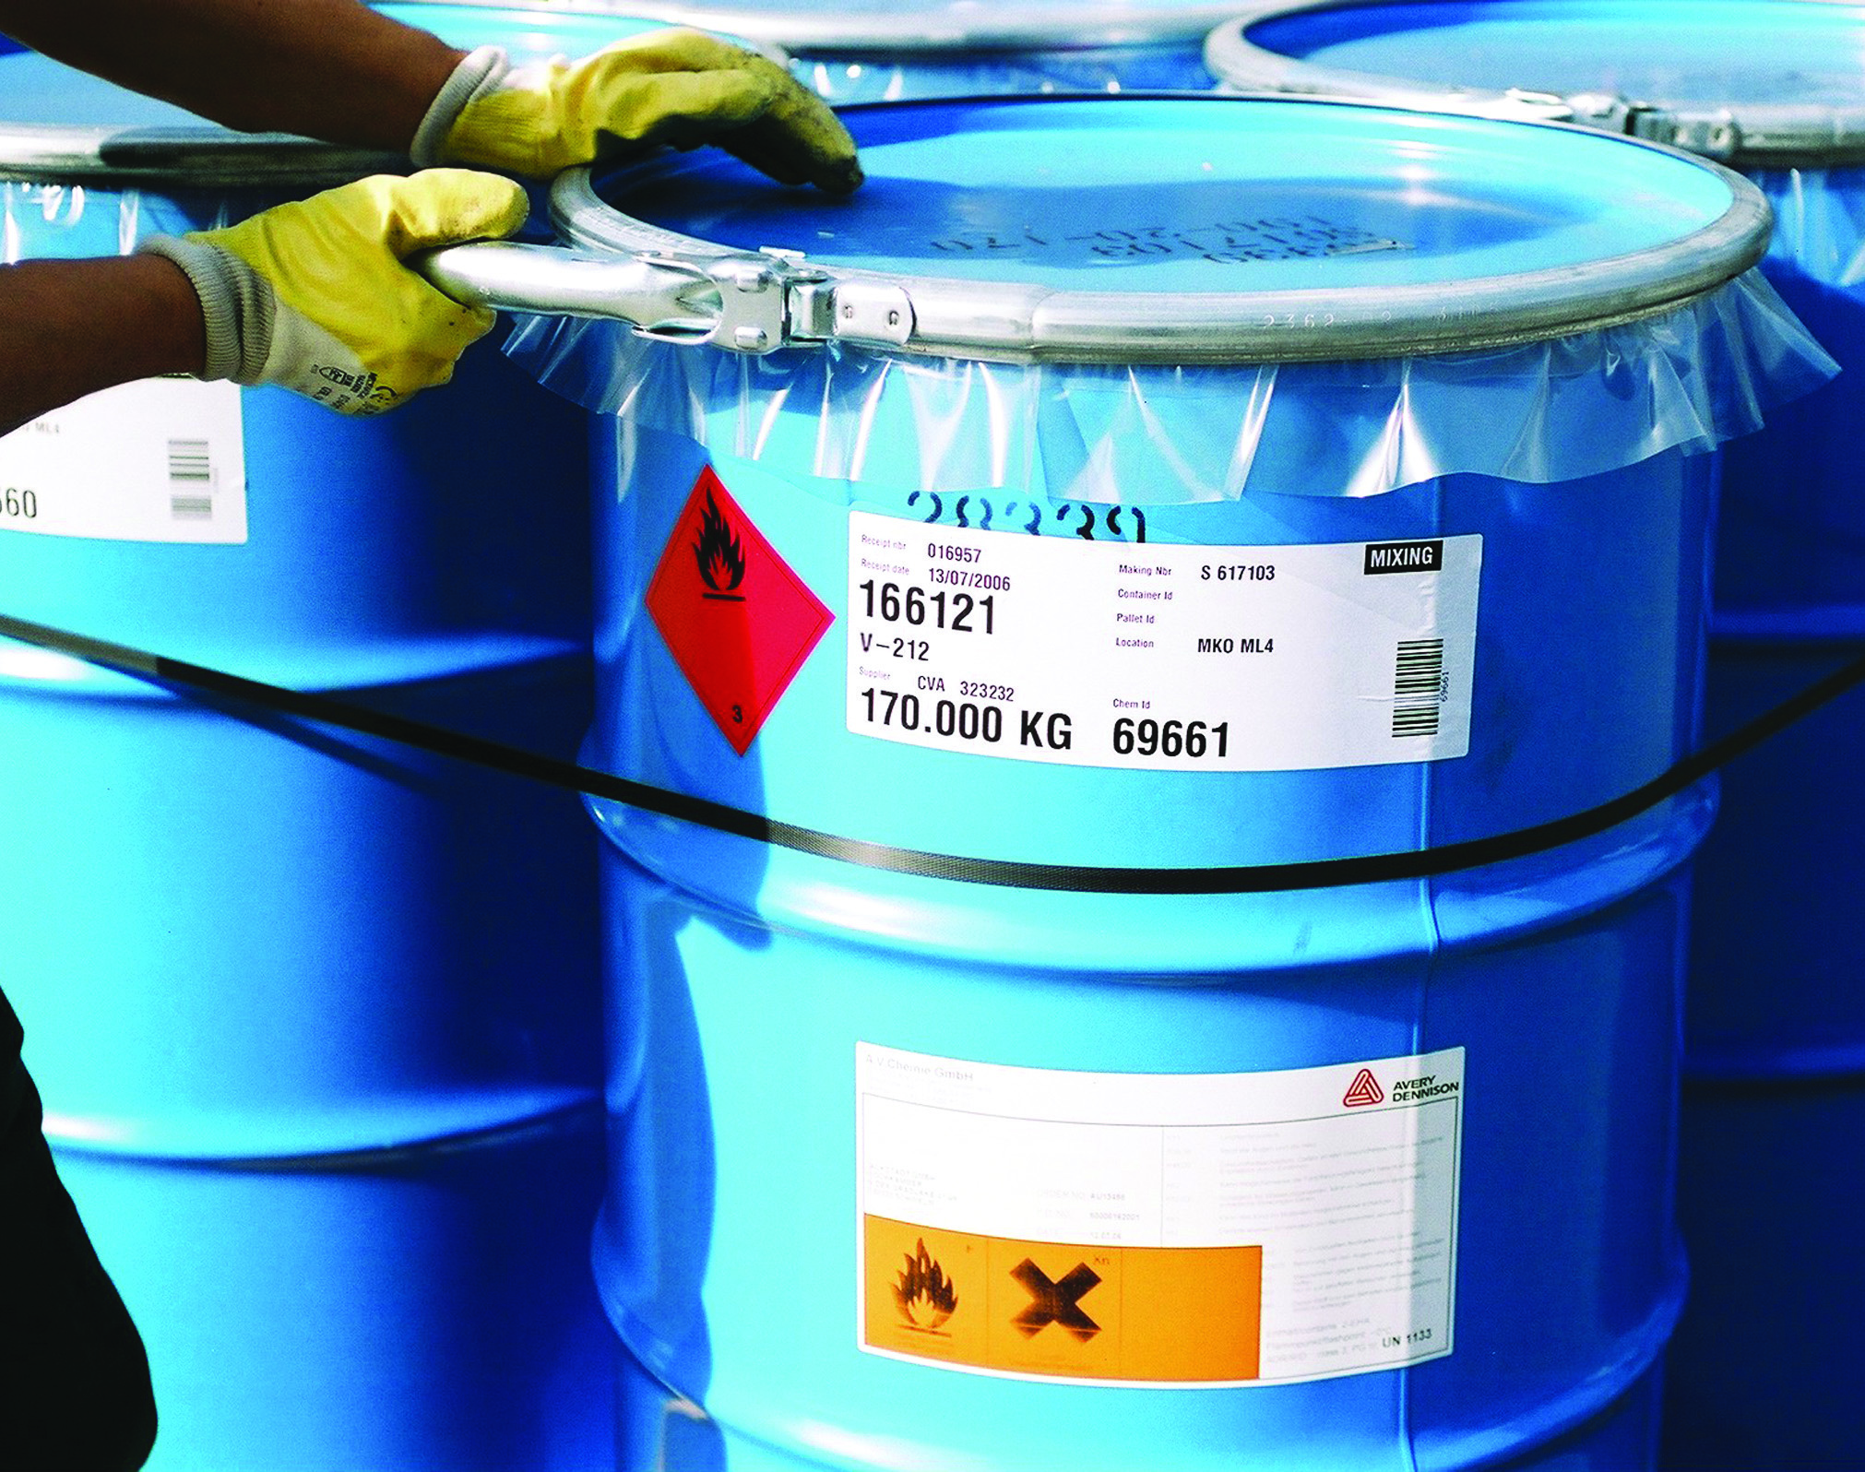
VIII.
DANGEROUS GOODS
THROUGH THIS SECTION,.

Slide 77
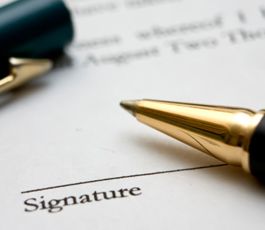
VII.
CHARTERING
GLOSARY

Slide 78
GENERAL EXPRESSIONS
Apparel.
As a rule the cargo capacity is defined in a charter-party as follows: “.... tons, not exceeding what she can reasonably stow and carry in addition to her tackle, apparel, provisions,bunkercoal and furniture"
The word “apparel” relates to the eguipment of the vessel such as anchors, chains, lifeboats etc.
Back letter.
Back letters are drawn up in amplification of a contract in order to lay down rights and/or obligations between both contracting parties, which, for some reason or other cannot very well be included in the original contract.
This expression is also used for letters of indemnity which are drawn up in the event the condition of the goods, loaded by the vessel, gives rise to remarks and shippers insist upon receiving clean Bills of Lading.

Slide 79
GENERAL EXPRESSIONS
Beaufort scale.
At sea, the wind force is expressed in numbers according to the Beaufort scale as follows:
Admiral Beufort ‘s Number | Description of wind | Speed in knots per hour
0 | Calm | Less than 1
1 | Light air | 1-3
2 | Light breeze | 4-6
3 | Gentle breeze | 7-10
4 | Moderate breeze | 11-16
5 | Fresh breeze | 17-21
6 | Strong breeze | 22-27
7 | Moderate gale | 28-33
8 | Fresh gale | 34-40
9 | Strong gale | 41-47
10 | Whole gale | 48-55
11 | Storm | 56-65
12 | Hurricane | Above 65

Slide 80
GENERAL EXPRESSIONS
Bill of health
The Bill of Health is the certificate issued by the local medical authorities indicating the general health conditions in the port of departure or ports of call. Before sailing the Bill of Health must have been vised by the Consul of that country of destination.
Blockade
Belligerent powers have the right of blockade, i.e. the right to blockade enemy ports of, coastal territory for ocean shipping by military measures. The blockade must be respected by neutral states. Running a blockade, if unsuccessful, will entail confiscation of ship and cargo.

Slide 81
GENERAL EXPRESSIONS
Blue Peter.
The international signal flag for the letter P (blue flag with white square in the center) is hoisted in the fore mast on the day of departure.
Compass.
As a rule the circumference of the card of a magnetic compass is divided in degrees from 0 to 359 (clockwise).The Principal points were:
North - East - South - West
and 4 intermediate Points:
North East - South East - South West - North West
Each point was subdivided in half-points and quarter-points. For navigation purposes the course to be steered is indicated in degrees.

Slide 82
GENERAL EXPRESSIONS
Cargocaire.
In order to reduce damage to cargo by sweat, modern cargo vessels are fitted with the so called “Cargocaire” system. The principal causes of damage to cargo by sweat are:
Condensation of moisture on the cold metal of the vessel, which will occur when the temperature of the ship's structure is below the dew point of the air in the cargo holds. Apart from damage, if any to cargo resulting from condensation on the beams and underside of deck plates, the ship's structure may be affected (rust).
By sweating of the cargo, which occurs when moist air condenses on cargo having a temperature below the dew point of the air in the holds, e.g. on vessels entering from cold into warms regions, ventilation with outside air with a higher dew point will inevitably cause condensation. The dew point is the minimum temperature at which a mixture of air and water vapour becomes saturated when cooled. Any further cooling will result in condensation.

Slide 83
GENERAL EXPRESSIONS
Cargocaire
The “cargocaire” system serves to reduce the dewpoint of air in the cargo holds dehumidification to such an extent that the formation of sweat is reduced or eliminated. The installation produces large volumes of dry air ,which can be circulated thought the holds. Outside air can also be used for ventilation provided it is sufficiently dry, whilst ventilation with a mixture of outside air and air produced by the installation is also practicable. All depends upon the dewpoint of the outside air and the dewpoint in the cargo holds.

Slide 84
GENERAL EXPRESSIONS
Construction differential subsidy - operating differential subsidy.
These expressions regularly occur in articles dealing with American shipping policy. To enable American operators to meet the competition from foreign shipowners, who enjoy the advantage of lower operating costs, the Merchant Marine Act 1936 opens the possibility to grant financial aid for the maintenance of an efficient American Merchant Marine not only for the development of foreign commerce but also from the viewpoint of national security, the importance of disposing of a sufficient number of cargoships having been clearly demonstrated in the late war
Daily operating costs.
This expression covers the daily running costs of a vessel which can be expressed in a fixed amount per day and which are not conditional upon the quantity of cargo, service speed, etc.

Slide 85
GENERAL EXPRESSIONS
Dateline.
When steaming from West to East, time is lost viz. for each degree longitude: 24 x 60 / 360 = 4 minutes. Conversely when proceeding from East to West time is gained at the rate of fl minutes for each degree.
The international date line running through the Pacific Ocean abt. 180 Meridian indicates the place for change of date. Assuming a vessel proceeds from London to Manila via Panama Canal (difference in longitude abt. 240 degrees) there will be a gain of time of 240 x 4 = 960 minutes = 16 hours. When crossing the date line proceeding westward, the date must be advanced by omitting one day. Conversely when proceeding in an opposite direction there will be a loss of time of 16 hours and the date must be put back one day by repeating the same day and date. It should be noted that in order to keep islands, belonging to one group e.g. Aleutian Islands on the same side of the date line, the l80 Meridian ls not exactly followed by the date line

Slide 86
GENERAL EXPRESSIONS
Delivery orders.
At the request of consignees, delivery orders are issued by the steamship company for part of the goods shipped on Bs/L. Consequently the Bs/L are divided in smaller lots. As a matter of course the origin Bs/L will be withdrawn upon issue of Delivery orders.
Deviation.
If a charterparty - the Hague Rules do not apply to charterparties - contains no stipulation to the contrary, this implies that owners tacitly undertake to carry out the voyage in the normal way without deviating unnecessarily from the customary route on the understanding that deviation with the object of saving life will be allowed.

Slide 87
GENERAL EXPRESSIONS
Dirty ship.
This expression is regularly used in tanker freight market reports and refers to fixtures for “'dirty” oils. e.g., fuel oil, lubricating oil and crude oil, in conrrast with “clean” oils e.g. gasoline, diesel oil, etc
Disbursements.
This expression covers all payments made by the ship's agents for port charges, stevedoring expenses, tug hire, customs fees, stores, bunkers, water, etc. on behalf of owners.
As a rule the agents charge a certain disbursements commission on such advances e.g. 2 ½ %.

Slide 88
GENERAL EXPRESSIONS
Economic speed.
Several factors enter into the picture when determining the economic speed of a vessel, being the speed producing the best possible financial result for owners, viz.:
The prices for bunkers in the ports en route.
The relation between fuel consumption of the vessel in question at high and low speeds.
Daily operating costs.
The net freight per ton of cargo.
Operating profit per day.
Future employment of vessel, in other words when the vessel should be-ready to load for the next voyage.

Slide 89
GENERAL EXPRESSIONS
Fair wear and tear.
Under time charter-parties charterers are not responsible for normal wear and tear during the course of the voyage. As a rule the redelivery clause reads as follows:
“Vessel to be redelivered in the same good order and condition (fair wear and tear excepted).”
Free from incumbrances.
Sale contracts of ships usually contain the proviso "free from incumbrances" which implies .that the vessel is free from any mortgage or other debt
Fumigation
Under the rules of the International Sanitary Convention of Paris, all ocean vessels must be in possession of a certificate of deratization or fumigation, which is valid for a maximum of 6 months. The validity can be extended by one month if the vessel is on her way to the homeport.

Slide 90
GENERAL EXPRESSIONS
Horsepower.
As a rule the power developed by oil engines or steam engines is expressed in brake horse-power
In Lloyd's Register of Shipping the capacity of the engines is indicated by the machinery numeral, which has been determined according to a special formula. As soon as the fuel consumption with a certain displacement and speed is known, it is practicable to calculate the fuel consumption with a higher and lower displacement and speed. The fuel consumption per day is directly proportional to the third power of the speed. ln case the displacement differs, allowance has to be made for this factor by applying the power 2/3 for the difference in displacement.

Slide 91
GENERAL EXPRESSIONS
Lawful trade.
The object of the restriction "lawful trade" or "legal merchandise" in a time charter party is to exclude the carriage of contraband.
Letter of Indemnity.
This term is closely connected with “clean” Bills of Lading. A “clean” Bill of Lading is "prima facie" evidence that the goods were shipped in “apparent good order and condition”. If goods are received for shipment, the condition of which cannot be described as “in apparent good order and condition”, ship owners must protect their interests by so clausing the Bills of Lading. The issue of “clean” Bills of Lading is also, a matter of particular interest to marine underwriters and banks. In this context it may be recalled that Letters of credit opened by buyers in favor of shippers provide for payment to be made against shipping documents, which include a full set of “clean” Bills of Lading.

Slide 92
GENERAL EXPRESSIONS
Management Agreement.
This expression is connected with the chartering of tankers by the major oil companies on long-term time charters, combined with a so-called 'Management Agreement". For a good understanding of the position it may be explained that the essential point in time charters on bareboat basis and time charters by demise is a passing of control from the owner to the charterer. The distinction between tanker demise and bareboat charters may be briefly explained as follows.
Under the terms of a bareboat time charter the owner puts his vessel at the disposal of the oil company for a period of time, as a rule for several years, at an agreed rate of hire. The oil company which has chartered the tanker operate her in exactly the same way as they operate their own tankers which implies that they appoint their own master and engage the crew and pay all operating expenses themselves.

Slide 93
GENERAL EXPRESSIONS
Management Agreement.
Under such a "Management Agreement" the ship owners, acting as managers, undertake to make all arrangements for operating the tanker according to charterers instruction and at charterers expense, which implies inter alia:
To appoint the master and officers;
To engage a full complement of Officers and crew;
To equip and supply the vessel;
To arrange for drydocking, repairs, maintenance, survey , etc.; briefly, to do all work normally connected with the commercial operation of a ship.

Slide 94
GENERAL EXPRESSIONS
Manifest.
A manifest is a document containing complete specifications of the goods loaded by á vessel for various destinations. As a rule cargo manifests are drawn up by the agents in the ports of loading based upon the Bills of Lading. the heading of the manifest shows:
Name of vessel,
Port bf loading and date of sailing,
Port of destination,
and in various columns:
Numbers of Bs/L,
Marks of packages,

Slide 95
GENERAL EXPRESSIONS
Manifest.
Number of packages and contents,
Names of shippers and consignees,
Notify address, if any,
Weight,
Cubic measurement,'
Rate of freight per unit,
Total freight,
Rebate,
Net freight.

Slide 96
GENERAL EXPRESSIONS
Mate's receipt.
The Mate's receipt is the document signed by the chief officer, acknowledging the receipt of cargo on board of the ship. If the goods are not “ in apparent good order and condition” a corresponding qualification will be inserted in the Mate’s receipt. As a rule the Mate's receipt specifically states that it is issued subject to the terms of the regular Bill of Lading of carriers.
Mile.
A nautical mile is the mean length of one minute of latitude and this varies from about 6046 f.t, in the region of the equator to about 6108 ft. near the poles. For convenience, a standard nautical mile, or Admiralty mile is assumed to be 6080 ft. which is the true length of a nautical mile in about latitude 52 (6080 ft. = approx. 1854 meters).

Slide 97
GENERAL EXPRESSIONS
Navicerts.
In time of war, navigation certificates are issued by the belligerents, stating that ship and cargo have been searched and that permission for continuing the voyage to the neutral port of destination has been given.
No cure - no pay.
Under the terms of Lloyd’s Standard Form of Salvage Agreement the contractors agree to use their best endeavours to salve the ship and her cargo upon the principle of “no cure - no pay”. for a certain remuneration if successful in these operations. "no cure - no pay" implies that only successful efforts entitle contractors to remuneration for services rendered.

Slide 98
GENERAL EXPRESSIONS
On her beam ends.
This term is used to describe a vessel which has listed . as the result of shifting of cargo or solid ballast to such an extent that her railing is submerged and her railing power is insufficient to restore the original position.
Optional cargo.
Goods which have not yet been definitely sold for delivery at a certain port, may be shipped as “optional cargo” e.g. Marseilles option London, Rotterdam or Hamburg. Shippers or consignees have the option to declare the final port of destination, say 24. or 48 hours before arrival of the vessel at the port in question.

Slide 99
GENERAL EXPRESSIONS
Out-of-the-pocket expenses.
The out-of-pocket expenses of a vessel in operation only cover the extra expenses which are incurred in comparison with a vessel lying idle in the homeport. part of the items:
Wages - Food - Maintenance - Repairs - Insurance
as well as depreciation charges in full can be deducted from the running costs of the vessel in operation, in order to arrive at the out of-pocket expenses.
Owners agents.
If the consignment clause in a charter party provides for charterers agents to be employed at ports of loading or discharge, it is in owners' interest to appoint their own agents who can assist the master in any controversy which may arise, ordinarily charterers agents will protect their principals interests first and owners interests second.

Slide 100
GENERAL EXPRESSIONS
Salvage.
This expression includes all expenses properly incurred by the salvage Co. in the performance of the salvage services. As a rule salvage agreements are made on “no cure - no pay” basis.
Seasonal ports.
Ports which are only accessible to ocean shipping during part of the year, such as Montreal, Quebec, Baltic and White Sea ports, are called seasonal ports. As a rule St. Lawrence river is closed for navigation between December 15th - April 15th.

Slide 101
GENERAL EXPRESSIONS
Seaworthiness.
Seaworthiness means that the vessel will be fit in every way for the contemplated voyage. The vessel must not only be in a condition to meet the risks which may be reasonably expected, but she must also be in a position to ensure safe carriage of the cargo. Seaworthiness not only means fitness as expressed in:
"tight, staunch and strong and in every may fitted for the voyage"
but it also relates to fitness for the receipt, carriage and preservation of the cargo.

Slide 102
GENERAL EXPRESSIONS
Self-consignment basis.
It may occur that the regular Conference lines in a particular trade are not in a position to berth sufficient tonnage to meet shippers requirement. A solution may be to charter extra tonnage for joint Conference account but this solution may be impracticable in the event special tonnage is required e.g. deep tank space for the carriage of vegetable oil in bulk, requiring special measures e.g. heating. As a rule tramp vessels, although equipped with deep tanks, are not fitted with heating coils, etc. A solution may then be to allow other regular lines to participate in the trade concerned in which they have no loading rights on so called “self consignment basis”.

Slide 103
GENERAL EXPRESSIONS
Self-consignment basis.
In that case one or the regular Conference lines in question attend to the outside vessel both at port of loading and discharge and look after all arrangements for delivery of the cargo.
Shipment takes place on the customary B/L form of the regular Conference line. The owners of the carrying ship are entitled to the full Conference freight less an agreed percentage out of which the Conference line will defray the remuneration due to the agents at port of loading and discharge.

Slide 104
GENERAL EXPRESSIONS
Shipbroker.
The shipbroker acts as intermediary between shippers and consignees of cargo on the one hand and the ship owners or . carriers by sea on the other. The principal functions of a shipbroker are:
Handling of ships in port (loading, discharge, bunkering, etc), receiving and redelivering cargo collection of freight and passenger fares, solicitation of cargo, settlement of claims, storing and provisioning of vessels, etc.
Acting as forwarding agents or customs brokers (clearance of goods and ships, payment of customs duties, attending to customs formalities, etc.).
Make arrangements for berthing, loading or discharge of a vessel.
Fixing of charters for cargo liners and tramp vessels (chartering brokers).
Acting as chartering agents for large trading concerns

Slide 105
GENERAL EXPRESSIONS
Ship owners.
The owners of a vessel are the persons or companies officially registered as owners of the ship. The certificate, or registry, issued by the registrar, contains the leading particulars which has been entered in the register book, viz.
The name of the ship and home port, i.e. the port of registry.
The details contained in the surveyors certificate.
The particulars respecting her origin stated in the declaration of ownership.
The name and description of her registered owner; if more than one, the proportionate share of each.

Slide 106
GENERAL EXPRESSIONS
Ship owners.
The owners of a vessel are the persons or companies officially registered as owners of the ship. The certificate, or registry, issued by the registrar, contains the leading particulars which has been entered in the register book, viz.
The name of the ship and home port, i.e. the port of registry.
The details contained in the surveyors certificate.
The particulars respecting her origin stated in the declaration of ownership.
The name and description of her registered owner; if more than one, the proportionate share of each.

Slide 107
GENERAL EXPRESSIONS
ship's protest
In case of damage to a vessel of her cargo or when the vessel has encountered exceptionally heavy weather during the voyage, which may have caused damage to the vessel or the cargo, the Master will register a protest before the competent authorities. e.g. notary public. or consul. Such a protest may be extended or completed within a certain limit of time after arrival.
Signed under protest.
If charterers object to the insertion of a certain clause in the Bs/L, the master may sign the Bs/L under protest. The words “signed under protest” affect the masters signature, so that it cannot be produced as evidence. Should there be any serious doubt as to the correctness of the quantity or weight inserted in the Bs/L, it is necessary to include the qualification “signed under protest” in the Bs/L or to have an official protest drawn up.

Slide 108
GENERAL EXPRESSIONS
Straddle ship.
This expression relates to a vessel offering shipping opportunity in 2 consecutive months. For a vessel arriving on June 30th and sailing on July 1st, June and July Bs/L can be issued for the cargo loaded in June or July respectively.
Tally.
Upon delivery of cargo, the number of packages is checked by tally clerks. If differences arise as to the number of packages. the receipt and Bs/L will be claused: “.... Package in dispute; if on board, to be delivered”.

Slide 109
GENERAL EXPRESSIONS
Timber trade certificate.
Under the safety and Load Line conventions Act 1932 special timber load lines have been fired to be used only when a ship carrying a cargo of timber on deck complies with the Regulations and the Load Line Rules.
The timber deck cargo must be compactly stowed, lashed and secured. It must not interfere in any way with the navigation and necessary work of the ship or with tire provision of a safe margin of stability at all stages of the voyage, regard being given to additions of weight such as those due to absorption of water and to losses of weight, such as those due to consumption of fuel and stores.

Slide 110
GENERAL EXPRESSIONS
Unseaworthiness
If the condition of a vessel is such that she is not reasonably fit ¡n all respects to encounter the ordinary perils of the sea, either by insufficient maintenance and repairs incomplete crew, insufficient equipment or wrong stowage of cargo, etc. she is referred to as being unseaworthy.

Slide 111
SHIPPING TERMS
Broken stowage.
The cargo space which is unavoidably lost when stowing general cargo is called broken stowage. It is obvious that the percentage of waste space depends upon various factors e.g. kind of cargo and packing (bags or cases), space occupied by dunnage, type of vessel (one or more tweendecks), number of permanent obstructions e.g. hold pillars, the lines of the ship's hull which affects the shape of the holds in particular nearest to the and stern etc.
The expression “broken stowage” has a second meaning viz. cargo, which is used for filling unoccupied space.

Slide 112
SHIPPING TERMS
Builder’s certificate.
As the name indicates this certificate is issued by the shipbuilding yard, containing:
A true account of the proper denomination and of the estimated tonnage;
Year and place where she was built as well as the name of the owners.
This certificate is required in addition to the declaration of ownership, on the first registry of a ship.

Slide 113
SHIPPING TERMS
Bulkhead.
The function of transverse bulkheads are:
To increase the safety of a ship.
To separate the engine room from the cargo holds.
To increase the transverse strength of a vessel.
To reduce the risk of fire spreading from the compartment of outbreak to other compartments.

Slide 114
SHIPPING TERMS
Capacity plan.
The capacity plan shows a longitudinal and transverse profile of the vessel, as well as. the principal particulars, such as:
Gross register tonnage;
Net register tonnage;
Deadweight capacity on winter, summer and tropical loadline;
Displacement scale on varying draught;
Winter, summer and tropical loadline;
Grain capacity of all cargo spaces in cubic feet;
Bale capacity of all cargo spaces in cubic feet;
Capacity in tons of double bottom tanks, peaktanks, deeptanks and fuel tanks.

Slide 115
SHIPPING TERMS
Cargo battens or sparring.
Cargo battens are fitted fore and aft horizontally inside the ship's frames in the holds and tweendecks at a regular distance of approximately 12 inches to prevent contact between the cargo and the frame plating. The cargo battens keep the cargo free from moisture or sweat, which may condense on the ship’s sides.
Cargo plan or stowage plan.
In the regular trade it is customary to draw up a stowage plan, showing in different colours the part of the ship in which the various parcels ha been stowed, stating at the same time marks and destination

Slide 116
SHIPPING TERMS
Ceiling.
The ceiling consists of wooden planks laid on top of the double bottom tanks. The planks are laid longitudinally and prevent contact between the cargo and the double bottom.
Centreline bulkhead.
As a rule modern tramp vessels are fitted with centreline bulkheads extending from the bulkheads to the hatchways. Apart from increasing the longitudinal strength, such centreline bulkheads mean a considerable saving in expenses for shifting boards required by vessels carrying grain in bulk.

Slide 117
SHIPPING TERMS
Coefficient of loading.
The coefficient of loading of a ship indicates the relationship between the deadweight of the cargo carrying capacity and the cargo space.
As soon as the weight of bunkers, fresh water, provisions, stores and spare parts, which a vessel will have on board on the contemplated voyage, is known, it will be possible to determine the coefficient of loading.

Slide 118
SHIPPING TERMS
Cofferdam.
In oil tankers the oil tanks are separated from the engine room by means of a cofferdam formed by two transverse bulkheads. The cofferdam extends over the entire breadth of the vessel and prevents leakage from the oiltanks to the engine room or diesel oil. The pump rooms are also separated from adjacent tanks by cofferdams.
Collision bulkhead.
According to the Rules of the London Conference of 1929 for the Safety of life at Sea, all ocean going vessels must be fitted with a collision bulkhead, which is carried up to, the maindeck in full scantling vessels and up to the shelterdeck in shelterdeck vessels. This transverse watertight bulkhead must be fitted at a distance from the stem equal to minimum 5% of the ship's length.

Slide 119
SHIPPING TERMS
Deadweight capacity.
The deadweight capacity or the carrying capacity of a vessel is the total weight of cargo, bunkers, dunnage, provisions, water, stores and spareparts, expressed in tons.
Deeptanks.
In order to increase the water ballast capacity, many cargo ships are equipped with deeptanks running from the tanktop of the double bottom to the lower or upper tweendeck and extending over the entire breadth. As a rule the deeptanks are constructed amidships forward of the engine room or at both ends.

Slide 120
SHIPPING TERMS
Depth moulded.
The moulded depth is the vertical distance measured from top of keel to the upperside of the deckbeams, which support the uppermost continuous deck. This distance is measured at the ship's side at the middle of the length between perpendiculars.
Displacement.
The expression displacement has 2 meanings:
The volume of water, displaced by the vessel, measured in cubic feet (volume of displacement).
The weight of the quantity of water displaced by the vessel expressed in tons of 20 cwt. (weight of displacement).
The term “displacement” without any qualification relates to the weight of displacement (sub b) being equal to the weight of the complete ship in tons of 2240 lbs.

Slide 121
SHIPPING TERMS
Displacement scale.
The displacement scale indicates:
Displacement of the ship on her light draught viz, the weight of the ship, ready for use, including normal deck stores and engine room spare parts and liquids in machinery and boilers
Displacement at varying draughts and the number of tons required to put down the ship one inch at the various draughts. This number of tons per inch is not a fixed number but varies according to the draught. In light condition fewer tons are required to put down a ship one inch on account of the fine lines of the ship's structure.
Deadweight capacity in tons of 20 cwt. With different draughts.
Maximum draughts on winter, summer and tropical loadlines.

Slide 122
SHIPPING TERMS
Down by the head. - Down by the stern - On even keel
These expressions mean:
The draught forward exceeds the draught aft. As a rule such a position will have a detrimental effect upon the ship's speed and steering.
The draught aft exceeds the draught forward. In most cases a certain drag is preferable in connection with the steering of the ship. Too much drag may result in loss of speed. Ships sailing in ballast will have to be trimmed by the stern 4 to 5 feet, so that the propeller will be sufficiently immersed say at least two thirds of the diameter otherwise the power developed will be wasted to a considerable extent
The draughts forward and aft are equal.

Slide 123
SHIPPING TERMS
Down to her marks.
This expression means that the vessel has been loaded to her maximum permissible draught, either winter, summer or tropical loadline as the case may be. It does not imply that all cargo space has been filled. If both deadweight and cargo space have been fully utilized the ship is “full and down”
Double bottom.
The double bottom, extending from the forepeak to afterpeak tank, considerably, increases the safety of the vessel in case of serious bottom damage by grounding, which might otherwise result in flooding of the cargoholds or engineroom. Moreover the double bottom, which is subdivided into a number of tanks, is suitable for the carriage of water ballast, fuel oil, fresh water, etc. and increase the longitudinal strength of the vessel.

Slide 124
SHIPPING TERMS
Draught.
The draught of a vessel is the vertical distance between the water line and the keel. During construction of the vessel, the marks showing the draught are cut into each side of the stem and sternpost and clearly painted from a certain distance below the light draught to a certain distance above the loaded draught.
Sometimes the draught is also indicated on both sides amidships near the Plimsoll mark, so that if the vessel should show signs of sagging in the course of loading, this can be noticed immediately by comparing the draught fore and aft with the draught amidships. The draught is indicated in feet and/or decimeters.

Slide 125
SHIPPING TERMS
Dunnage.
The use of sufficient dunnage is one of the principal precautions against damage to cargo. Various articles, which are not affected by moisture, are used as dunnage e.g. boards, matting, burlap, rattans. Dunnage is laid on the ceiling and along the permanent wooden cargo battens, in brief, in all places where necessary. The main object of dunnaging is to prevent or limit damage by sweat, breakage, chafing, crushing, moisture, contact with hold pillars, etc.

Slide 126
SHIPPING TERMS
Feeders.
When grain is carried in bulk, feeders are erected to feed the different ports of the holds or, compartments thereby filling any free space which might result from the settling of cargo during the voyage. Grain in bulk may settle as much as 5% during a voyage; therefore, measures should be taken to prevent the shifting of grain in bulk resulting in a list to the ship.
Freehoard.
The minimum freeboard of a vessel is the vertical distance from the freeboard-deck to the loadlines, indicating the maximum permissible draught, measured at the middle of the ship's length.
The freeboard deck is the uppermost continuous deck equipped with permanent means of closing all openings which are exposed to the elements. This uppermost continuous deck is indicated on the ship's side by a small horizontal line (deckline above the Plimsoll mark.)

Slide 127
SHIPPING TERMS
Evaporator.
Modern vessels are fitted with a fresh water distilling plant. This installation is particularly useful on long voyages where heavy cargo is carried, as it results in considerable savings on the quantity of fresh water required, thereby increasing the deadweight capacity for cargo correspondingly.
Full and down.
A vessel is said to be "full and down" when loaded in such a way that upon sailing she is down to her marks -either winter, summer or tropical loadline - whilst the cargo space has been fully utilized. Unless rates of freight for heavy and light cargo vary considerably, best results, from a revenue standpoint, are obtained by loading a ship full and down.

Slide 128
TONNAGE OF SHIPS
lIeating coits' Vessels canying vegetable oil in bulk in deeptanks
. ale fitted with iteam heatingcoils in order to maintain the required
tempereture for pumping. By circulatlng steam through the coils it
is possible.to lacrease the temperature gradually to the regulred
level.
Fuel oil tad<s are also eguipped wtth tle necessary heatiag coils,
in order to ensuie sufficient liquid riobility for pumping at all times.
[ength between perpendiculare. The leagth :between perpencliculars
is the length between tüe fore side of the stem and the after side ' of the sternpost at the vessel's summer loadliire.

Slide 129
TONNAGE OF SHIPS
Light üsplacenent or light weight. This expression relates to the
weight of the hull cómpletely eguipped plus the welght of the
machiaery; boile¡-s, water in boilers and spare'parts, but excluding
bunkers, cargo, dunaage, provlsions; stores and water' The llght
. weight is expressed in tons of 2240 lbs. The vessel's draught at
light displacement is called "ltgbt draught".

Slide 130
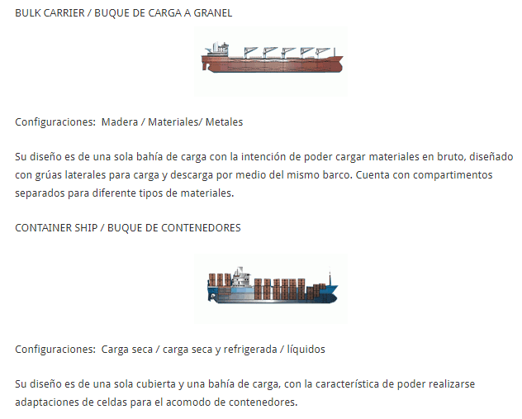
TYPES OF SHIPS

Slide 131
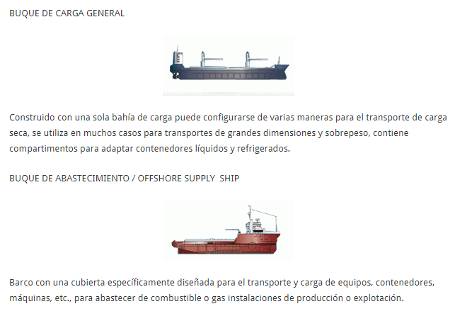
TYPES OF SHIPS

Slide 132
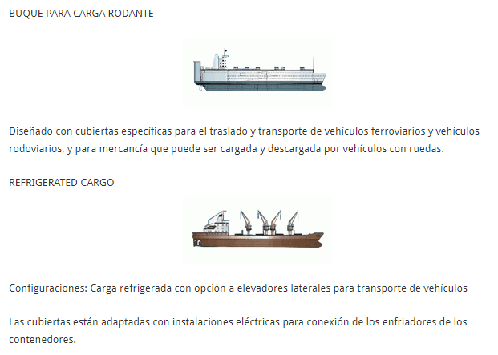
TYPES OF SHIPS

Slide 133
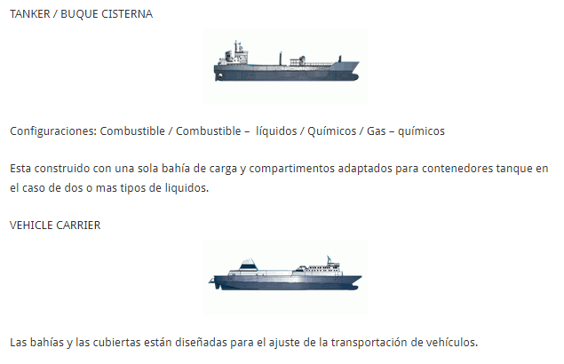
TYPES OF SHIPS

Slide 134
TONNAGE OF SHIPS
El tonelaje de peso muerto, TPM, tonelaje de porte bruto o DWT (acrónimo del término en inglés Deadweight tonnage), es la medida para determinar la capacidad de carga sin riesgo de una embarcación, cuyo valor se expresa en toneladas, normalmente especificado en "toneladas métricas" para diferenciar con otras medidas usadas en comercio internacional como la tonelada corta. Como se ve por las unidades empleadas, en realidad se refiere a la masa, no al peso. También es la forma de medir el tamaño de una flota, como la suma del DWT de cada una de las unidades que la compongan.
Consiste en la suma de las masas (en lenguaje cotidiano pesos) que transporta un buque, e incluye el cargamento, el combustible propio del buque, las provisiones, el agua dulce para consumo humano, el agua de lastre, la tripulación, los pasajeros y sus equipajes.

Slide 135
TONNAGE OF SHIPS
El término se usa frecuentemente para indicar el máximo peso muerto, es decir su tonelaje de peso muerto cuando el barco se encuentra completamente cargado, de modo que su francobordo esté en el punto de sumersión. Este porte bruto es la diferencia entre el desplazamiento de un buque a plena carga y el desplazamiento en rosca (buque vacío propiamente dicho).
TPM =Δmax - Δrosca
Así mismo se define como porte neto de un buque mercante o tonelaje de porte neto a la capacidad de carga de mercancías que abonan un flete de transporte.
El porte bruto y el porte neto de un buque son parámetros que se miden en unidades de masa y no deben confundirse con el tonelaje de arqueo bruto y neto que son parámetros de volumen por los que se afora la capacidad de carga de un mercante.

Slide 136
TONNAGE OF SHIPS
En el vocabulario naviero se designan como «de poco porte» o «de porte menor» las embarcaciones menores de unas 1000 t de peso muerto (areneros, pesqueros menores, yates, barcazas, etc.) La cifra no es exacta, pero las regulaciones de algunos países lo especifican.
Los buques que superan ese valor se conocen como «buques de porte» o, si son muy grandes, «buques de gran porte».

